Slide 1
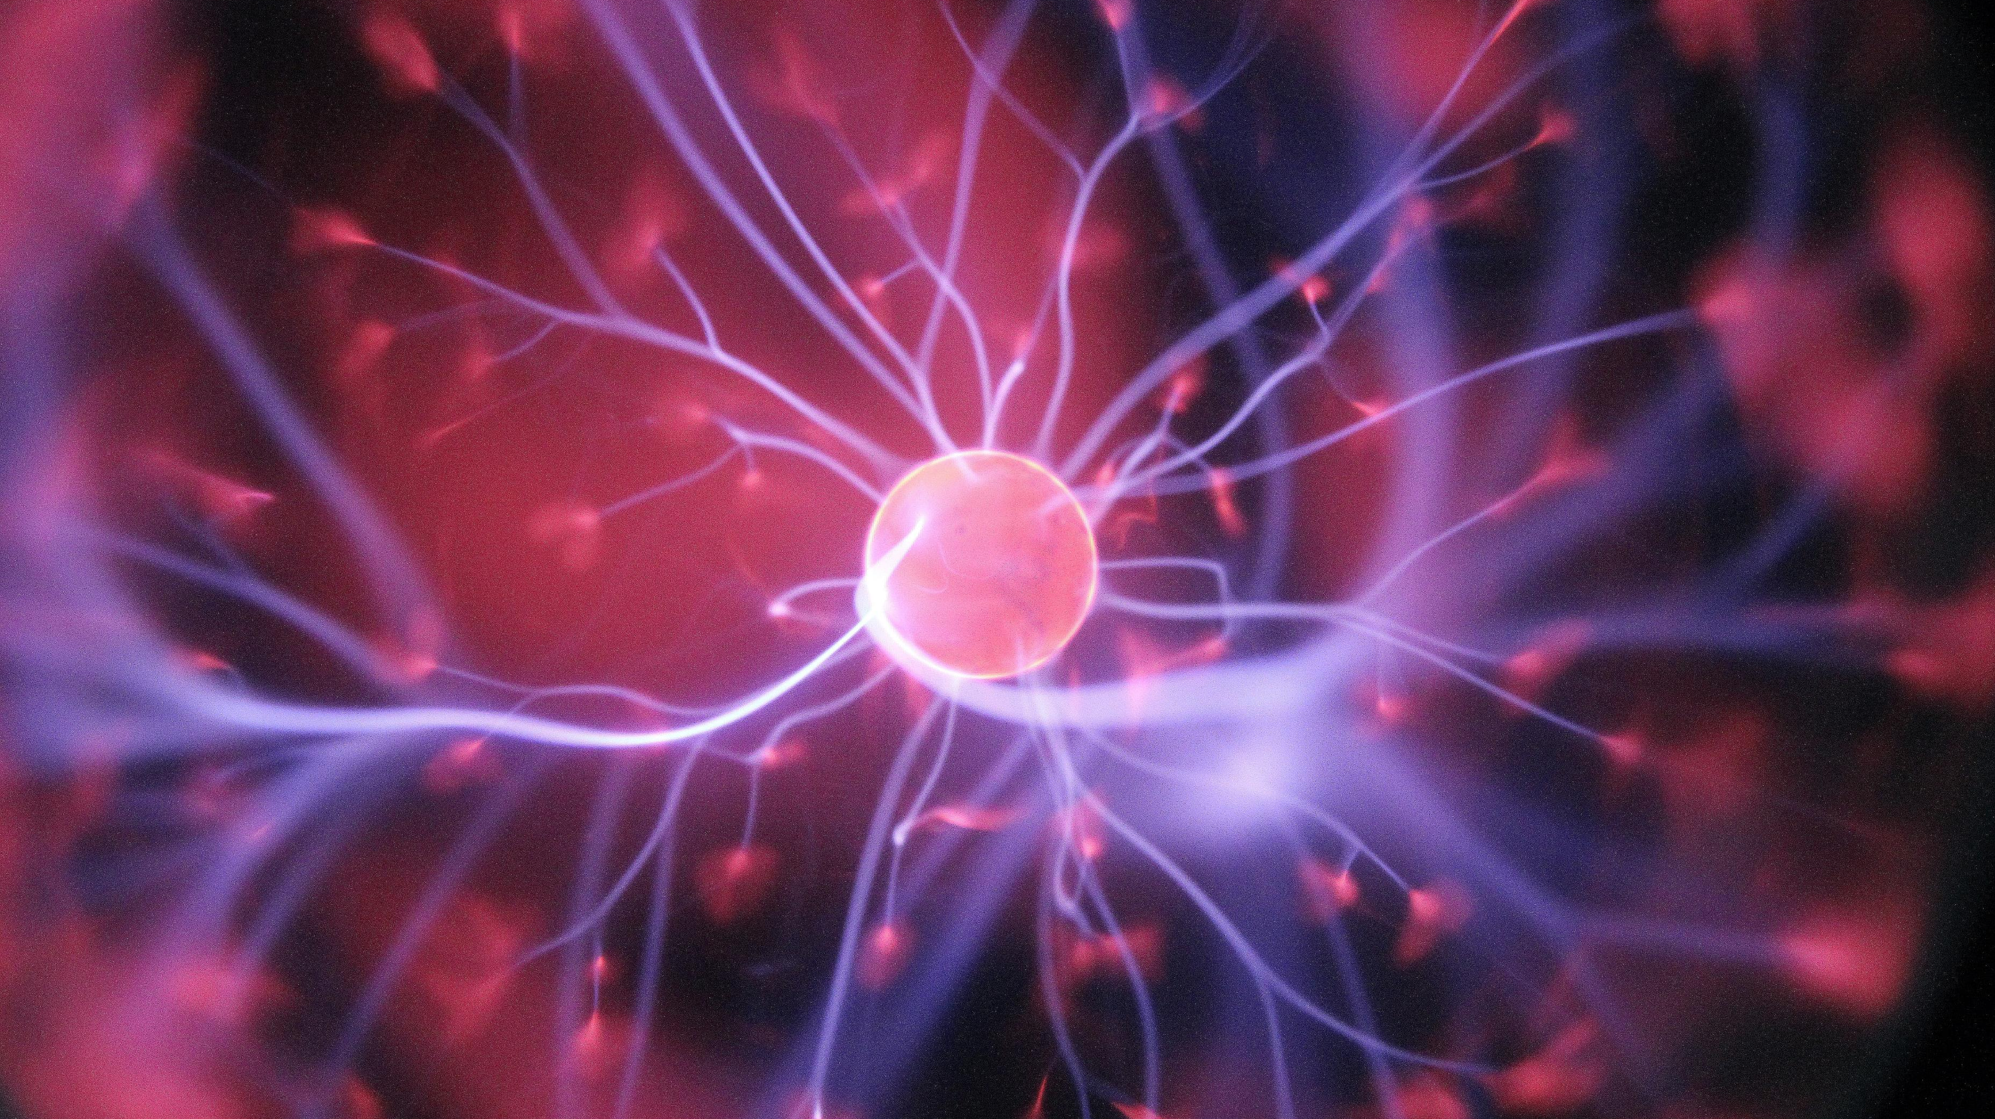
Matthew 11:28-30 MSG
“Are you tired? Worn out? Burned out on religion? Come to me. Get away with me and you’ll recover your life. I’ll show you how to take a real rest. Walk with me and work with me—watch how I do it. Learn the unforced rhythms of grace. I won’t lay anything heavy or ill-fitting on you. Keep company with me and you’ll learn to live freely and lightly.”

Slide 2
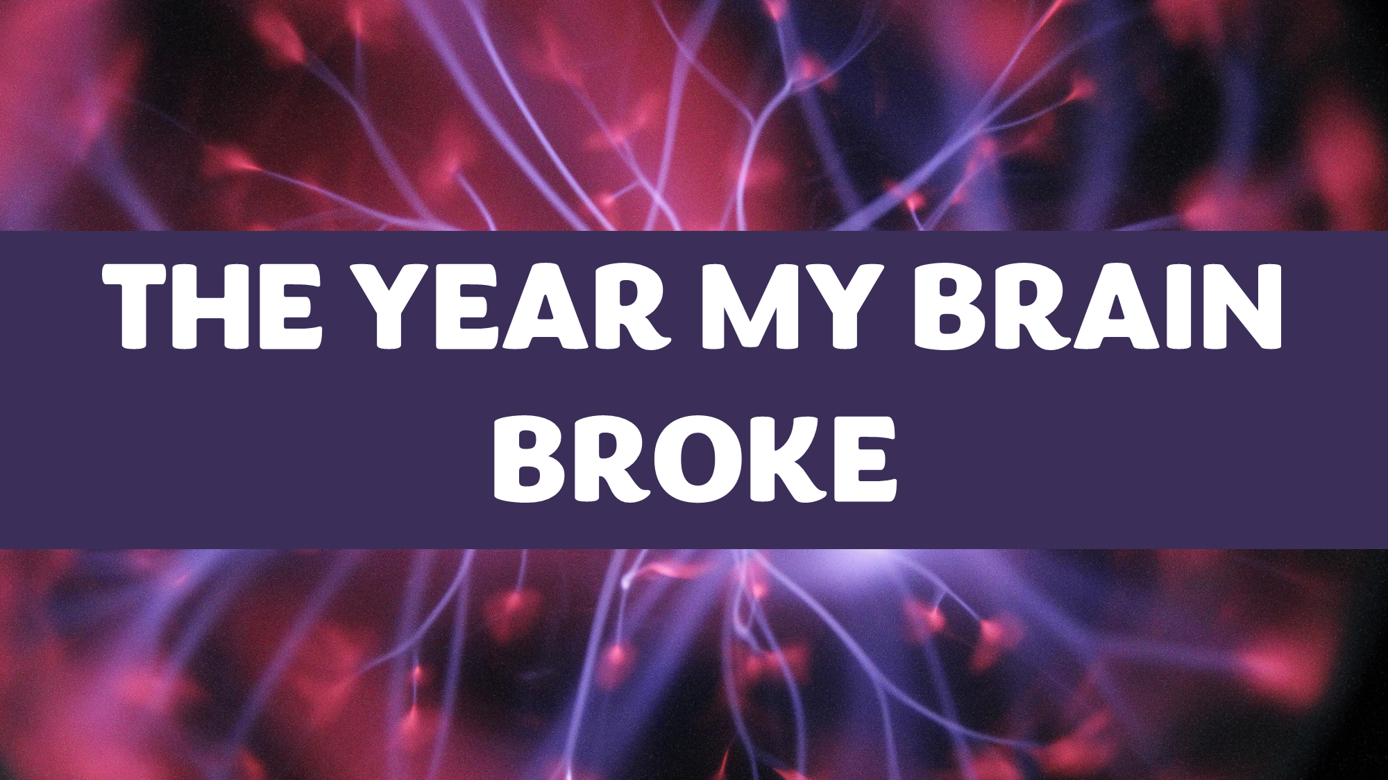
THE YEAR MY BRAIN BROKE

Slide 3
I’ve learned…
God’s Love doesn’t depend on my Performance.

Slide 4
1 John 4:9-10 NLT
God showed how much he loved us by sending his one and only Son into the world so that we might have eternal life through him. This is real love—not that we loved God, but that he loved us and sent his Son as a sacrifice to take away our sins.

Slide 5
I’ve learned…
Idols do not Work.
An Idol is anything other than Christ which we turn to when under pressure.

Slide 6
Ezekiel 8:10 NLT
So I went in and saw the walls covered with engravings of all kinds of crawling animals and detestable creatures. I also saw the various idols worshiped by the people of Israel.

Slide 7
3. I’ve learned…
to Rest in God.

Slide 8
Hebrews 4:1-3a NLT
God’s promise of entering his rest still stands, so we ought to tremble with fear that some of you might fail to experience it. For this good news—that God has prepared this rest—has been announced to us just as it was to them. But it did them no good because they didn’t share the faith of those who listened to God. For only we who believe can enter his rest.

Slide 9
Matthew 11:28-30 MSG
“Are you tired? Worn out? Burned out on religion? Come to me. Get away with me and you’ll recover your life. I’ll show you how to take a real rest. Walk with me and work with me—watch how I do it. Learn the unforced rhythms of grace. I won’t lay anything heavy or ill-fitting on you. Keep company with me and you’ll learn to live freely and lightly.”

Slide 10
THE YEAR MY BRAIN BROKE

