Slide 1
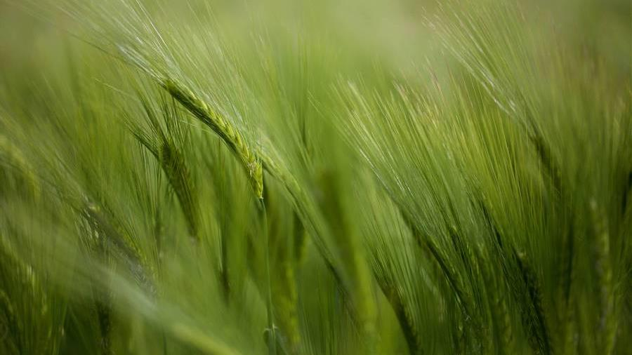
F A I T H

Slide 2
What is FAITH?
Hebrews 11:1
Faith shows the reality of what we hope for; it is the evidence of things we cannot see (NLT)
Now faith is the substance of things hoped for, the evidence of things not seen (KJV) substance – ‘matter’

Slide 3
John 20:24-29
This event happened:
Days after the resurrection of Jesus
After Jesus showed himself to the disciples the first time, minus Thomas (v 24)

Slide 4
v24-25
“We have seen the Lord.”
Thomas response, ‘to see is to believe’?

Slide 5
v26
Disciples were gathered together again, at this time Thomas is with them
Gathered in the room with the doors were locked
Jesus joined them by appearing in their midst
If you were Thomas, how would you feel seeing Jesus?
‘Peace be with you’

Slide 6
v27
After greeting the disciples, Jesus faced Thomas
What Thomas asked in v 25,’I won’t believe it unless I see the nail wounds in his hands, put my fingers into them, and place my hand into the wound in his side’ is literally what Jesus asked him to do
Did one of the disciples told Jesus that Thomas has asked this?
What would be Thomas’ feeling at this stage?

Slide 7
V28
‘My Lord and my God’
Have Thomas put his hands to Jesus’ wounds before exclaiming these words?

Slide 8
V29
“You believe because you have seen me. Blessed are those who believe without seeing me.” (NLT)
This is what Faith is all about
Hebrews 11:6 ...without faith it is impossible to please God...

Slide 9
John 11:16 - Thomas, nicknamed the Twin, said to his fellow disciples, “Let’s go, too—and die with Jesus.”
In our passage, Thomas was searching and desiring for an answer that gave birth to FAITH

Slide 10
‘In the footsteps of the Apostles’
- National Geographic Magazine, March 2012
Many historians believe that Thomas landed on the palm-lined coast of Kerala at a site now called Cranganore. He is reported to have established seven churches in Kerala and to have been martyred 20 years later on the other side of the country, in Mylapore, now a neighbourhood in Chennai.

Slide 11
At Palayur Church in Guruvayur, Thomas is said to have raised the first cross in India and performed one of his earliest miracles: When he encountered a group of Brahmans throwing water into the air as part of a ritual, he asked why the water fell back to Earth if it was pleasing to their deity. My God, Thomas said, would accept such an offering. He then flung a great spray into the air, and the droplets hung there in the form of glistening white blossoms. Most onlookers converted on the spot; the rest fled.

Slide 12
REFLECTIONS

