Slide 1
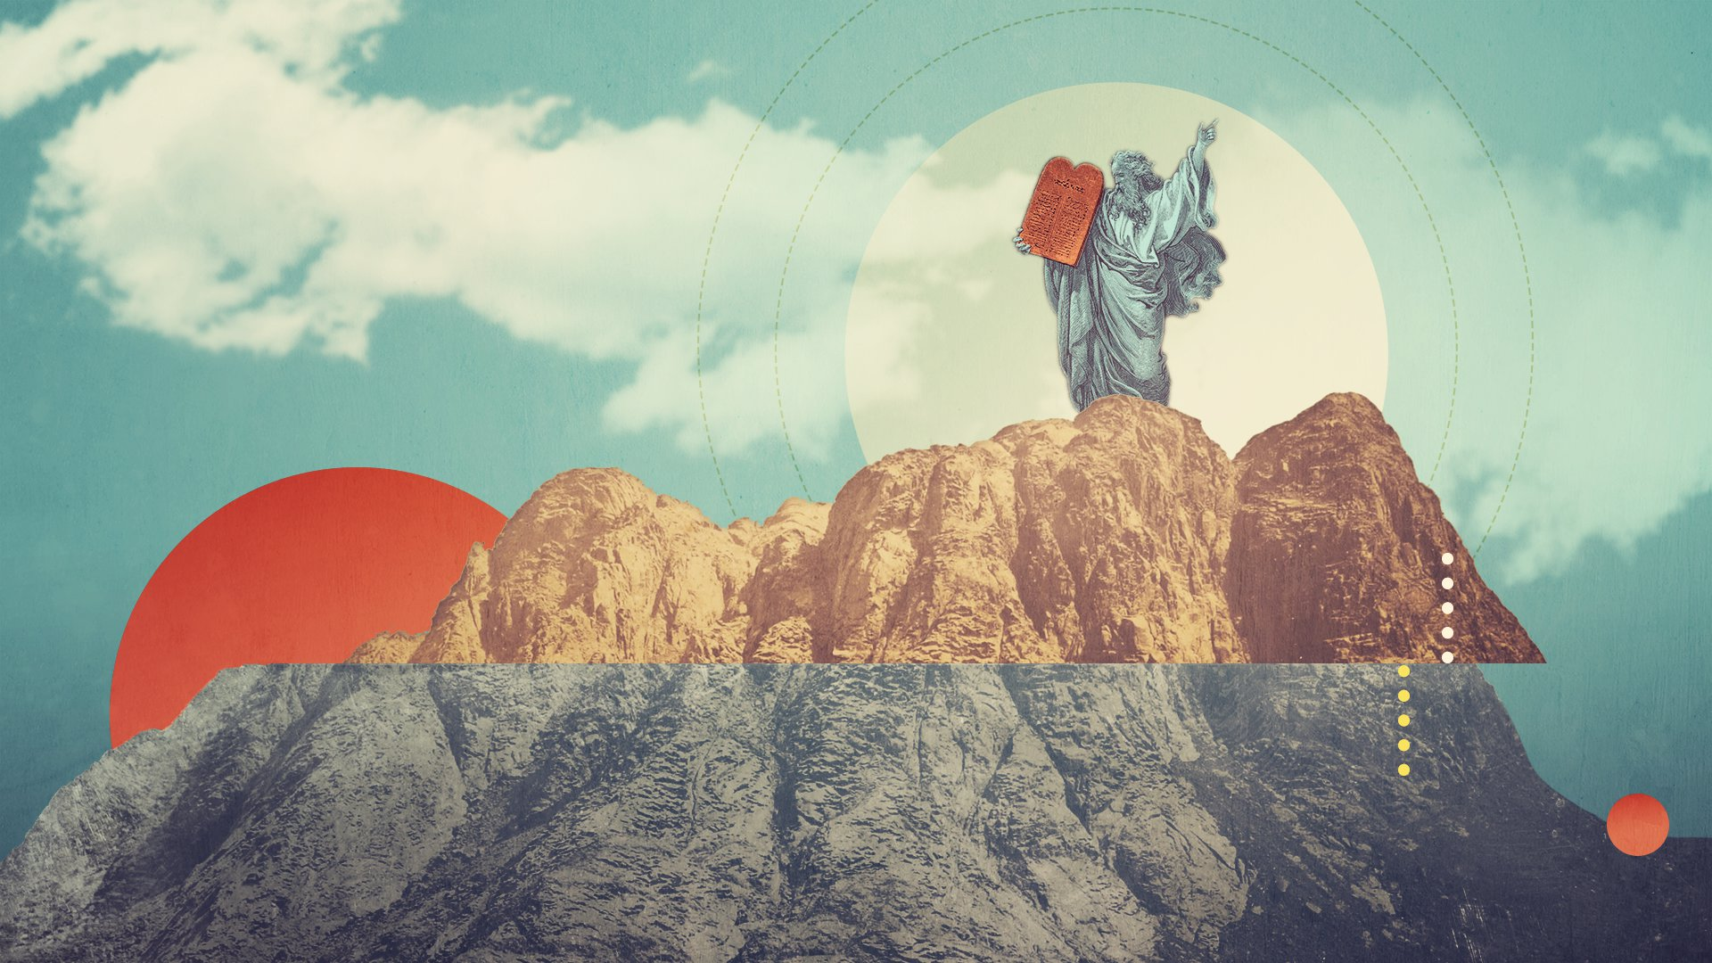
MOSES
The Life of

Slide 2

Exodus 2:15-25
New Living Translation
And sure enough, Pharaoh heard what had happened, and he tried to kill Moses. But Moses fled from Pharaoh and went to live in the land of Midian.
When Moses arrived in Midian, he sat down beside a well.

Slide 3
Psalm 119:67
New Living Translation
I used to wander off until you disciplined me;
but now I closely follow your word.

Slide 4
Psalm 119:71-72
New Living Translation
My suffering was good for me,
for it taught me to pay attention to your decrees.
Your instructions are more valuable to me
than millions in gold and silver.

Slide 5
He Developed a Servant’s Attitude

Slide 6
Exodus 2:15-25
New Living Translation
Now the priest of Midian had seven daughters who came as usual to draw water and fill the water troughs for their father’s flocks.
But some other shepherds came and chased them away. So Moses jumped up and rescued the girls from the shepherds. Then he drew water for their flocks.

Slide 7
“Wherever the Providence of God casts us, we should desire and endeavour to be useful; and, when we cannot do the good we would, we must be ready to do the good we can.”
Matthew Henry

Slide 8
He Was Willing To Be Obscure

Slide 9
Exodus 2:15-25
New Living Translation
When the girls returned to Reuel, their father, he asked, “Why are you back so soon today?”
“An Egyptian rescued us from the shepherds,” they answered. “And then he drew water for us and watered our flocks.”
“Then where is he?” their father asked. “Why did you leave him there? Invite him to come and eat with us.”

Slide 10
Exodus 2:15-25
New Living Translation
Moses accepted the invitation, and he settled there with him. In time, Reuel gave Moses his daughter Zipporah to be his wife. Later she gave birth to a son, and Moses named him Gershom, for he explained, “I have been a foreigner in a foreign land.”

Slide 11
He Learned to Rest and Rely on God

Slide 12
Exodus 2:15-25
New Living Translation
Years passed, and the king of Egypt died. But the Israelites continued to groan under their burden of slavery. They cried out for help, and their cry rose up to God. God heard their groaning, and he remembered his covenant promise to Abraham, Isaac, and Jacob. He looked down on the people of Israel and knew it was time to act.

