Slide 1
Words
to Live By

Slide 4
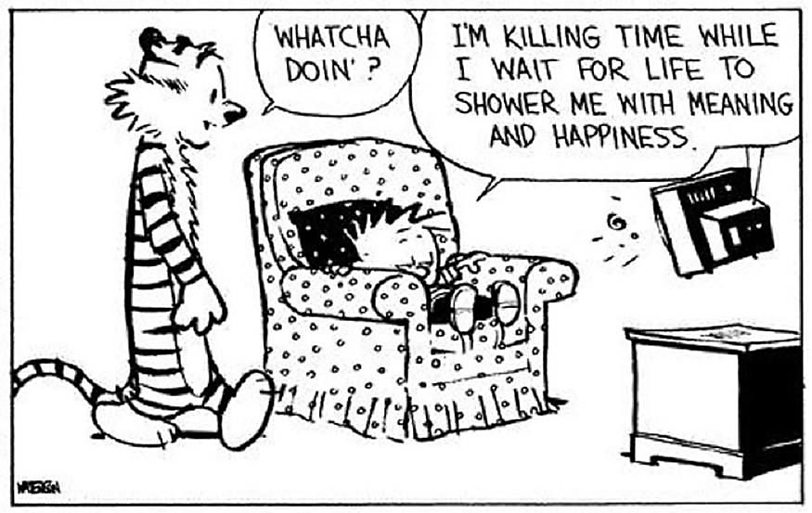

Slide 5
Galatians 5:24-25
New Living Translation
Those who belong to Christ Jesus have nailed the passions and desires of their sinful nature to his cross and crucified them there. Since we are living by the Spirit, let us follow the Spirit’s leading in every part of our lives.

Slide 7
2 Timothy 1:7
New Living Translation
I remember your genuine faith, for you share the faith that first filled your grandmother Lois and your mother, Eunice. And I know that same faith continues strong in you. This is why I remind you to fan into flames the spiritual gift God gave you when I laid my hands on you. For God has not given us a spirit of fear and timidity, but of power, love, and self-discipline.

Slide 8
Faith
A Spirit of…

Slide 9
2 Corinthians 5:1
New Living Translation
For we know that if the earthly tent we live in is destroyed, we have a building from God, an eternal house in heaven, not built by human hands.

Slide 10
2 Corinthians 5:4-7
New Living Translation
For while we are in this tent, we groan and are burdened, because we do not wish to be unclothed but to be clothed instead with our heavenly dwelling, so that what is mortal may be swallowed up by life. Now the one who has fashioned us for this very purpose is God, who has given us the Spirit as a deposit, guaranteeing what is to come.
Therefore we are always confident and know that as long as we are at home in the body we are away from the Lord. For we live by faith, not by sight.

Slide 11
Power
A Spirit of…

Slide 12
Acts 1:8
New Living Translation
But you will receive power when the Holy Spirit comes upon you. And you will be my witnesses, telling people about me everywhere—in Jerusalem, throughout Judea, in Samaria, and to the ends of the earth.”

Slide 13
Love
A Spirit of…

Slide 14
“Power divorced from love quickly becomes destructive… Love without power can degenerate into wishy-washy sentimentality.”
Tom Wright, Paul for Everyone, 2004

Slide 15
1 Corinthians 13:1-3
New Living Translation
If I could speak all the languages of earth and of angels, but didn’t love others, I would only be a noisy gong or a clanging cymbal. If I had the gift of prophecy, and if I understood all of God’s secret plans and possessed all knowledge, and if I had such faith that I could move mountains, but didn’t love others, I would be nothing. If I gave everything I have to the poor and even sacrificed my body, I could boast about it; but if I didn’t love others, I would have gained nothing.

Slide 16
A Spirit of…
Self-Discipline

Slide 17
Matthew 5:38-45a
New Living Translation
³⁸ “You have heard that it was said, ‘Eye for eye, and tooth for tooth.’ ³⁹ But I tell you, do not resist an evil person. If anyone slaps you on the right cheek, turn to them the other cheek also. ⁴⁰ And if anyone wants to sue you and take your shirt, hand over your coat as well. ⁴¹ If anyone forces you to go one mile, go with them two miles. ⁴² Give to the one who asks you, and do not turn away from the one who wants to borrow from you.

Slide 18
Matthew 5:38-45a
New Living Translation
⁴³ “You have heard that it was said, ‘Love your neighbor and hate your enemy.’ ⁴⁴ But I tell you, love your enemies and pray for those who persecute you, ⁴⁵ that you may be children of your Father in heaven.

Slide 19
Galatians 5:25
New Living Translation
Since we are living by the Spirit, let us follow the Spirit’s leading in every part of our lives.

