Slide 1
The Servant King
An Unexpected Gift

Slide 2
John 1:1-5
In the beginning the Word already existed. The Word was with God, and the Word was God. He existed in the beginning with God. God created everything through him, and nothing was created except through him. The Word gave life to everything that was created, and his life brought light to everyone. The light shines in the darkness, and the
darkness can never extinguish it.

Slide 3
We expect the Christmas story to be comfortable and trouble-free,
but God wanted to identify with us in our struggles.

Slide 4
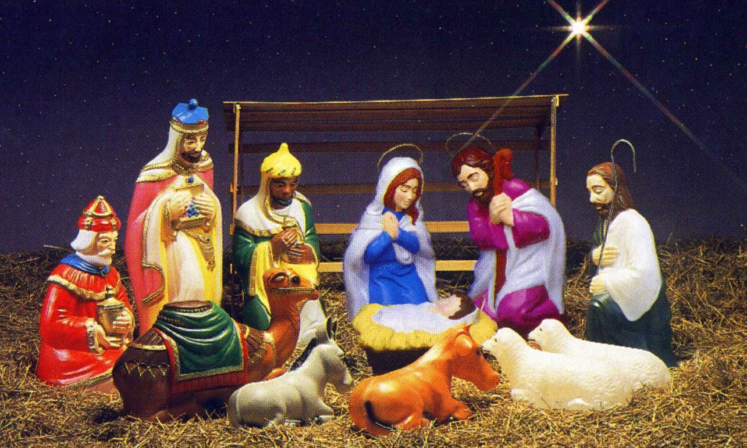

Slide 5
1 Corinthians 1:25
For the foolishness of God is wiser than human wisdom, and the weakness of God is stronger than human strength.

Slide 6
Hebrews 4:14-16
So then, since we have a great High Priest who has entered heaven, Jesus the Son of God, let us hold firmly to what we believe. This High Priest of ours understands our weaknesses, for he faced all of the same testings
we do, yet he did not sin. So let us come boldly to the throne of our gracious God. There we will receive his mercy, and we will find grace to help
us when we need it most.

Slide 7
We expect the Christmas story to be a Royal Extravaganza,
but God wanted to set an example of humility for us to follow.

Slide 8
Philippians 2:5-8
You must have the same attitude that Christ Jesus had.
Though he was God, he did not think of equality with God as something to cling to. Instead, he gave up his divine privileges, he took the humble position of a slave and was born as a human being. When he appeared in human form, he humbled himself in
obedience to God and died a
criminal’s death on a cross.

Slide 9
Matthew 20:25
…“You know that the rulers in this world lord it over their people, and officials flaunt their authority over those under them. But among you it will be different. Whoever wants to be a leader among you must be your servant, and whoever wants to be first among you must become your slave. For even the Son of Man came not to be served but to serve others and to
give his life as a ransom for many.”

Slide 10
Matthew 23:5-7
“Everything [the Pharisees] do is for show. On their arms they wear extra wide prayer boxes with Scripture verses inside, and they wear robes with extra long tassels. And they love to sit at the head table at banquets and in the seats of honor in the synagogues. They love to receive respectful greetings
as they walk in the marketplaces, and
to be called ‘Rabbi.’

Slide 11
Matthew 23:11-12
The greatest among you must be a servant. But those who exalt themselves will be humbled, and those who humble themselves will be exalted.

