Slide 1
Hold on to Hope
The power of patient endurance

Slide 2
Hebrews 6:10-12
New Living Translation
For God is not unjust. He will not forget how hard you have worked for him and how you have shown your love to him by caring for other believers, as you still do. Our great desire is that you will keep on loving others as long as life lasts, in order to make certain that what you hope for will come true. Then you will not become spiritually dull and indifferent. Instead, you will follow the example of those who are going to inherit God’s promises because of their faith and endurance.

Slide 3
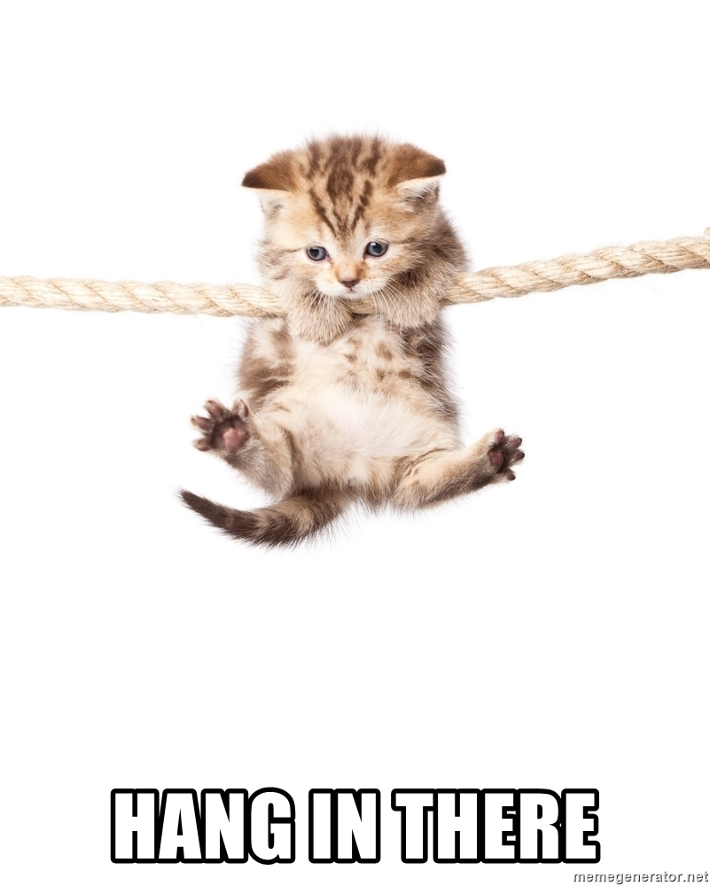

Slide 4
Abraham Genesis 12-25

Slide 5
Hebrews 6:13-15
New Living Translation
For example, there was God’s promise to Abraham. Since there was no one greater to swear by, God took an oath in his own name, saying:
“I will certainly bless you, and I will multiply your descendants beyond number.”
Then Abraham waited patiently, and he received what God had promised.

Slide 6
Joseph Genesis 37-50

Slide 7
Psalm 105:16-22
New Living Translation
He called for a famine on the land of Canaan, cutting off its food supply. Then he sent someone to Egypt ahead of them— Joseph, who was sold as a slave. They bruised his feet with fetters and placed his neck in an iron collar. Until the time came to fulfill his dreams, the Lord tested Joseph’s character.

Slide 8
Psalm 105:16-22
New Living Translation
Then Pharaoh sent for him and set him free; the ruler of the nation opened his prison door. Joseph was put in charge of all the king’s household; he became ruler over all the king’s possessions. He could instruct the king’s aides as he pleased and teach the king’s advisers.

Slide 9
David 1 Samuel 16 – 31 2 Samuel

Slide 10
James 1:3-4
New Living Translation
For you know that when your faith is tested, your endurance has a chance to grow. So let it grow, for when your endurance is fully developed, you will be perfect and complete, needing nothing.

Slide 11
Galatians 6:9
New Living Translation
So let’s not get tired of doing what is good. At just the right time we will reap a harvest of blessing if we don’t give up.

Slide 12
Hebrews 10:35-38
New Living Translation
So do not throw away this confident trust in the Lord. Remember the great reward it brings you! Patient endurance is what you need now, so that you will continue to do God’s will. Then you will receive all that he has promised.

Slide 13
Hebrews 10:35-38
New Living Translation
“For in just a little while, the Coming One will come and not delay. And my righteous ones will live by faith. But I will take no pleasure in anyone who turns away.”

Slide 14
Hebrews 6:19-20
New Living Translation
This hope is a strong and trustworthy anchor for our souls. It leads us through the curtain into God’s inner sanctuary. Jesus has already gone in there for us. He has become our eternal High Priest in the order of Melchizedek.

