Slide 2
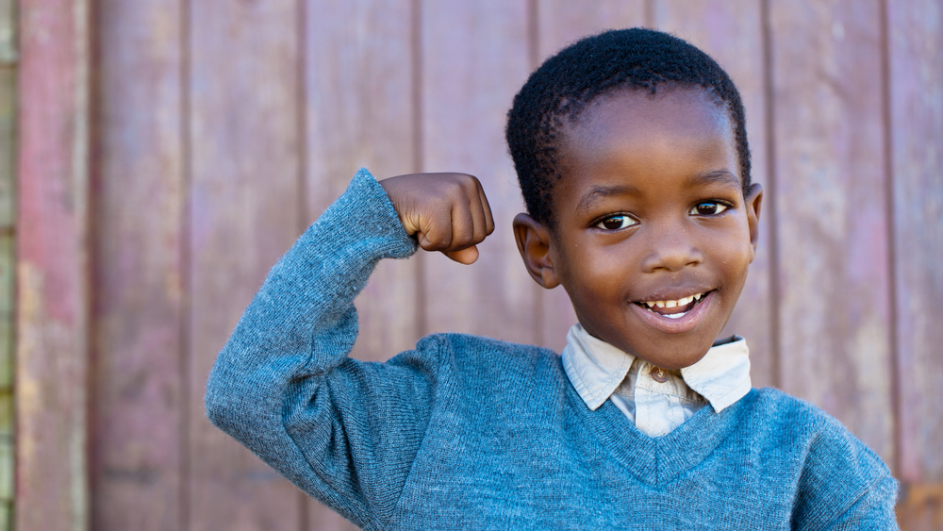
I Am…
Confident

Slide 3
But Moses protested again, “What if they won’t believe me or listen to me? What if they say, ‘The Lord never appeared to you’?”
Then the Lord asked him, “What is that in your hand?”
“A shepherd’s staff,” Moses replied.
“Throw it down on the ground,” the Lord told him. So Moses threw down the staff, and it turned into a snake! Moses jumped back.
Exodus 4:1-17

Slide 4
Then the Lord told him, “Reach out and grab its tail.” So Moses reached out and grabbed it, and it turned back into a shepherd’s staff in his hand.
“Perform this sign,” the Lord told him. “Then they will believe that the Lord, the God of their ancestors—the God of Abraham, the God of Isaac, and the God of Jacob—really has appeared to you.”
Exodus 4:1-17

Slide 5
Then the Lord said to Moses, “Now put your hand inside your cloak.” So Moses put his hand inside his cloak, and when he took it out again, his hand was white as snow with a severe skin disease. “Now put your hand back into your cloak,” the Lord said. So Moses put his hand back in, and when he took it out again, it was as healthy as the rest of his body.
Exodus 4:1-17

Slide 6
The Lord said to Moses, “If they do not believe you and are not convinced by the first miraculous sign, they will be convinced by the second sign. And if they don’t believe you or listen to you even after these two signs, then take some water from the Nile River and pour it out on the dry ground. When you do, the water from the Nile will turn to blood on the ground.”
Exodus 4:1-17

Slide 7
But Moses pleaded with the Lord, “O Lord, I’m not very good with words. I never have been, and I’m not now, even though you have spoken to me. I get tongue-tied, and my words get tangled.”
Then the Lord asked Moses, “Who makes a person’s mouth? Who decides whether people speak or do not speak, hear or do not hear, see or do not see? Is it not I, the Lord?
Exodus 4:1-17

Slide 8
Now go! I will be with you as you speak, and I will instruct you in what to say.”
But Moses again pleaded, “Lord, please! Send anyone else.”
Then the Lord became angry with Moses. “All right,” he said. “What about your brother, Aaron the Levite? I know he speaks well. And look! He is on his way to meet you now. He will be delighted to see you.
Exodus 4:1-17

Slide 9
Talk to him, and put the words in his mouth. I will be with both of you as you speak, and I will instruct you both in what to do. Aaron will be your spokesman to the people. He will be your mouthpiece, and you will stand in the place of God for him, telling him what to say. And take your shepherd’s staff with you, and use it to perform the miraculous signs I have shown you.”
Exodus 4:1-17

Slide 10
After the death of Moses the Lord’s servant, the Lord spoke to Joshua son of Nun, Moses’ assistant. He said, “Moses my servant is dead. Therefore, the time has come for you to lead these people, the Israelites, across the Jordan River into the land I am giving them. I promise you what I promised Moses: ‘Wherever you set foot, you will be on land I have given you…
Joshua 1:1-9

Slide 11
…from the Negev wilderness in the south to the Lebanon mountains in the north, from the Euphrates River in the east to the Mediterranean Sea in the west, including all the land of the Hittites.’ No one will be able to stand against you as long as you live. For I will be with you as I was with Moses. I will not fail you or abandon you.
Joshua 1:1-9

Slide 12
“Be strong and courageous, for you are the one who will lead these people to possess all the land I swore to their ancestors I would give them. Be strong and very courageous. Be careful to obey all the instructions Moses gave you. Do not deviate from them, turning either to the right or to the left. Then you will be successful in everything you do.
Joshua 1:1-9

Slide 13
Study this Book of Instruction continually. Meditate on it day and night so you will be sure to obey everything written in it. Only then will you prosper and succeed in all you do. This is my command—be strong and courageous! Do not be afraid or discouraged. For the Lord your God is with you wherever you go.”
Joshua 1:1-9

Slide 14
This is why I remind you to fan into flames the spiritual gift God gave you when I laid my hands on you. For God has not given us a spirit of fear and timidity, but of power, love, and self-discipline.
2 Timothy 1:6-7

Slide 15
And then he told them, “Go into all the world and preach the Good News to everyone.
Mark 16:15

Slide 16
These miraculous signs will accompany those who believe: They will cast out demons in my name, and they will speak in new languages. They will be able to handle snakes with safety, and if they drink anything poisonous, it won’t hurt them. They will be able to place their hands on the sick, and they will be healed.”
Mark 16:17-18

Slide 17
And the disciples went everywhere and preached, and the Lord worked through them, confirming what they said by many miraculous signs.
Mark 16:20

