Slide 1
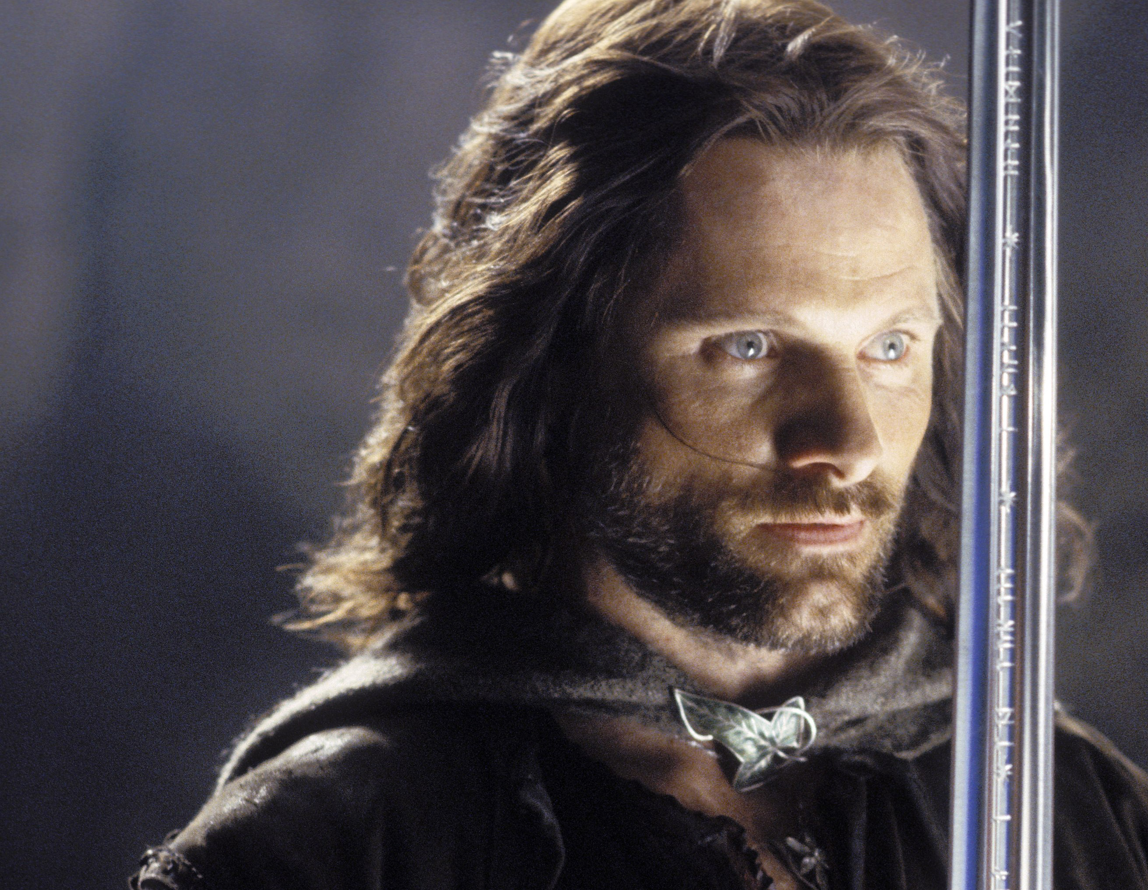
Return
of the
King
Still Burning

Slide 2
Matthew 25:1-13
New Living Translation
“Then the Kingdom of Heaven will be like ten bridesmaids who took their lamps and went to meet the bridegroom. Five of them were foolish, and five were wise. The five who were foolish didn’t take enough olive oil for their lamps, but the other five were wise enough to take along extra oil.

Slide 3
Matthew 25:1-13
New Living Translation
When the bridegroom was delayed, they all became drowsy and fell asleep.
“At midnight they were roused by the shout, ‘Look, the bridegroom is coming! Come out and meet him!’
“All the bridesmaids got up and prepared their lamps.

Slide 4
Matthew 25:1-13
New Living Translation
Then the five foolish ones asked the others, ‘Please give us some of your oil because our lamps are going out.’ “But the others replied, ‘We don’t have enough for all of us. Go to a shop and buy some for yourselves.’
“But while they were gone to buy oil, the bridegroom came.

Slide 5
Matthew 25:1-13
New Living Translation
Then those who were ready went in with him to the marriage feast, and the door was locked. Later, when the other five bridesmaids returned, they stood outside, calling, ‘Lord! Lord! Open the door for us!’
“But he called back, ‘Believe me, I don’t know you!’

Slide 6
Matthew 25:1-13
New Living Translation
“So you, too, must keep watch! For you do not know the day or hour of my return.

Slide 7
Revelation 2:2-5a
New Living Translation
“I know all the things you do. I have seen your hard work and your patient endurance. I know you don’t tolerate evil people. You have examined the claims of those who say they are apostles but are not. You have discovered they are liars. You have patiently suffered for me without quitting.

Slide 8
Revelation 2:2-5a
New Living Translation
“But I have this complaint against you. You don’t love me or each other as you did at first! Look how far you have fallen! Turn back to me and do the works you did at first.

Slide 9
Song of Songs 1:2-4
New Living Translation
Kiss me and kiss me again,
for your love is sweeter than wine.
How pleasing is your fragrance;
your name is like the spreading fragrance of scented oils.
No wonder all the young women love you!
Take me with you; come, let’s run!
The king has brought me into his bedroom.

Slide 10
Song of Songs 2:14
New Living Translation
My dove is hiding behind the rocks,
behind an outcrop on the cliff.
Let me see your face;
let me hear your voice.
For your voice is pleasant,
and your face is lovely.

Slide 11
Song of Songs 3:1-4
New Living Translation
One night as I lay in bed, I yearned for my lover.
I yearned for him, but he did not come.
So I said to myself, “I will get up and roam the city,
searching in all its streets and squares.
I will search for the one I love.”
So I searched everywhere but did not find him.

Slide 12
Song of Songs 3:1-4
New Living Translation
The watchmen stopped me as they made their rounds,
and I asked, “Have you seen the one I love?”
Then scarcely had I left them
when I found my love!

Slide 13
Song of Songs 3:1-4
New Living Translation
I caught and held him tightly,
then I brought him to my mother’s house,
into my mother’s bed, where I had been conceived.

Slide 14
Song of Songs 4:1, 9
New Living Translation
You are beautiful, my darling,
beautiful beyond words.
You have captured my heart…
You hold it hostage
with one glance of your eyes…

Slide 15
Song of Songs 5:2-3
New Living Translation
I slept, but my heart was awake,
when I heard my lover knocking and calling:
“Open to me, my treasure, my darling,
my dove, my perfect one.
My head is drenched with dew,
my hair with the dampness of the night.”

Slide 16
Song of Songs 5:2-3
New Living Translation
But I responded,
“I have taken off my robe.
Should I get dressed again?
I have washed my feet.
Should I get them soiled?”

Slide 17
Song of Songs 5:4-7
New Living Translation
My lover tried to unlatch the door,
and my heart thrilled within me.
I jumped up to open the door for my love,
and my hands dripped with perfume.
My fingers dripped with lovely myrrh
as I pulled back the bolt.

Slide 18
Song of Songs 5:4-7
New Living Translation
I opened to my lover,
but he was gone!
My heart sank.
I searched for him
but could not find him anywhere.
I called to him,
but there was no reply.

Slide 19
Song of Songs 5:4-7
New Living Translation
The night watchmen found me
as they made their rounds.
They beat and bruised me
and stripped off my veil,
those watchmen on the walls.

Slide 20
Song of Songs 5:4-7
New Living Translation
Make this promise, O women of Jerusalem—
If you find my lover,
tell him I am weak with love.

Slide 21
Matthew 10:34-38
New Living Translation
“Don’t imagine that I came to bring peace to the earth! I came not to bring peace, but a sword.
‘I have come to set a man against his father,
a daughter against her mother,
and a daughter-in-law against her mother-in-law.
Your enemies will be right in your own household!’

Slide 22
Matthew 10:34-38
New Living Translation
“If you love your father or mother more than you love me, you are not worthy of being mine; or if you love your son or daughter more than me, you are not worthy of being mine. If you refuse to take up your cross and follow me, you are not worthy of being mine.

Slide 23
Psalm 84:2
New Living Translation
My soul yearns, even faints,
for the courts of the Lord;
my heart and my flesh cry out
for the living God.

