Slide 1
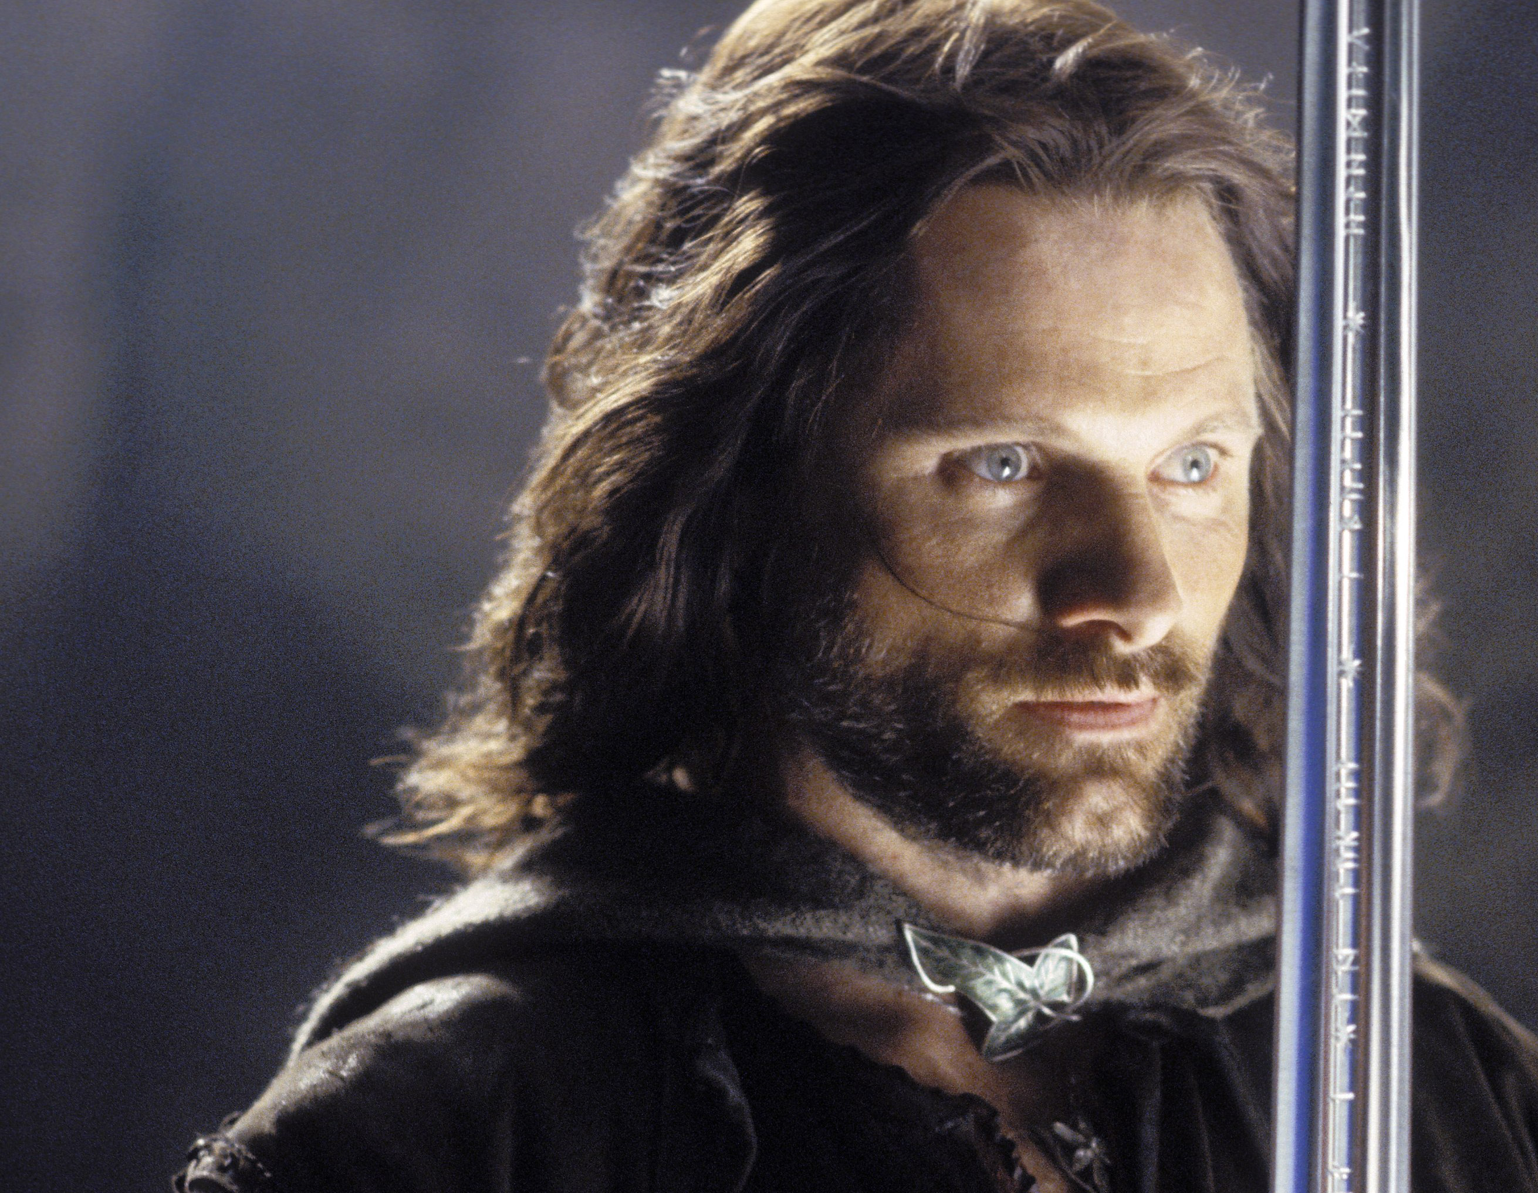
Return
of the
King
Dealing with the Stuff

Slide 2
Matthew 24:45-51
New Living Translation
“A faithful, sensible servant is one to whom the master can give the responsibility of managing his other household servants and feeding them. If the master returns and finds that the servant has done a good job, there will be a reward. I tell you the truth, the master will put that servant in charge of all he owns. But what if the servant is evil and thinks, ‘My master won’t be back for a while,’ and he begins beating the other servants, partying, and getting drunk?

Slide 3
Matthew 24:45-51
New Living Translation
The master will return unannounced and unexpected, and he will cut the servant to pieces and assign him a place with the hypocrites. In that place there will be weeping and gnashing of teeth.

Slide 4
Revelation 13:16-18
New International Version
It also forced all people, great and small, rich and poor, free and slave, to receive a mark on their right hands or on their foreheads, so that they could not buy or sell unless they had the mark, which is the name of the beast or the number of its name. This calls for wisdom. Let the person who has insight calculate the number of the beast, for it is the number of a man. That number is 666.

Slide 5
1 John 2:15-17
New Living Translation
Do not love this world nor the things it offers you, for when you love the world, you do not have the love of the Father in you. For the world offers only a craving for physical pleasure, a craving for everything we see, and pride in our achievements and possessions. These are not from the Father, but are from this world. And this world is fading away, along with everything that people crave. But anyone who does what pleases God will live forever.

Slide 6
Matthew 6:24
New Living Translation
“No one can serve two masters. For you will hate one and love the other; you will be devoted to one and despise the other. You cannot serve God and be enslaved to money.

Slide 7
James 4:4-5
New Living Translation
You adulterers! Don’t you realize that friendship with the world makes you an enemy of God? I say it again: If you want to be a friend of the world, you make yourself an enemy of God. Do you think the Scriptures have no meaning? They say that God is passionate that the spirit he has placed within us should be faithful to him.

Slide 8
James 4:1-3
New Living Translation
What is causing the quarrels and fights among you? Don’t they come from the evil desires at war within you? You want what you don’t have, so you scheme and kill to get it. You are jealous of what others have, but you can’t get it, so you fight and wage war to take it away from them. Yet you don’t have what you want because you don’t ask God for it.

Slide 9
James 4:1-3
New Living Translation
And even when you ask, you don’t get it because your motives are all wrong—you want only what will give you pleasure.

Slide 10
1 Timothy 6:6-10
New Living Translation
Yet true godliness with contentment is itself great wealth. After all, we brought nothing with us when we came into the world, and we can’t take anything with us when we leave it. So if we have enough food and clothing, let us be content.

Slide 11
1 Timothy 6:6-10
New Living Translation
But people who long to be rich fall into temptation and are trapped by many foolish and harmful desires that plunge them into ruin and destruction.
For the love of money is the root of all kinds of evil. And some people, craving money, have wandered from the true faith and pierced themselves with many sorrows.

Slide 12
1. We are only stewards of what we’ve been given.

Slide 13
Psalm 24:1
New Living Translation
The earth is the Lord’s, and everything in it.
The world and all its people belong to him.

Slide 14
2. What we get is to be used to help others.

Slide 15
James 1:27
New Living Translation
Pure and genuine religion in the sight of God the Father means caring for orphans and widows in their distress and refusing to let the world corrupt you.

Slide 16
1 Timothy 5:8
New Living Translation
But those who won’t care for their relatives, especially those in their own household, have denied the true faith. Such people are worse than unbelievers.

Slide 17
3. Remember that the Master is returning

Slide 18
Luke 12:47-48
New Living Translation
“And a servant who knows what the master wants, but isn’t prepared and doesn’t carry out those instructions, will be severely punished. But someone who does not know, and then does something wrong, will be punished only lightly. When someone has been given much, much will be required in return; and when someone has been entrusted with much, even more will be required.

