Slide 1
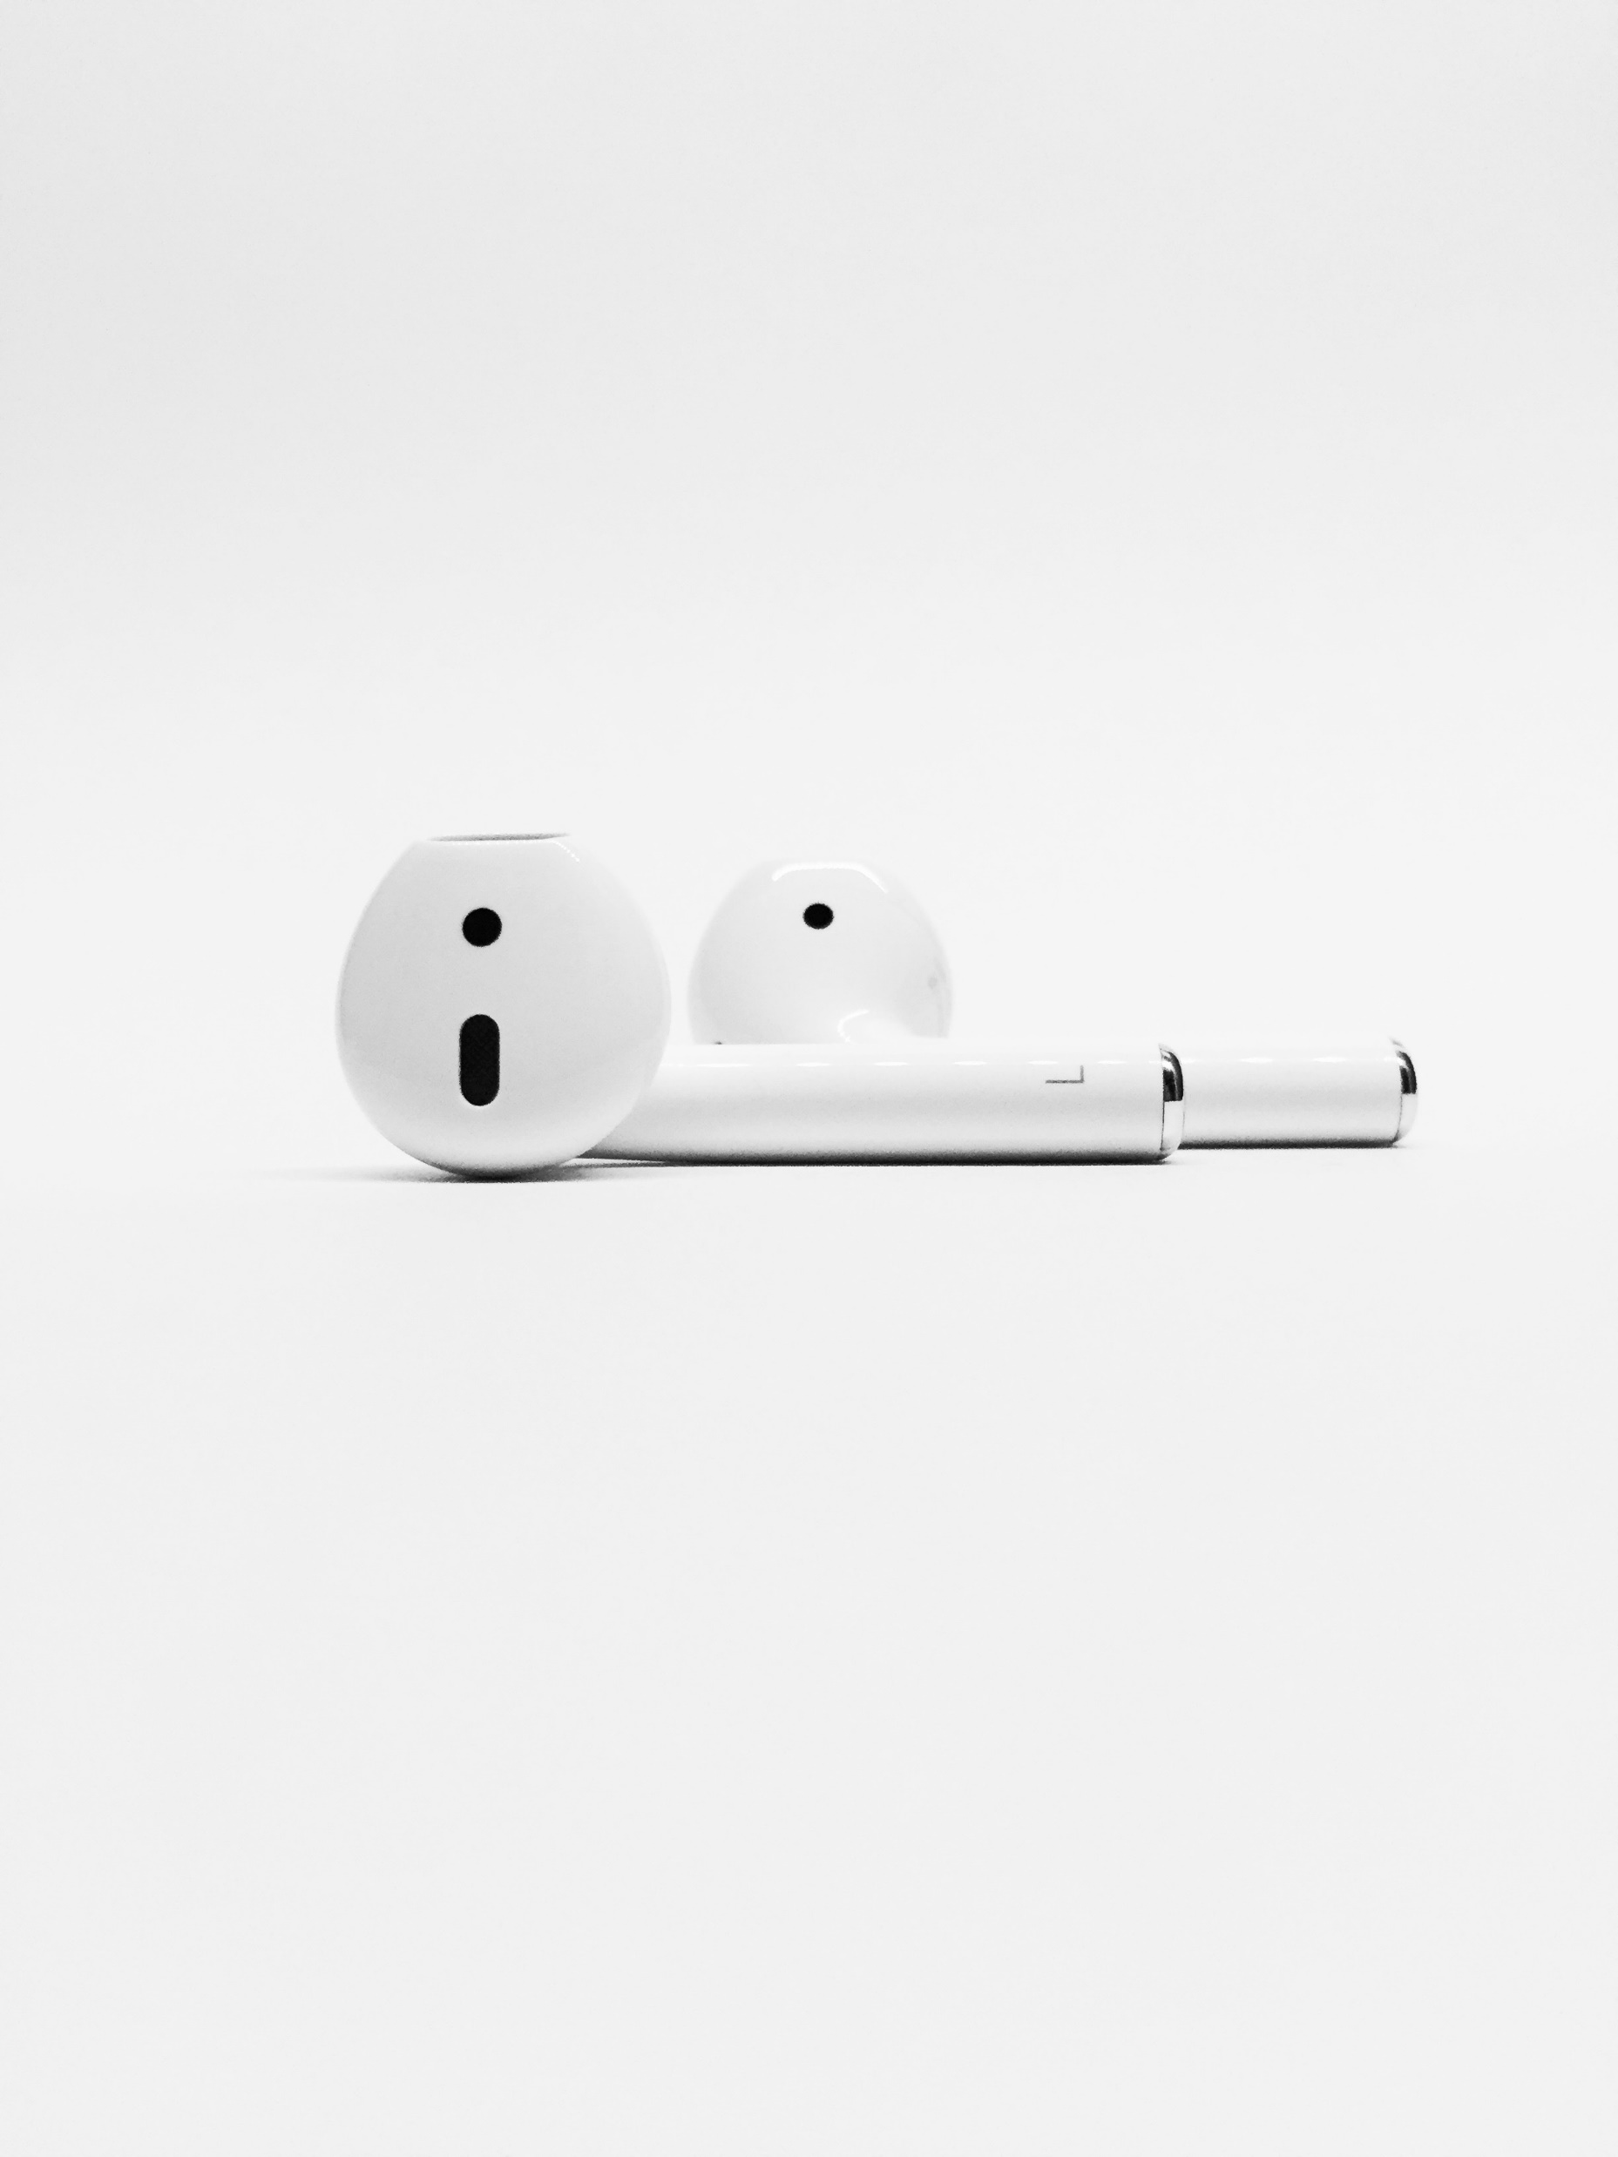

On Repeat

Slide 2
God is With Me

Slide 3
The Problem?
Fear

Slide 4
Psalm 23:4
New Living Translation
Even when I walk
through the darkest valley,
I will not be afraid,
for you are close beside me.
Your rod and your staff
protect and comfort me.

Slide 5
1 Chronicles 28:20
New Living Translation
Then David continued, “Be strong and courageous, and do the work. Don’t be afraid or discouraged, for the Lord God, my God, is with you. He will not fail you or forsake you. He will see to it that all the work related to the Temple of the Lord is finished correctly.

Slide 6
Jeremiah 1:7-8
New Living Translation
The Lord replied, “Don’t say, ‘I’m too young,’ for you must go wherever I send you and say whatever I tell you. And don’t be afraid of the people, for I will be with you and will protect you.

Slide 7
Romans 8:15
New Living Translation
So you have not received a spirit that makes you fearful slaves. Instead, you received God’s Spirit when he adopted you as his own children.

Slide 8
I will not fear, God is with me

Slide 9
Hebrews 13:5-6
New Living Translation
Don’t love money; be satisfied with what you have. For God has said, “I will never fail you. I will never abandon you.”
So we can say with confidence, “The Lord is my helper, so I will have no fear. What can mere people do to me?”

Slide 10
God is... omnipresent & omniscient

Slide 11
Psalm 139:1
New Living Translation
O Lord, you have examined my heart and know everything about me.

Slide 12
Jeremiah 23:24
New Living Translation
Can anyone hide from me in a secret place? Am I not everywhere in all the heavens and earth?” says the Lord.

Slide 13
Is God with everyone?

Slide 14
God is not with the proud

Slide 15
James 4:6
New Living Translation
God opposes the proud
but gives grace to the humble.

Slide 16
God is not with the rebellious

Slide 17
Isaiah 1:2
New Living Translation
Listen, O heavens! Pay attention, earth! This is what the Lord says: “The children I raised and cared for have rebelled against me.

Slide 18
Isaiah 1:15
New Living Translation
When you lift up your hands in prayer, I will not look.
Though you offer many prayers, I will not listen, for your hands are covered with the blood of innocent victims.

Slide 19
God is not with the worldly

Slide 20
James 4:4
New Living Translation
You adulterers! Don’t you realize that friendship with the world makes you an enemy of God? I say it again: If you want to be a friend of the world, you make yourself an enemy of God.

Slide 21
God is not with those who harbour sin

Slide 22
Psalm 66:8
New International Version
If I had cherished sin in my heart, the Lord would not have listened…

Slide 23
How much is God for me really?

Slide 24
Romans 8:31-32
New Living Translation
What shall we say about such wonderful things as these? If God is for us, who can ever be against us? Since he did not spare even his own Son but gave him up for us all, won’t he also give us everything else?

Slide 25
Deuteronomy 31:6
New Living Translation
So be strong and courageous! Do not be afraid and do not panic before them. For the Lord your God will personally go ahead of you. He will neither fail you nor abandon you.

Slide 26
Keep it
On Repeat

