Slide 1
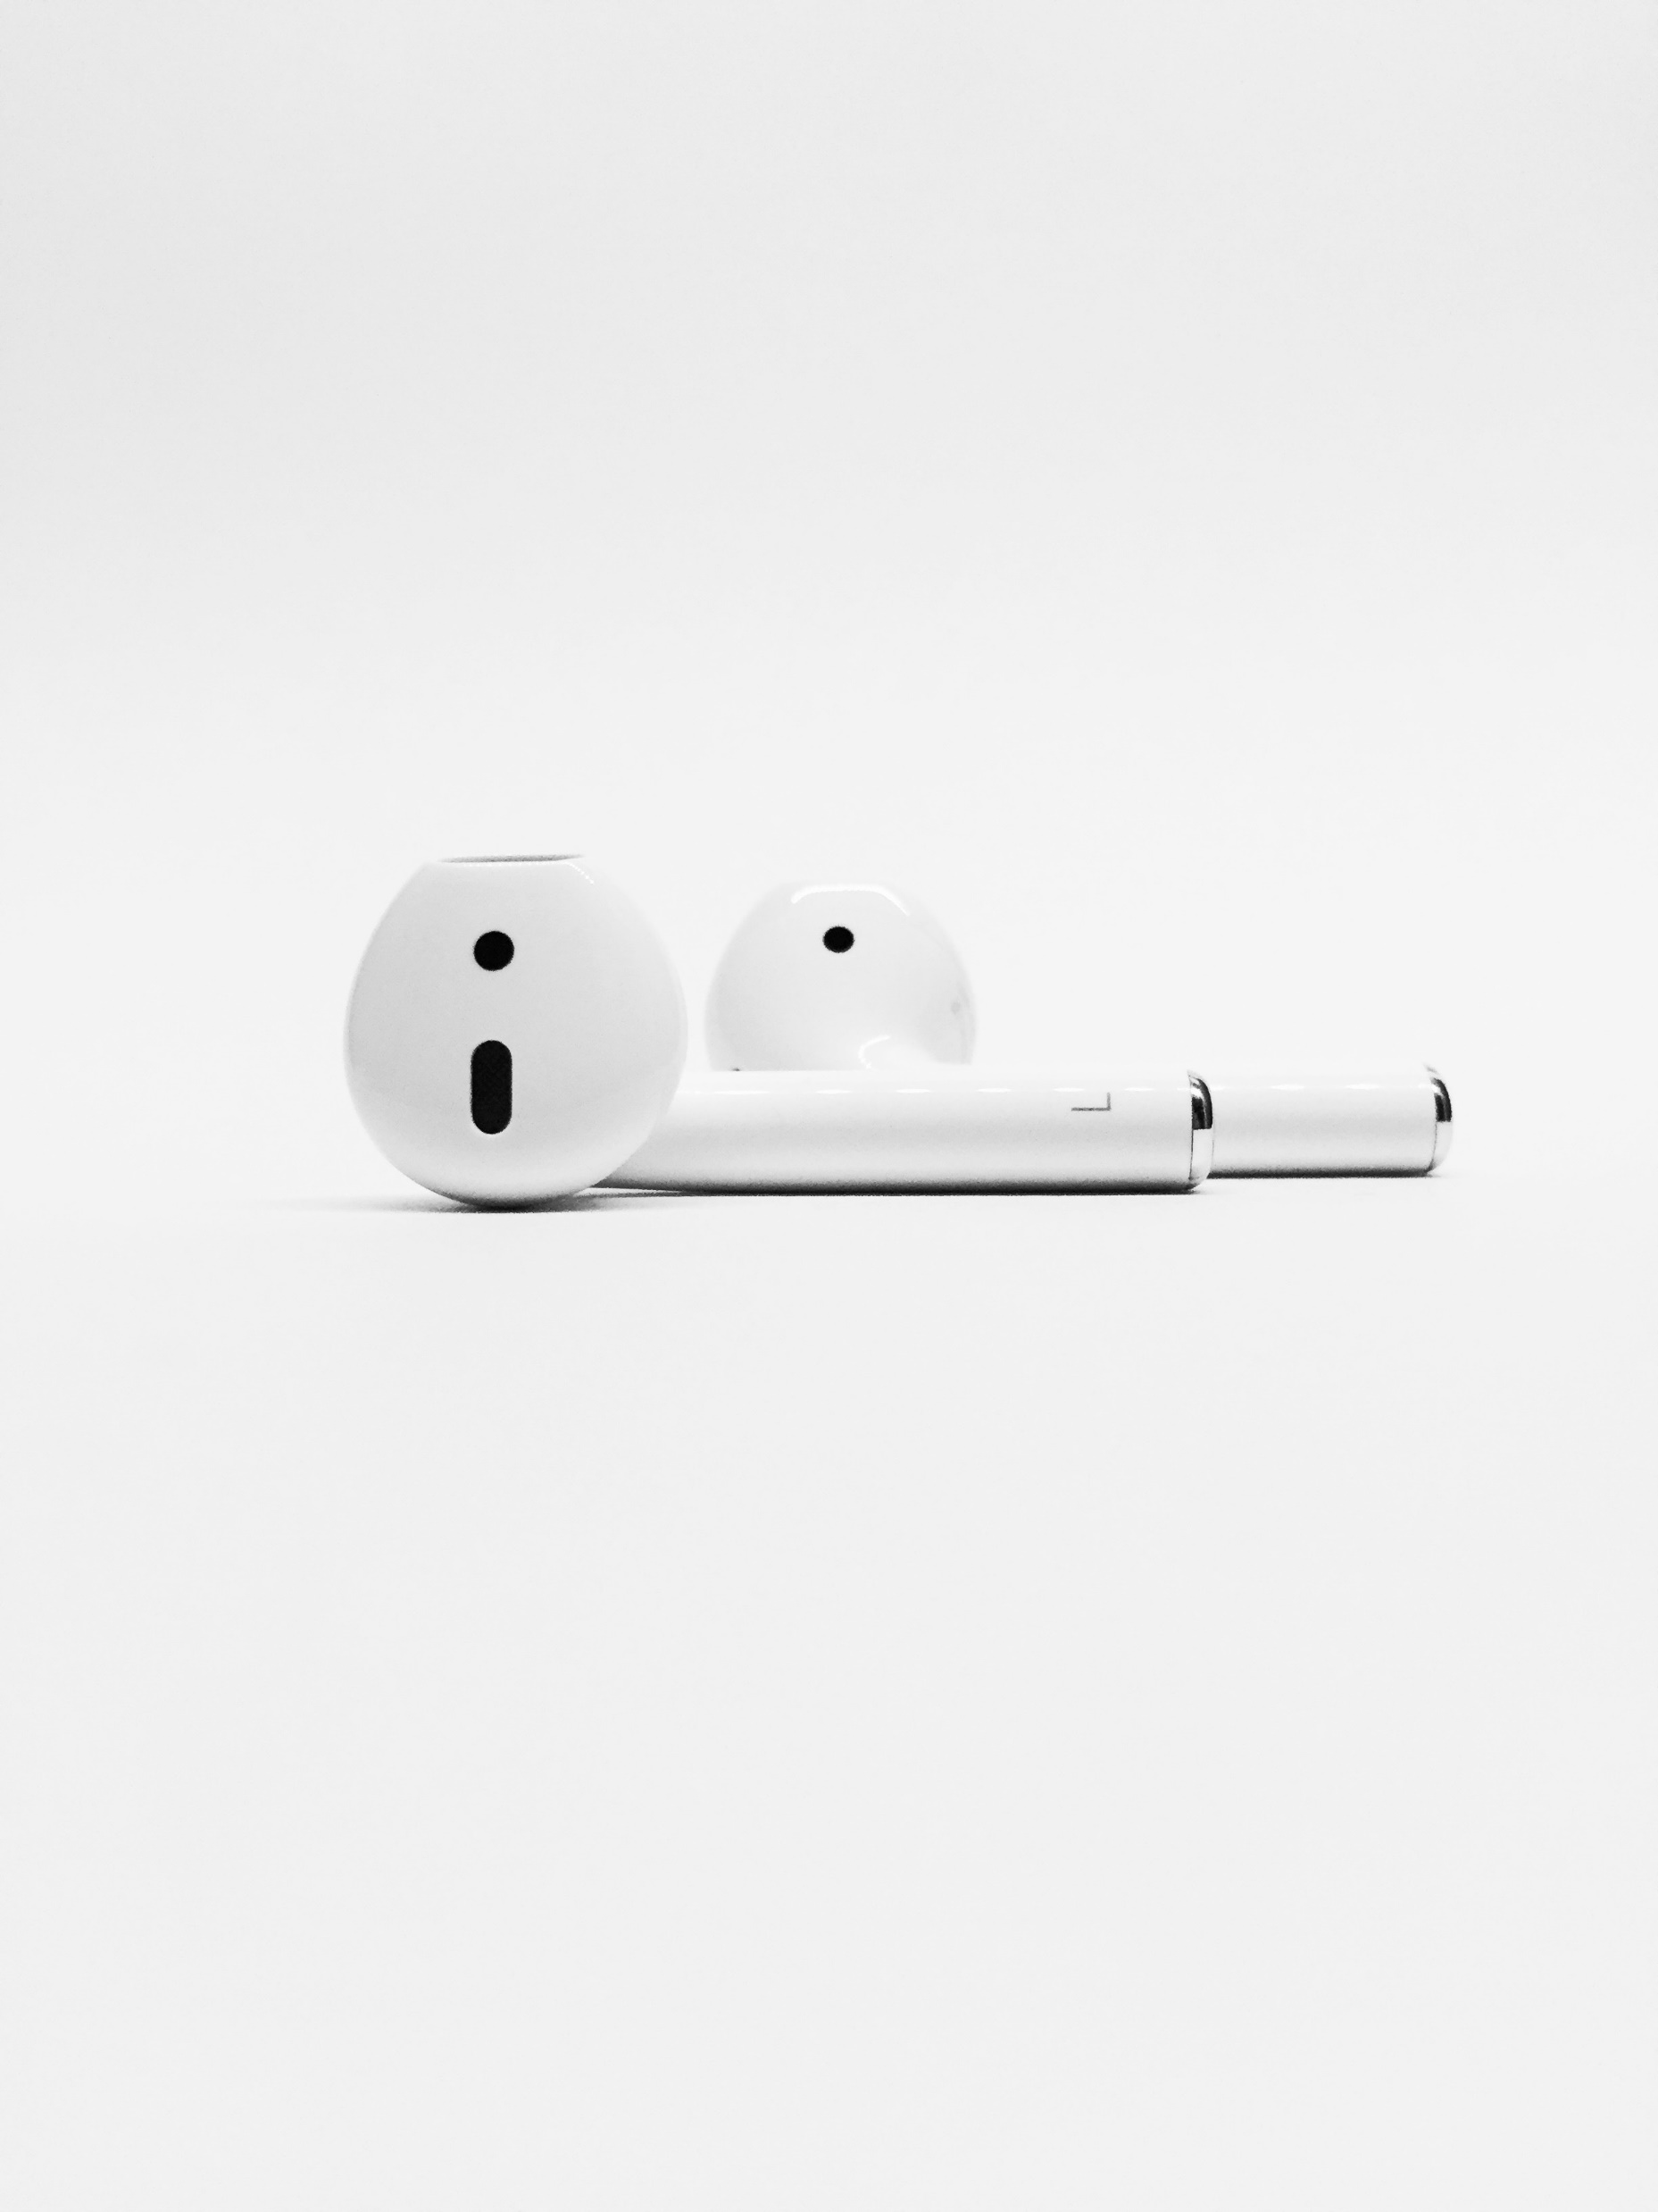
On Repeat

Slide 2
The Church is God’s Plan

Slide 3
God Created The Church

Slide 4
Romans 5:8 New Living Translation
But God showed his great love for us by sending Christ to die for us while we were still sinners.

Slide 5
1 John 3:1a New Living Translation
See how very much our Father loves us, for he calls us his children, and that is what we are!

Slide 6
God Loves the Church

Slide 7
Psalm 139:7-10 New Living Translation
I can never escape from your Spirit!
I can never get away from your presence! If I go up to heaven, you are there;
if I go down to the grave, you are there. If I ride the wings of the morning,
if I dwell by the farthest oceans, even there your hand will guide me,
and your strength will support me.

Slide 8
God

Slide 9
Proverbs 3:11-12 New Living Translation
My child, don’t reject the Lord’s discipline, and don’t be upset when he corrects you. For the Lord corrects those he loves, just as a father corrects a child in whom he delights.

Slide 10
Hebrews 12:10-11 New Living Translation
For our earthly fathers disciplined us for a few years, doing the best they knew how. But God’s discipline is always good for us, so that we might share in his holiness. No discipline is enjoyable while it is happening—it’s painful! But afterward there will be a peaceful harvest of right living for those who are trained in this way.

Slide 11
Provide

Slide 12
Matthew 6:7-8 New Living Translation
“When you pray, don’t babble on and on as people of other religions do. They think their prayers are answered merely by repeating their words again and again. Don’t be like them, for your Father knows exactly what you need even before you ask him!

Slide 13
Philippians 4:19 New Living Translation
And this same God who takes care of me will supply all your needs from his glorious riches, which have been given to us in Christ Jesus.

Slide 14
Lead by Example

Slide 15
John 14:9 New Living Translation
Jesus replied, “Have I been with you all this time, Philip, and yet you still don’t know who I am? Anyone who has seen me has seen the Father! So why are you asking me to show him to you?

Slide 16
John 13:14-15 New Living Translation
And since I, your Lord and Teacher, have washed your feet, you ought to wash each other’s feet. I have given you an example to follow. Do as I have done to you.

Slide 17
1 Corinthians 11:1 New Living Translation
And you should imitate me, just as I imitate Christ.

Slide 18
Romans 8:15-16 New Living Translation
So you have not received a spirit that makes you fearful slaves. Instead, you received God’s Spirit when he adopted you as his own children. Now we call him, “Abba, Father.” For his Spirit joins with our spirit to affirm that we are God’s children.

Slide 19
Keep it On Repeat

