Slide 1
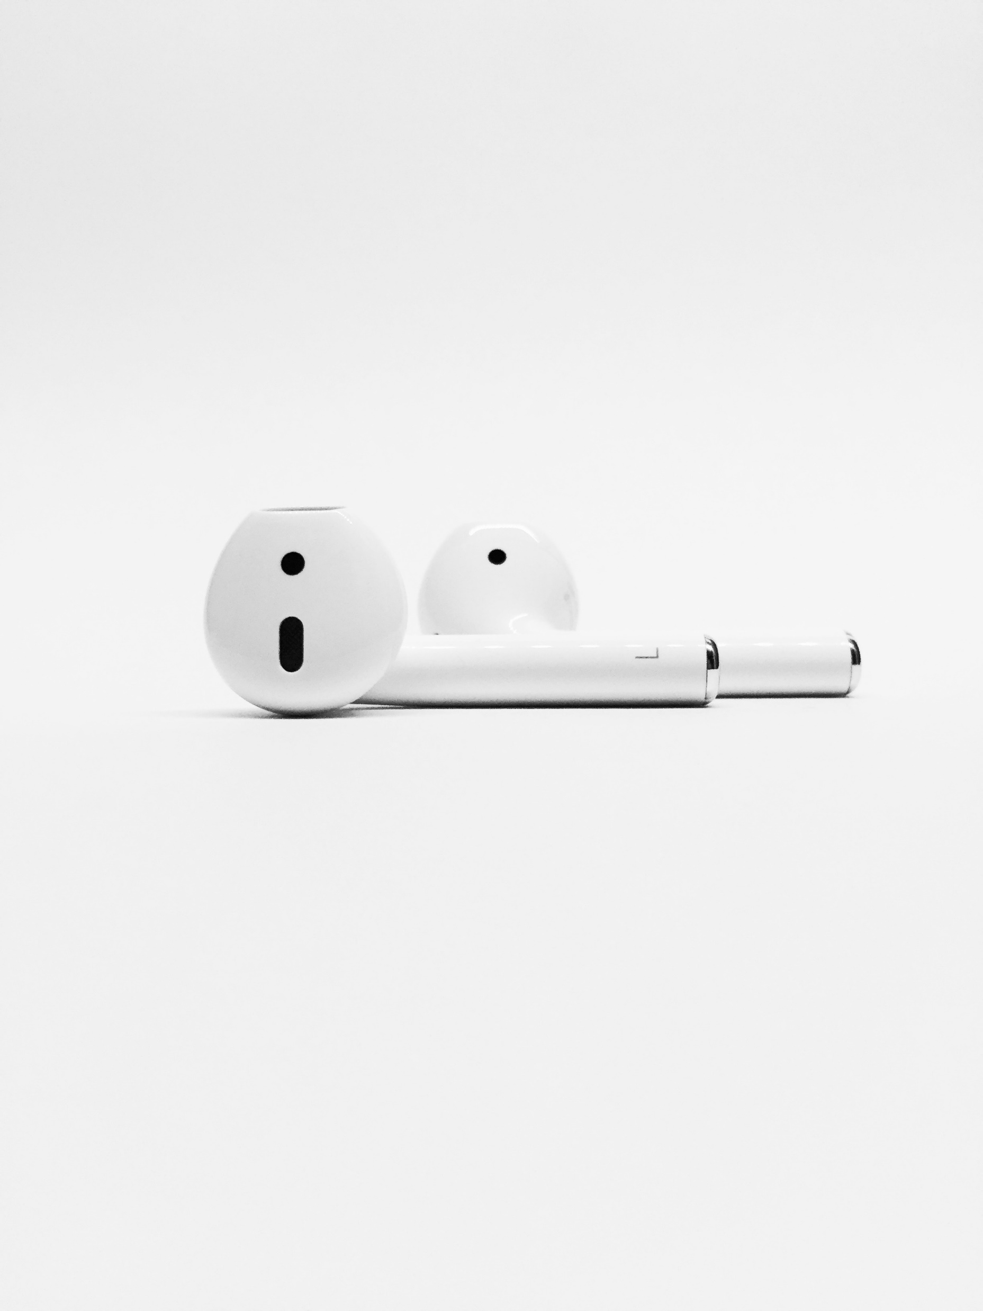
On Repeat

Slide 2
I Need to Feed

Slide 3
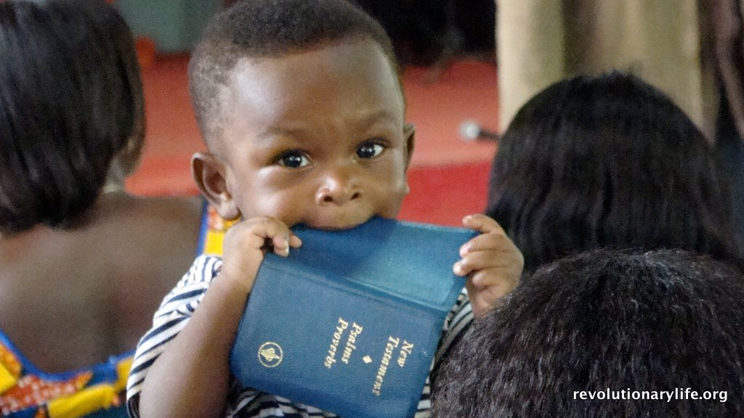
I need to feed... on God’s Word

Slide 4
Matthew 4:4 New Living Translation
During that time the devil came and said to him, “If you are the Son of God, tell these stones to become loaves of bread.”
But Jesus told him, “No! The Scriptures say, ‘People do not live by bread alone, but by every word that comes from the mouth of God.’”

Slide 5
1 Peter 2:2-3 New Living Translation
Like newborn babies, you must crave pure spiritual milk so that you will grow into a full experience of salvation. Cry out for this nourishment, now that you have had a taste of the Lord’s kindness.

Slide 6
regularly
I need to Feed...

Slide 7
Psalm 119:55 New Living Translation
I reflect at night on who you are, O Lord; therefore, I obey your instructions.

Slide 8
Psalm 119:62 New Living Translation
I rise at midnight to thank you for your just regulations.

Slide 9
Psalm 119:97 New Living Translation
Oh, how I love your instructions! I think about them all day long.

Slide 10
Psalm 119:147-148 New Living Translation
I rise early, before the sun is up; I cry out for help and put my hope in your words.
I stay awake through the night, thinking about your promise.

Slide 11
Psalm 119:164 New Living Translation
I will praise you seven times a day because all your regulations are just.

Slide 12
Intentionally
I need to Feed...

Slide 13
2 Timothy 3:16-17 New Living Translation
All Scripture is inspired by God and is useful to teach us what is true and to make us realize what is wrong in our lives. It corrects us when we are wrong and teaches us to do what is right. God uses it to prepare and equip his people to do every good work.

Slide 14
diligently
I need to Feed...

Slide 15
Psalm 119:15-16 New Living Translation
I will study your commandments
and reflect on your ways.
I will delight in your decrees
and not forget your word.

Slide 16
expectantly
I need to Feed...

Slide 17
Hebrews 11:6 New Living Translation
And it is impossible to please God without faith. Anyone who wants to come to him must believe that God exists and that he rewards those who sincerely seek him.

Slide 18
humbly
I need to Feed...

Slide 19
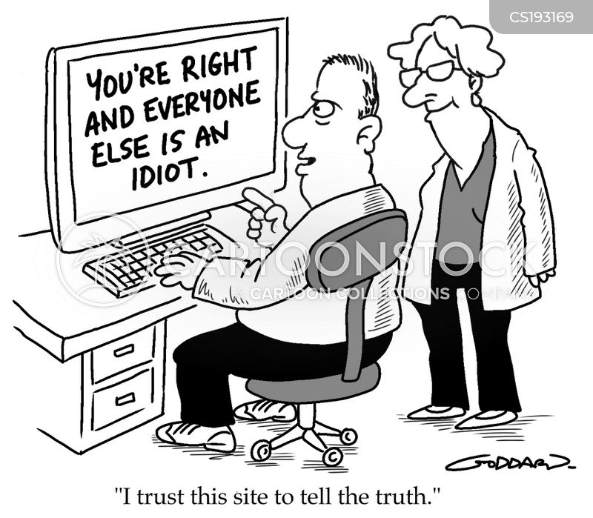

Slide 20
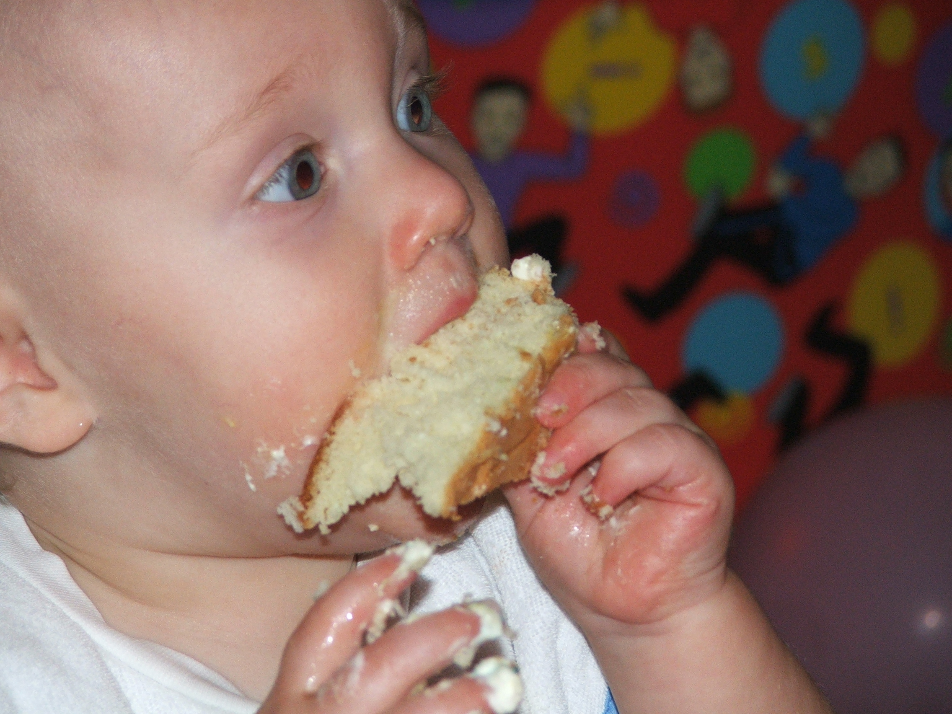
I need to Feed...

Slide 21
Keep it On Repeat

