Slide 1
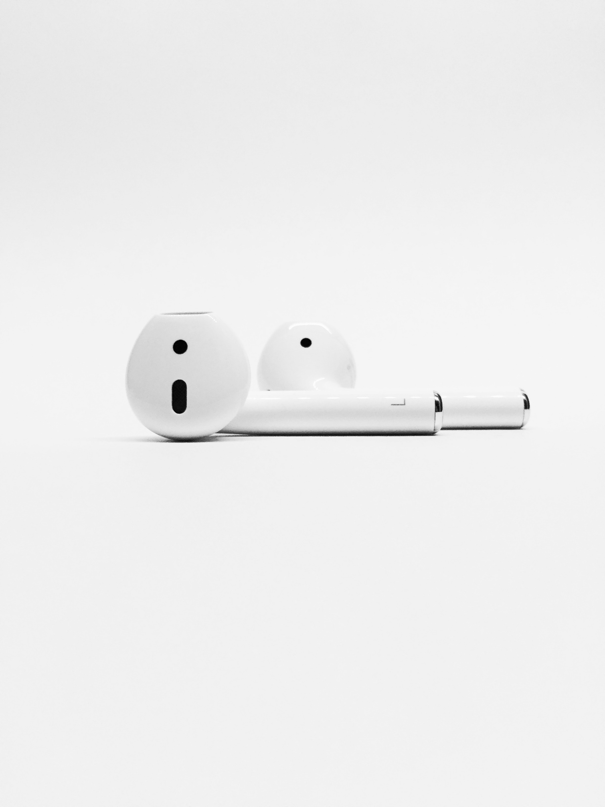
On Repeat

Slide 2
2 Peter 1:12 New Living Translation
Therefore, I will always remind you about these things—even though you already know them and are standing firm in the truth you have been taught.

Slide 3
We Are Saved by Grace

Slide 4
What is Grace?

Slide 5
Ephesians 2:8-10 New Living Translation
God saved you by his grace when you believed. And you can’t take credit for this; it is a gift from God. Salvation is not a reward for the good things we have done, so none of us can boast about it. For we are God’s masterpiece. He has created us anew in Christ Jesus, so we can do the good things he planned for us long ago.

Slide 6
Romans 11:5-6 New Living Translation
It is the same today, for a few of the people of Israel have remained faithful because of God’s grace—his undeserved kindness in choosing them. And since it is through God’s kindness, then it is not by their good works. For in that case, God’s grace would not be what it really is—free and undeserved.

Slide 7
vaccinates against pride
Salvation by grace...

Slide 8
Luke 18:9-14 New Living Translation
Then Jesus told this story to some who had great confidence in their own righteousness and scorned everyone else: “Two men went to the Temple to pray. One was a Pharisee, and the other was a despised tax collector. The Pharisee stood by himself and prayed this prayer:

Slide 9
Luke 18:9-14 New Living Translation
‘I thank you, God, that I am not like other people—cheaters, sinners, adulterers. I’m certainly not like that tax collector! I fast twice a week, and I give you a tenth of my income.’
“But the tax collector stood at a distance and dared not even lift his eyes to heaven as he prayed.

Slide 10
Luke 18:9-14 New Living Translation
Instead, he beat his chest in sorrow, saying, ‘O God, be merciful to me, for I am a sinner.’ I tell you, this sinner, not the Pharisee, returned home justified before God. For those who exalt themselves will be humbled, and those who humble themselves will be exalted.”

Slide 11
Romans 3:20 New Living Translation
For no one can ever be made right with God by doing what the law commands. The law simply shows us how sinful we are.

Slide 12
Ephesians 2:6-7 New Living Translation
For he raised us from the dead along with Christ and seated us with him in the heavenly realms because we are united with Christ Jesus. So God can point to us in all future ages as examples of the incredible wealth of his grace and kindness toward us, as shown in all he has done for us who are united with Christ Jesus.

Slide 13
James 4:6 New Living Translation
God opposes the proud, but gives grace to the humble.

Slide 14
vaccinates against fear
Salvation by grace...

Slide 15
Romans 3:22-24 New Living Translation
We are made right with God by placing our faith in Jesus Christ. And this is true for everyone who believes, no matter who we are.
For everyone has sinned; we all fall short of God’s glorious standard.

Slide 16
Romans 3:22-24 New Living Translation
Yet God, in his grace, freely makes us right in his sight. He did this through Christ Jesus when he freed us from the penalty for our sins.

Slide 17
Romans 5:8 New Living Translation
But God showed his great love for us by sending Christ to die for us while we were still sinners.

Slide 18
Keep it On Repeat

