Slide 1
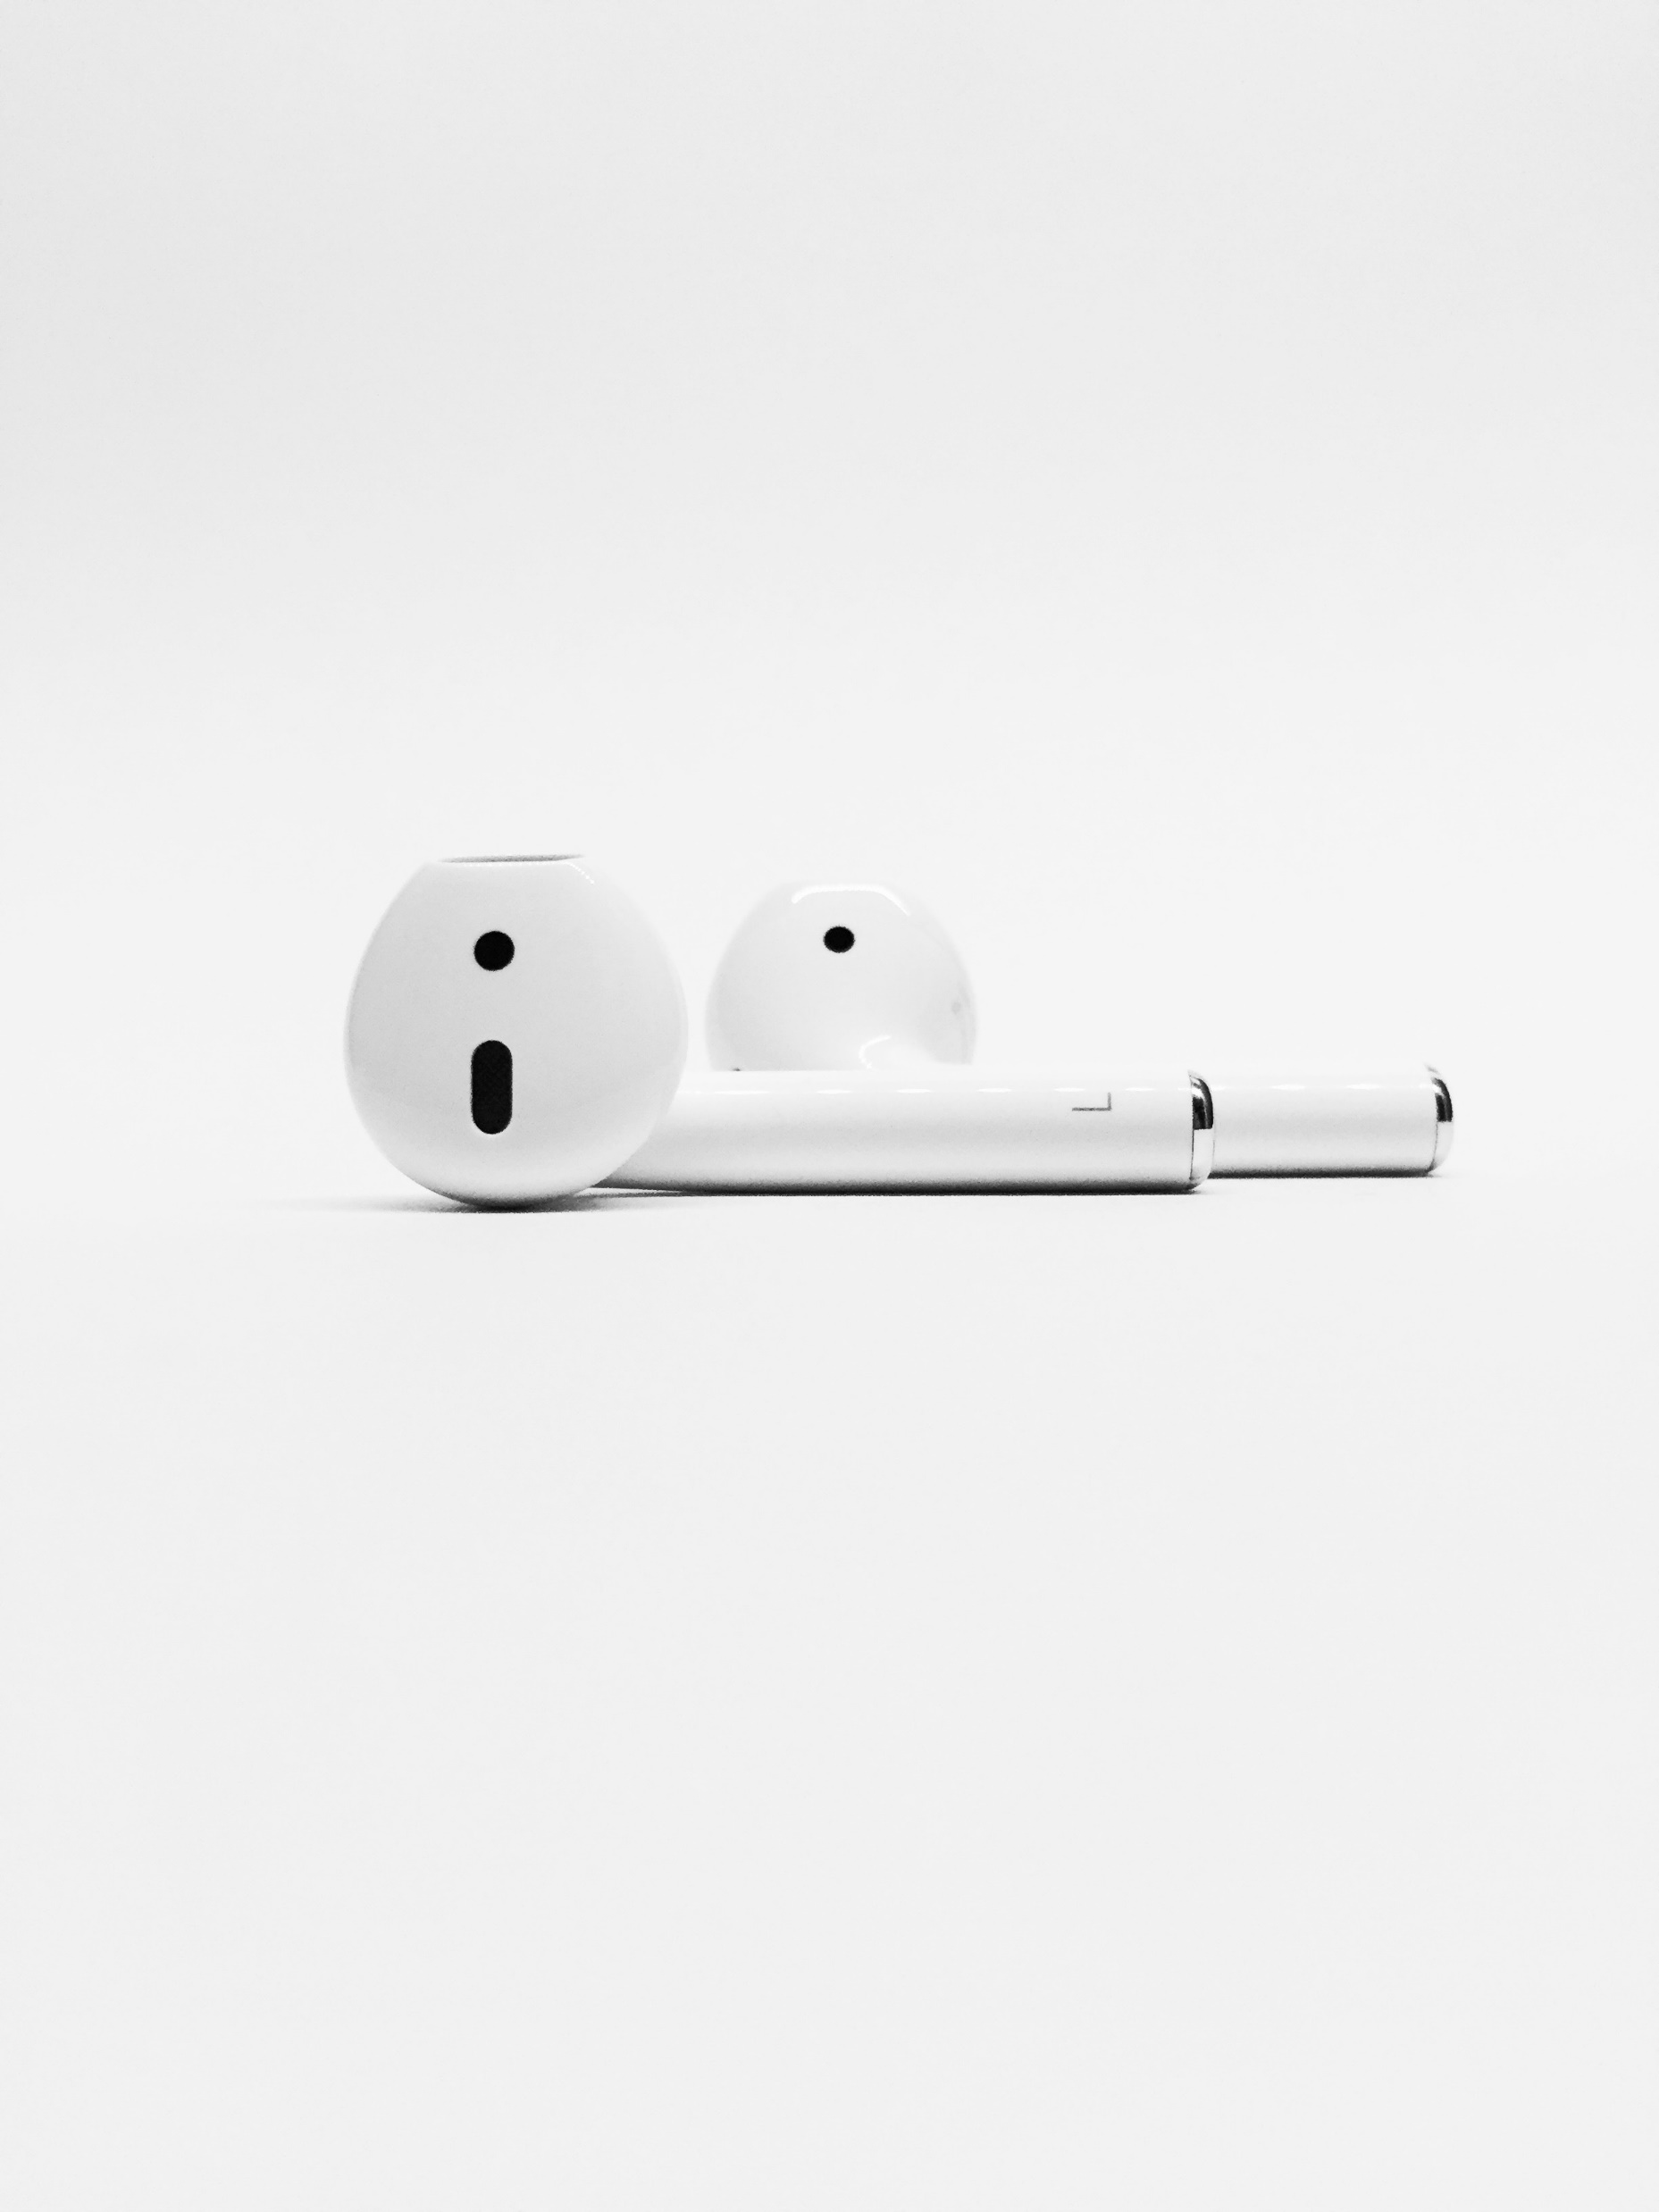
On Repeat

Slide 2
2 Peter 1:12 New Living Translation
Therefore, I will always remind you about these things—even though you already know them and are standing firm in the truth you have been taught.

Slide 3
God is Worthy of Worship

Slide 4
What is Worship

Slide 5
Romans 12:1 New Living Translation
And so, dear brothers and sisters, I plead with you to give your bodies to God because of all he has done for you. Let them be a living and holy sacrifice—the kind he will find acceptable. This is truly the way to worship him.

Slide 6
Isaiah 29:13 New Living Translation
“These people say they are mine. They honor me with their lips, but their hearts are far from me. And their worship of me is nothing but man-made rules learned by rote.

Slide 7
Because He is the Alpha and Omega
God is worthy of worship...

Slide 8
Revelation 1:8 New Living Translation
“I am the Alpha and the Omega—the beginning and the end,” says the Lord God. “I am the one who is, who always was, and who is still to come—the Almighty One.”

Slide 9
Philippians 2:9-11 New Living Translation
Therefore, God elevated him to the place of highest honor and gave him the name above all other names, that at the name of Jesus every knee should bow, in heaven and on earth and under the earth, and every tongue declare that Jesus Christ is Lord, to the glory of God the Father.

Slide 10
Because He is the Creator
God is worthy of worship...

Slide 11
Revelation 4:11 New International Version
“You are worthy, our Lord and God,
to receive glory and honor and power,
for you created all things,
and by your will they were created
and have their being.”

Slide 12
Because He is Lord
God is worthy of worship...

Slide 13
Psalm 96:8-9 New Living Translation
Give to the Lord the glory he deserves! Bring your offering and come into his courts. Worship the Lord in all his holy splendor. Let all the earth tremble before him.

Slide 14
Luke 4:8 New Living Translation
‘You must worship the Lord your God and serve only him.’

Slide 15
Because He is my Redeemer
God is worthy of worship...

Slide 16
Job 1:21 New International Version
“Naked I came from my mother’s womb, and naked I will depart. The Lord gave and the Lord has taken away; may the name of the Lord be praised.”

Slide 17
Keep it On Repeat

