Slide 1
God Coloured Glasses

Slide 2
OUR CALLING AS CHRISTIANS
Matthew 28:19
¹⁹ Therefore go and make disciples of all nations, baptizing them in the name of the Father and of the Son and of the Holy Spirit,

Slide 3


Slide 4
As a church we are given the challenge to love and pray for those people who are not on our favourites list:
The people we dislike intensely
Those who have wronged us
People who just seem evil

Slide 5
PASSIONATELY
GOD LOVES YOU

Slide 6
John 3:16
¹⁶ For God so loved the world that he gave his one and only Son, that whoever believes in him shall not perish but have eternal life.

Slide 7
God’s Passionate Love
Ephesians 3:18 – How long, wide, deep and high
Psalm 56:8 – God collects our tears
Luke 12:7 and Matthew 10:30 – He counts the hairs on our head

Slide 8
Matthew 22:37 - 39
Jesus replied: “‘Love the Lord your God with all your heart and with all your soul and with all your mind.’ This is the first and greatest commandment. And the second is like it: ‘Love your neighbor as yourself.

Slide 9
Matthew 5:44
⁴⁴ But I tell you, love your enemies and pray for those who persecute you,

Slide 10
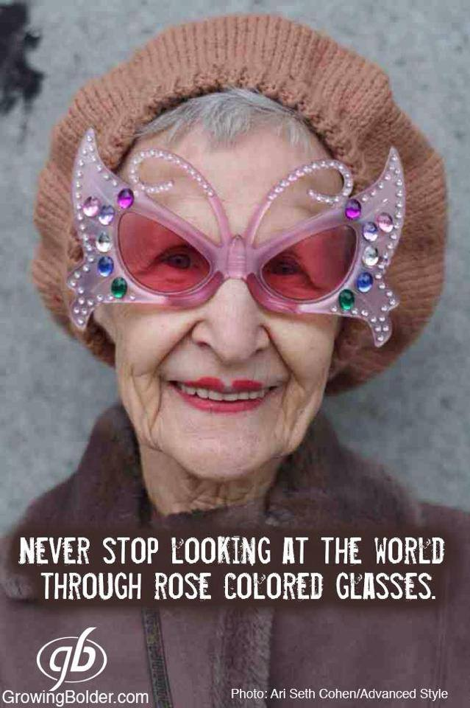

Slide 11


Slide 12
Matthew 5:44
⁴⁴ But I tell you, love your enemies and pray for those who persecute you,
He PASSIONATELY loves them and sent his son Jesus to die for them

Slide 13
GOD COLOURED GLASSES
What lens are you judging others through?
Who did Jesus keep company with?

Slide 14
PASSIONATELY
GOD LOVES YOU

