Slide 1
What’s Underpinning Your World?
Bethel CRC Church Whyalla 1st August 2021.

Slide 2
Underpinning... Foolish and Wise Foundations.
Matthew 7:24-27 24“Everyone then who hears these words of mine and does them will be like a wise man who built his house on the rock. 25And the rain fell, and the floods came, and the winds blew and beat on that house, but it did not fall, because it had been founded on the rock. 26And everyone who hears these words of mine and does not do them will be like a foolish man who built his house on the sand. 27And the rain fell, and the floods came, and the winds blew and beat against that house, and it fell, and great was the fall of it.”

Slide 3
So what’s your life built upon?
A Sure Foundation...
Isaiah 40:8 “The grass withers and the flowers fade, but the Word of God stands forever!”
My early childhood...

Slide 4
Some Key Verses...
Matt 4:4 But he answered, “It is written
“‘Man shall not live by bread alone, but by every word that comes from the mouth of God.’”
Ps 119:105 “Your word is a lamp to my feet and a light to my path.”

Slide 5
‘The Word’ in your life...
The Power of a ‘Prophetic Word’…
Matt 22:29 But Jesus answered them, “You are wrong, because you know neither the Scriptures nor the power of God.”

Slide 6
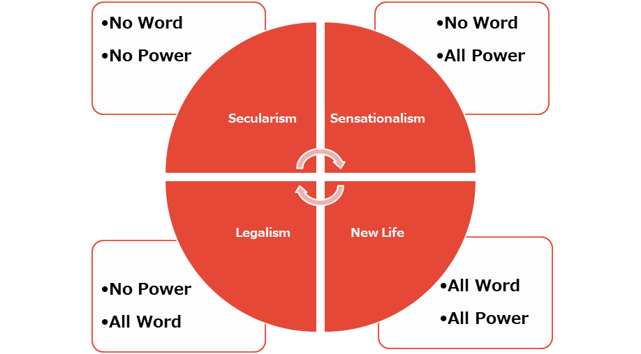
Bethel!

Slide 7
Renewing Your Mind… The ‘washing’ of the WORD!
“Our Internal Reality affects our External Reality.”

Slide 8
Jesus in Storms…
Mark 4:38-39 “Let us go across to the other side…”
³⁸ Jesus was in the stern, sleeping on a cushion. The disciples woke him and said to him, “Teacher, don’t you care if we drown?”
³⁹ He got up, rebuked the wind and said to the waves, “Quiet! Be still!” Then the wind died down and it was completely calm.

Slide 9
Mark 6:50-52 Jesus’ and Disciples…
Jesus spoke to them and said, “Take courage! It is I. Don’t be afraid.” 51 Then he climbed into the boat with them, and the wind died down. They were completely amazed, 52 for they had not understood, (because) …their hearts were hardened.
Eph 4:18 You are darkened in your understanding and separated from the life of God because of the ignorance that is in you due to the hardening of your hearts.

Slide 10
Renewing Your Mind!
The Key Issue… ‘Hardening of Hearts’!

Slide 11
‘Transformed Minds’ through ‘Softened Hearts’...
Rom 12:2 “Be transformed by the renewing of your mind…”
Matt 4:4 But he answered, “It is written, “‘Man shall not live by bread alone, but by every word that comes from the mouth of God.’”
Ps 119:105 “Your word is a lamp to my feet and a light to my path.”

Slide 12
Believe the WORD not the Circumstances!
The Faith of the Centurion for his ‘Paralyzed servant’... Matt 8:8 “…just speak the Word”!
2 Timothy 3:14 “But as for you, continue in what you have learned and have firmly believed.”

Slide 13
Living by the Truth and not just the Facts!
“Don’t say you can’t when God says you can!”
The Twelve Spies... Numbers 13-14 ‘Grasshoppers or Giants’?!
Lu 18:27 “What is impossible with Men, is possible with God’!

Slide 14
Underpinning... What’s shaping your opinions?
FOCUS ON ‘THE WORD’!
Heb 4:12 (MSG) “God means what he says. What he says goes. His powerful Word is sharp as a surgeon’s scalpel, cutting through everything, whether doubt or defence, laying us open to listen and obey. Nothing and no one is impervious to God’s Word. We can’t get away from it—no matter what.”
2 Tim 2:9 “...God’s Word is not chained”!

Slide 15
Softening our Hearts… Renewing Your Mind!
Underpinned by ‘THE WORD”!

