Slide 1
Faith That Works
(when life doesn’t)

Slide 2
week 4:
Faith That anchors me in storms

Slide 4
Matthew 7:24-27
New Living Translation
“Anyone who listens to my teaching and follows it is wise, like a person who builds a house on solid rock. Though the rain comes in torrents and the floodwaters rise and the winds beat against that house, it won’t collapse because it is built on bedrock. But anyone who hears my teaching and doesn’t obey it is foolish, like a person who builds a house on sand.

Slide 5
Matthew 7:24-27
New Living Translation
When the rains and floods come and the winds beat against that house, it will collapse with a mighty crash.”

Slide 6
Hebrews 6:19
New Living Translation
This hope is a strong and trustworthy anchor for our souls.

Slide 7
Psalm 119:81
New Living Translation
I am worn out waiting for your rescue, but I have put my hope in your word.

Slide 8
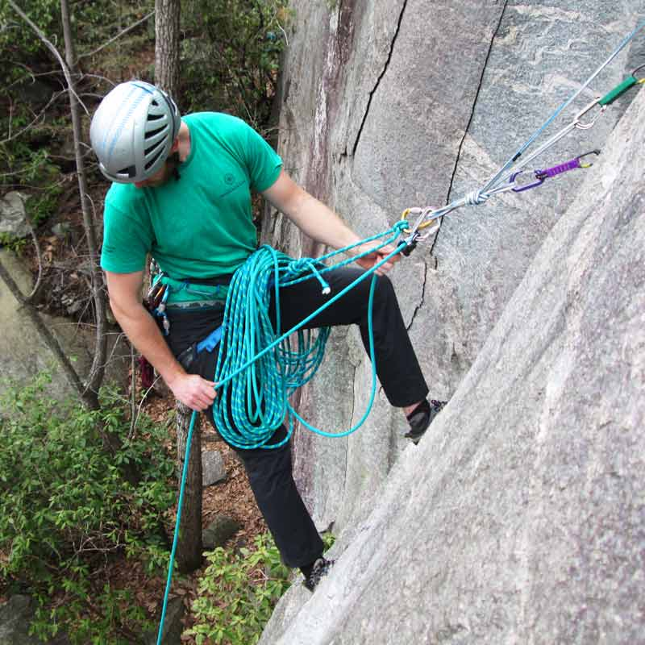
How do I anchor my life to the Rock of God’s Word?

Slide 9
1. Treat God’s Word as a precious gift to me

Slide 10
Isaiah 59:21
New Living Translation
“And this is my covenant with them,” says the Lord. “My Spirit will not leave them, and neither will these words I have given you. They will be on your lips and on the lips of your children and your children’s children forever. I, the Lord, have spoken!

Slide 11
James 1:17-18
New Living Translation
Whatever is good and perfect is a gift coming down to us from God our Father, who created all the lights in the heavens. He never changes or casts a shifting shadow. He chose to give birth to us by giving us his true word. And we, out of all creation, became his prized possession.

Slide 12
1. God’s Word is Good

Slide 13
2. God’s Word is Perfect

Slide 14
3. God’s Word is True

Slide 15
4. God’s Word is Unchanging

Slide 16
5. God’s Word is Life-Giving

Slide 17
Romans 15:4
New Living Translation
Such things were written in the Scriptures long ago to teach us. And the Scriptures give us hope and encouragement as we wait patiently for God’s promises to be fulfilled.

Slide 18
2. Humbly accept whatever God says

Slide 19
James 1:21
New Living Translation
So get rid of all the filth and evil in your lives, and humbly accept the word God has planted in your hearts, for it has the power to save your souls.

Slide 21
3. Study it and then do what it says

Slide 22
James 1:22-25
New Living Translation
Do not merely listen to the word, and so deceive yourselves. Do what it says. Anyone who listens to the word but does not do what it says is like someone who looks at his face in a mirror and, after looking at himself, goes away and immediately forgets what he looks like.

Slide 23
James 1:22-25
New Living Translation
But whoever looks intently into the perfect law that gives freedom, and continues in it—not forgetting what they have heard, but doing it—they will be blessed in what they do.

Slide 24
God blesses those who...
Listen to the word

Slide 25
God blesses those who...
Listen to the word
Study the word

Slide 26
God blesses those who...
Listen to the word
Study the word
Make it a habit

Slide 27
God blesses those who...
Listen to the word
Study the word
Make it a habit
Memorise the word

Slide 28
God blesses those who...
Listen to the word
Study the word
Make it a habit
Memorise the word
Do what it says

Slide 29
Proverbs 30:24, 26
New Living Translation
There are four things on earth that are small but unusually wise:
----
Hyraxes —they aren’t powerful, but they make their homes among the rocks.

