Slide 1
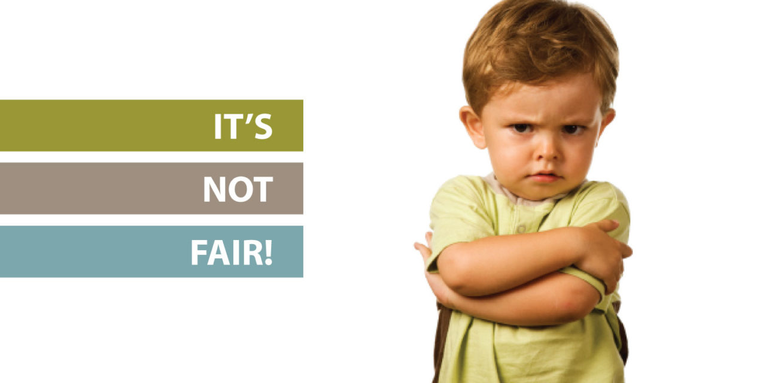

Slide 3
Matthew 20:1-16 New Living Translation
“For the Kingdom of Heaven is like the landowner who went out early one morning to hire workers for his vineyard. ² He agreed to pay the normal daily wage and sent them out to work. ³ “At nine o’clock in the morning he was passing through the marketplace and saw some people standing around doing nothing.

Slide 4
Matthew 20:1-16 New Living Translation
⁴ So he hired them, telling them he would pay them whatever was right at the end of the day. ⁵ So they went to work in the vineyard. At noon and again at three o’clock he did the same thing. ⁶ “At five o’clock that afternoon he was in town again and saw some more people standing around. He asked them, ‘Why haven’t you been
working today?’
⁷ “They replied, ‘Because no one hired us.’

Slide 5
Matthew 20:1-16 New Living Translation
“The landowner told them, ‘Then go out and join the others in my vineyard.’
⁸ “That evening he told the foreman to call the workers in and pay them, beginning with the last workers first. ⁹ When those hired at five o’clock were paid, each received a full day’s wage. ¹⁰ When those hired first
came to get their pay, they assumed they would
receive more. But they, too, were paid a day’s wage.

Slide 6
Matthew 20:1-16 New Living Translation
¹¹ When they received their pay, they protested to the owner, ¹² ‘Those people worked only one hour, and yet you’ve paid them just as much as you paid us who worked all day in the scorching heat.’ ¹³ “He answered one of them, ‘Friend, I haven’t been unfair! Didn’t you agree to work all day for the usual wage?

Slide 7
Matthew 20:1-16 New Living Translation
¹⁴ Take your money and go. I wanted to pay this last worker the same as you. ¹⁵ Is it against the law for me to do what I want with my money? Should you be jealous because I am kind to others?’ ¹⁶ “So those who are last now will be first then, and those who are first will be
last.”

Slide 8
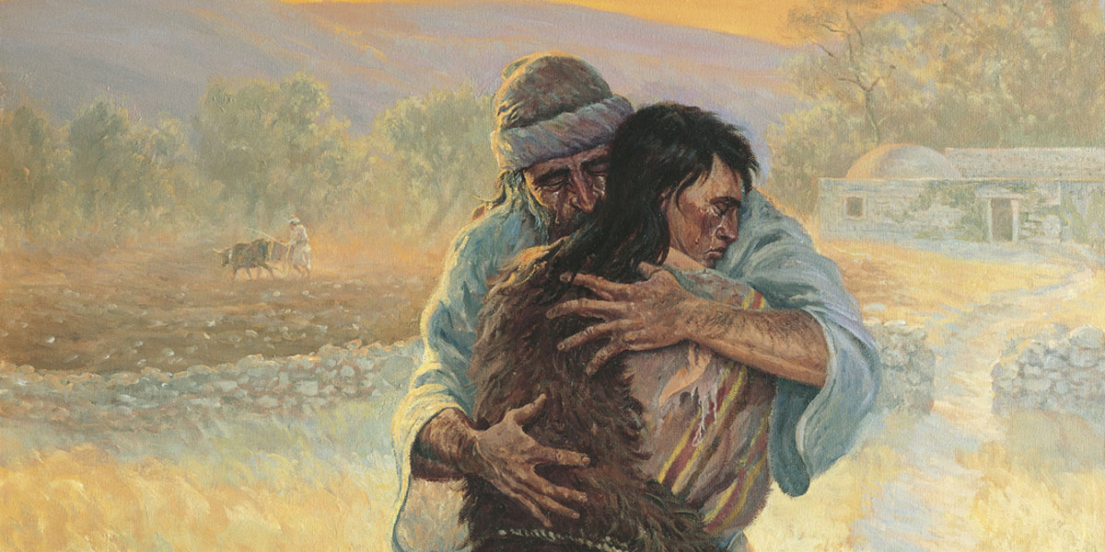
The
Prodigal
Son

Slide 9
Jonah 4:1-3 New Living Translation
This change of plans greatly upset Jonah, and he became very angry. So he complained to the Lord about it: “Didn’t I say before I left home that you would do this, Lord? That is why I ran away to Tarshish! I knew that you are a merciful and compassionate God, slow to get angry and filled with unfailing love. You are eager to turn back from destroying people.
Just kill me now, Lord! I’d rather be dead than alive if
what I predicted will not happen.”

Slide 10
Romans 6:1-2 New Living Translation
Well then, should we keep on sinning so that God can show us more and more kindness and forgiveness? Of course not! Since we have died to sin, how can we continue to live in it?

Slide 11
Romans 6:1-2 New Living Translation
"Two men owed money to a certain moneylender. One owed him five hundred denarii, and the other fifty. Neither of them had the money to pay him back, so he cancelled the debts of both. Now which of them will love him more?" Simon replied, "I suppose the one who
had the bigger debt cancelled." "You have judged
correctly," Jesus said. …

