Slide 1
Highly
FAVOURED

Slide 2
In the sixth month of Elizabeth’s pregnancy, God sent the angel Gabriel to Nazareth, a town in Galilee, to a virgin pledged to be married to a man named Joseph, a descendant of David. The virgin’s name was Mary.
LUKE 1:26-28

Slide 3
The angel went to her and said, “Greetings, you who are highly favoured! The Lord is with you.”
LUKE 1:26-28

Slide 4
1. Does God Have Favourites?

Slide 5
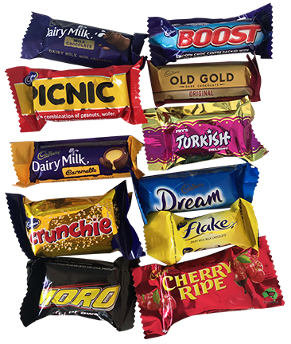

Slide 6
But Noah found favour in the eyes of the Lord.
GENESIS 6:8

Slide 7
The Lord said to Moses, “I will do this thing also that you have requested, for you have found favour in my sight, and I know you by name.”
EXODUS 33:17

Slide 8
“David found favour with God and asked for the privilege of building a permanent Temple for the God of Jacob.
ACTS 7:46

Slide 9
Now God had caused the official to show favour and compassion to Daniel…
DANIEL 1:9

Slide 10
2. What is Favour?

Slide 11
“Don’t be afraid, Mary,” the angel told her, “for you have found favour with God!
LUKE 1:30

Slide 12
For out of His fullness [the superabundance of His grace and truth] we have all received grace upon grace [spiritual blessing upon spiritual blessing, favour upon favour, and gift heaped upon gift].
JOHN 1:16

Slide 13
God saved you by his grace when you believed.
EPHESIANS 2:8

Slide 14
3. What is Faith?

Slide 15
Mary responded, “I am the Lord’s servant. May everything you have said about me come true.” And then the angel left her.
LUKE 1:38

Slide 16
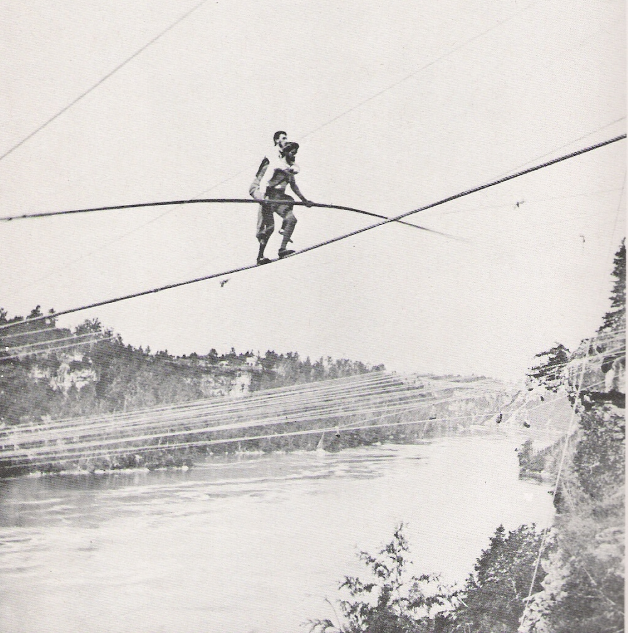

Slide 17
Highly
FAVOURED

