Slide 1
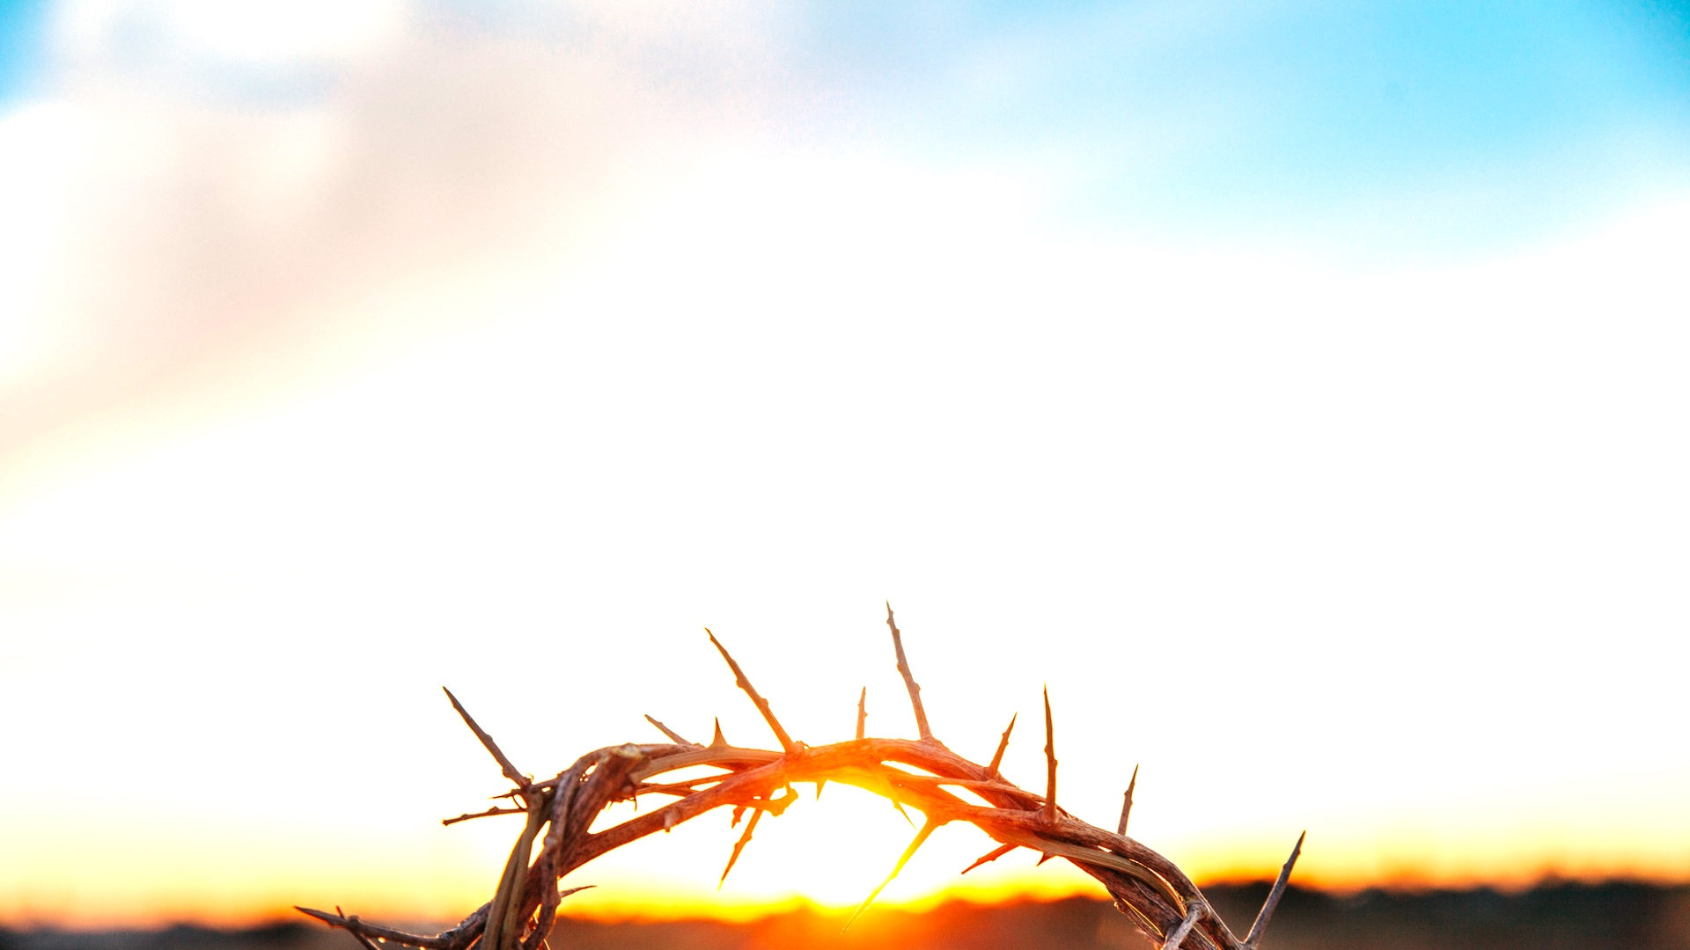
for the WIN

Slide 2
Week 7: God is With Us

Slide 3
Matthew 1:18-23 New Living Translation
¹⁸ This is how Jesus the Messiah was born. His mother, Mary, was engaged to be married to Joseph. But before the marriage took place, while she was still a virgin, she became pregnant through the power of the Holy Spirit. ¹⁹ Joseph, to whom she was engaged, was a righteous man and did not want to disgrace her publicly, so he decided to break the engagement quietly.

Slide 4
Matthew 1:18-23 New Living Translation
²⁰ As he considered this, an angel of the Lord appeared to him in a dream. “Joseph, son of David,” the angel said, “do not be afraid to take Mary as your wife. For the child within her was conceived by the Holy Spirit. ²¹ And she will have a son, and you are to name him Jesus, for he will save his people from their sins.”

Slide 5
Matthew 1:18-23 New Living Translation
²² All of this occurred to fulfill the Lord’s message through his prophet:
²³ “Look! The virgin will conceive a child! She will give birth to a son, and they will call him Immanuel, which means ‘God is with us.’”

Slide 6
God has always wanted to be Present with His People

Slide 7
Judges 6:11-12 New Living Translation
¹¹ Then the angel of the Lord came and sat beneath the great tree at Ophrah, which belonged to Joash of the clan of Abiezer. Gideon son of Joash was threshing wheat at the bottom of a winepress to hide the grain from the Midianites. ¹² The angel of the Lord appeared to him and said, “Mighty hero, the Lord is with you!”

Slide 8
Joshua 1:9 New Living Translation
⁹ This is my command—be strong and courageous! Do not be afraid or discouraged. For the Lord your God is with you wherever you go.”

Slide 9
3 Ways God’s Presence Gives us Victory:
You are not alone

Slide 10
Hebrews 13:5 New Living Translation
Don’t love money; be satisfied with what you have. For God has said,
“I will never fail you. I will never abandon you.”

Slide 11
Matthew 28:20b New Living Translation
“… And be sure of this: I am with you always, even to the end of the age.”

Slide 12
Romans 8:38a New Living Translation
And I am convinced that nothing can ever separate us from God’s love.

Slide 13
3 Ways God’s Presence Gives us Victory:
You are not alone
God sees what you’re going through

Slide 14
Mark 6:45-48a New Living Translation
⁴⁵ Immediately after this, Jesus insisted that his disciples get back into the boat and head across the lake to Bethsaida, while he sent the people home. ⁴⁶ After telling everyone good-bye, he went up into the hills by himself to pray.

Slide 15
Mark 6:45-48a New Living Translation
⁴⁷ Late that night, the disciples were in their boat in the middle of the lake, and Jesus was alone on land. ⁴⁸ He saw that they were in serious trouble, rowing hard and struggling against the wind and waves.

Slide 16
3 Ways God’s Presence Gives us Victory:
You are not alone
God sees what you’re going through
You have everything you need

Slide 17
2 Peter 1:3 New Living Translation
By his divine power, God has given us everything we need for living a godly life. We have received all of this by coming to know him, the one who called us to himself by means of his marvellous glory and excellence.

