Slide 1
for the WIN

Slide 2
Week 3: The Battle Begins in Your Mind

Slide 3
2 Corinthians 10:4-5 New International Version
⁴ The weapons we fight with are not the weapons of the world. On the contrary, they have divine power to demolish strongholds. ⁵ We demolish arguments and every pretension that sets itself up against the knowledge of God, and we take captive every thought to make it obedient to Christ.

Slide 4
1. Believing Lies Leads Us Into Slavery

Slide 5
John 8:44b New International Version
When he lies, he speaks his native language, for he is a liar and the father of lies.

Slide 6
2. Discovering God’s Truth Sets Us Free

Slide 7
John 8:31-32 New Living Translation
Jesus said to the people who believed in him, “You are truly my disciples if you remain faithful to my teachings. And you will know the truth, and the truth will set you free.”

Slide 8
3. Renewing Our Minds Leads Us Into God’s Good Plan

Slide 9
Romans 12:2 New Living Translation
Don’t copy the behavior and customs of this world, but let God transform you into a new person by changing the way you think. Then you will learn to know God’s will for you, which is good and pleasing and perfect.

Slide 10
1. Follow the example of Jesus

Slide 11
2. Fill Your Mind With Better Thoughts

Slide 14
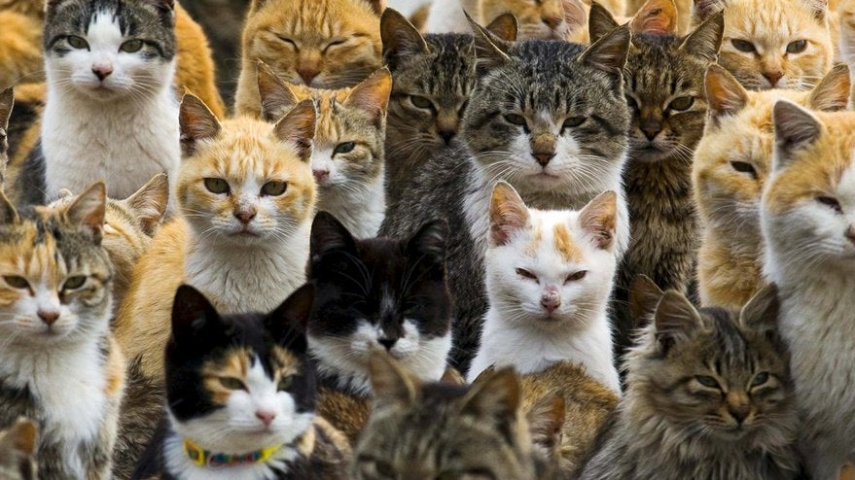
Stop Thinking About
CATS!

Slide 15
Philippians 4:8 New Living Translation
And now, dear brothers and sisters, one final thing. Fix your thoughts on what is true, and honorable, and right, and pure, and lovely, and admirable. Think about things that are excellent and worthy of praise.

Slide 16
3. Fill Your Mind With Better Thoughts

