Slide 1
for the WIN

Slide 2
Week 3: Getting Dressed for Battle

Slide 3
Ephesians 6:13-17 New Living Translation
¹³ Therefore, put on every piece of God’s armor so you will be able to resist the enemy in the time of evil. Then after the battle you will still be standing firm. ¹⁴ Stand your ground, putting on the belt of truth and the body armor of God’s righteousness. ¹⁵ For shoes, put on the peace that comes from the Good News so that you will be fully prepared.

Slide 4
Ephesians 6:13-17 New Living Translation
¹⁶ In addition to all of these, hold up the shield of faith to stop the fiery arrows of the devil. ¹⁷ Put on salvation as your helmet, and take the sword of the Spirit, which is the word of God.

Slide 5
Ephesians 6:18 New Living Translation
¹⁸ Pray in the Spirit at all times and on every occasion. Stay alert and be persistent in your prayers for all believers everywhere.

Slide 6
The Belt of Truth

Slide 7
The Breastplate of Righteousness

Slide 8
Philippians 3:9 New Living Translation
I no longer count on my own righteousness through obeying the law; rather, I become righteous through faith in Christ. For God’s way of making us right with himself depends on faith.

Slide 9
Shoes of “Peace that Comes from the Gospel”

Slide 10
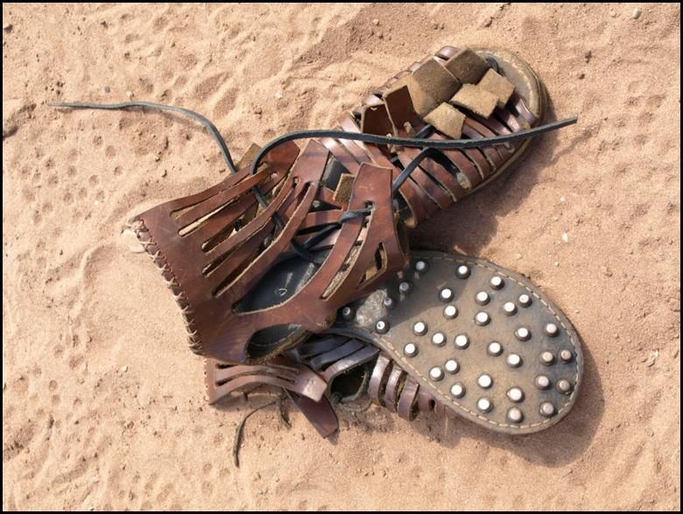

Slide 11
The Shield of Faith

Slide 12
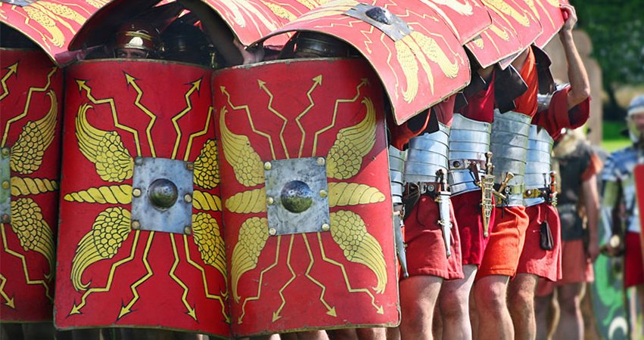

Slide 13
The Helmet of Salvation

Slide 14
The Sword of the Spirit

Slide 15
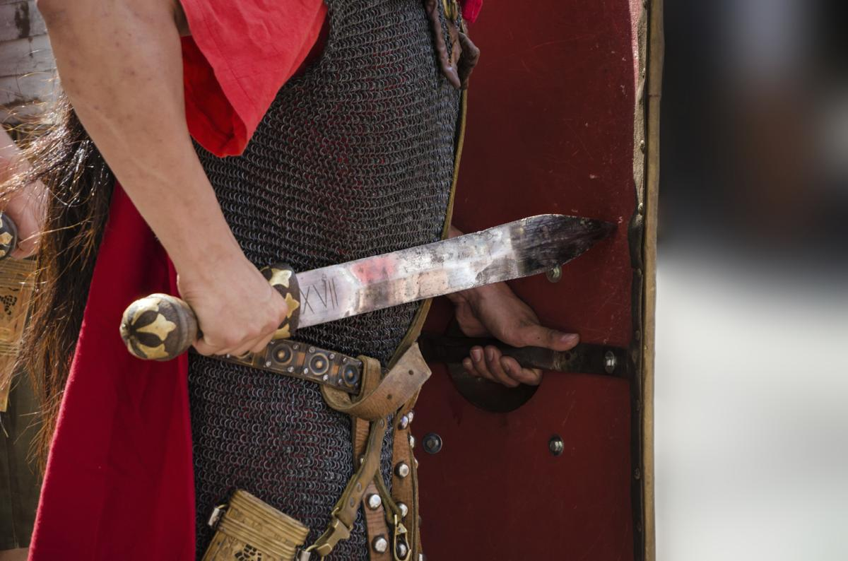

Slide 16
Luke 12:11-12 New Living Translation
¹¹ “And when you are brought to trial in the synagogues and before rulers and authorities, don’t worry about how to defend yourself or what to say, ¹² for the Holy Spirit will teach you at that time what needs to be said.”

Slide 17
Hebrews 4:12 New Living Translation
¹² For the word of God is alive and powerful. It is sharper than the sharpest two-edged sword, cutting between soul and spirit, between joint and marrow. It exposes our innermost thoughts and desires.

