Slide 1
for the WIN

Slide 2
Week 2: Open Your Eyes to the Unseen World

Slide 3
1. There is a Spiritual Realm All Around Us

Slide 4
Ephesians 6:10-12 New Living Translation
Be strong in the Lord and in his mighty power. Put on all of God’s armor so that you will be able to stand firm against all strategies of the devil. For we are not fighting against flesh-and-blood enemies, but against evil rulers and authorities of the unseen world, against mighty powers in this dark world, and against evil spirits in the heavenly places.

Slide 5
1 Peter 5:8 New Living Translation
Stay alert! Watch out for your great enemy, the devil. He prowls around like a roaring lion, looking for someone to devour.

Slide 6
Ephesians 1:3 New Living Translation
Praise be to the God and Father of our Lord Jesus Christ, who has blessed us in the heavenly realms with every spiritual blessing in Christ.

Slide 7
2. The Spiritual World Will Influence Us

Slide 8
3. The Victory is Found in our Relationship with Jesus

Slide 9
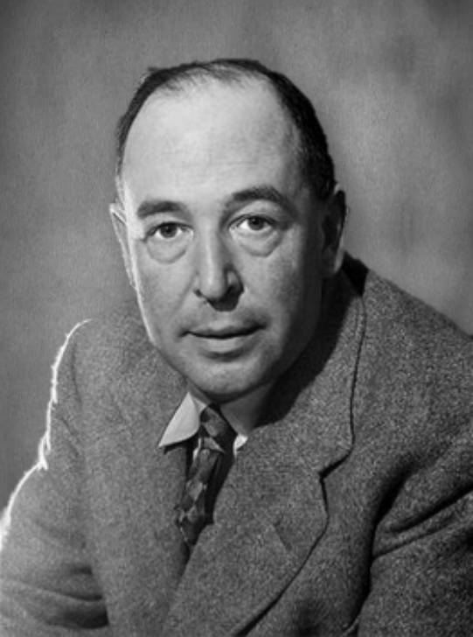
C. S. LEWIS
“There are two equal and opposite errors into which our race can fall about the devils. One is to disbelieve in their existence. The other is to believe, and to feel an excessive and unhealthy interest in them.”

Slide 10
Luke 10:17-20 New Living Translation
¹⁷ When the seventy-two disciples returned, they joyfully reported to him, “Lord, even the demons obey us when we use your name!” ¹⁸ “Yes,” he told them, “I saw Satan fall from heaven like lightning! ¹⁹ Look, I have given you authority over all the power of the enemy, and you can walk among snakes and scorpions and crush them.

Slide 11
Luke 10:17-20 New Living Translation
Nothing will injure you. ²⁰ But don’t rejoice because evil spirits obey you; rejoice because your names are registered in heaven.”

Slide 12
Hebrews 12:1-2 New Living Translation
And let us run with endurance the race God has set before us. ² We do this by keeping our eyes on Jesus, the champion who initiates and perfects our faith.

Slide 13
Colossians 3:1-2 New Living Translation
Since, then, you have been raised with Christ, set your hearts on things above, where Christ is, seated at the right hand of God. ² Set your minds on things above, not on earthly things.

Slide 14
1 John 4:4 New Living Translation
You belong to God, my dear children. You have already won a victory over those people, because the Spirit who lives in you is greater than the spirit who lives in the world.

