Slide 4
1 Thessalonians 5:18
New Living Translation
Be thankful in all circumstances, for this is God’s will for you who belong to Christ Jesus.

Slide 5
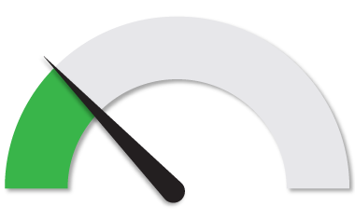
Beginner Level

Slide 6
Luke 17:11-19
New Living Translation
¹¹ As Jesus continued on toward Jerusalem, he reached the border between Galilee and Samaria. ¹² As he entered a village there, ten men with leprosy stood at a distance, ¹³ crying out, “Jesus, Master, have mercy on us!” ¹⁴ He looked at them and said, “Go show yourselves to the priests.” And as they went, they were cleansed of their leprosy.

Slide 7
Luke 17:11-19
New Living Translation
¹⁵ One of them, when he saw that he was healed, came back to Jesus, shouting, “Praise God!” ¹⁶ He fell to the ground at Jesus’ feet, thanking him for what he had done. This man was a Samaritan.
¹⁷ Jesus asked, “Didn’t I heal ten men? Where are the other nine? ¹⁸ Has no one returned to give glory to God except this foreigner?” ¹⁹ And Jesus said to the man, “Stand up and go. Your faith has healed you.”

Slide 8
Psalm 103:1-5
New Living Translation
¹ Let all that I am praise the Lord; with my whole heart, I will praise his holy name. ² Let all that I am praise the Lord; may I never forget the good things he does for me. ³ He forgives all my sins and heals all my diseases.

Slide 9
Psalm 103:1-5
New Living Translation
⁴ He redeems me from death and crowns me with love and tender mercies. ⁵ He fills my life with good things. My youth is renewed like the eagle’s!

Slide 10
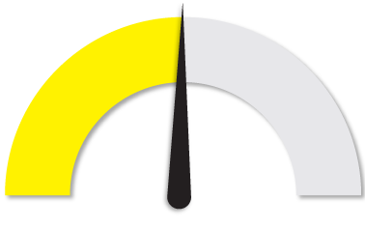
Intermediate Level

Slide 11
Psalm 3:3
New Living Translation
But you, O Lord, are a shield around me; you are my glory, the one who holds my head high.

Slide 12
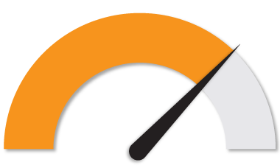
Advanced Level

Slide 13
1 Thessalonians 5:18
New Living Translation
Be thankful in all circumstances, for this is God’s will for you who belong to Christ Jesus.

Slide 14
