Slide 2
Giving Honour
…where honour is due…

Slide 3
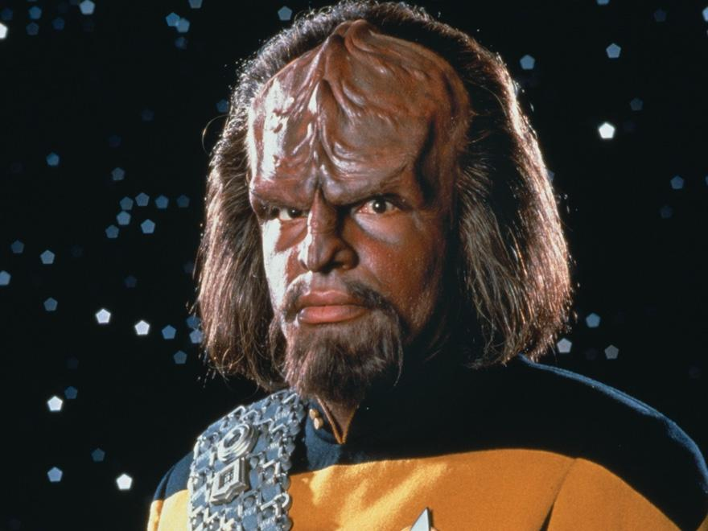
Worf
(Michael Dorn)

Slide 5
Timao (v) (Greek)
To Prize, to fix a value on.

Slide 6
This fulfilled the prophecy of Jeremiah that says,
“They took the thirty pieces of silver—the price at which he was valued by the people of Israel, and purchased the potter’s field, as the Lord directed.
Matthew 27:9-10
New Living Translation

Slide 7
‘These people honor me with their lips, but their hearts are far from me.
Their worship is a farce, for they teach man-made ideas as commands from God.’ ”
Matthew 15:8-9
New Living Translation

Slide 8
Don’t you realize that your body is the temple of the Holy Spirit, who lives in you and was given to you by God? You do not belong to yourself, for God bought you with a high price. So you must honor God with your body.
1 Corinthians 6:19-20
New Living Translation

Slide 9
Glorify God with all your wealth, honoring him with your very best, with every increase that comes to you.
Proverbs 3:9
The Passion Translation

Slide 10
Be careful to live properly among your unbelieving neighbors. Then even if they accuse you of doing wrong, they will see your honorable behavior, and they will give honor to God when he judges the world.
1 Peter 2:12
New Living Translation

Slide 11
Anyone who wants to serve me must follow me, because my servants must be where I am. And the Father will honor anyone who serves me.
John 12:26
New Living Translation

Slide 12
For the Lord’s sake, submit to all human authority—whether the king as head of state, or the officials he has appointed.
1 Peter 2:13-14a
New Living Translation

Slide 13
Be devoted to one another in love. Honor one another above yourselves.
Romans 12:10
New Living Translation

Slide 14
Recognize the value of every person and continually show love to every believer. Live your lives with great reverence and in holy awe of God. Honor your rulers.
1 Peter 2:17
The Passion Translation

