Slide 3
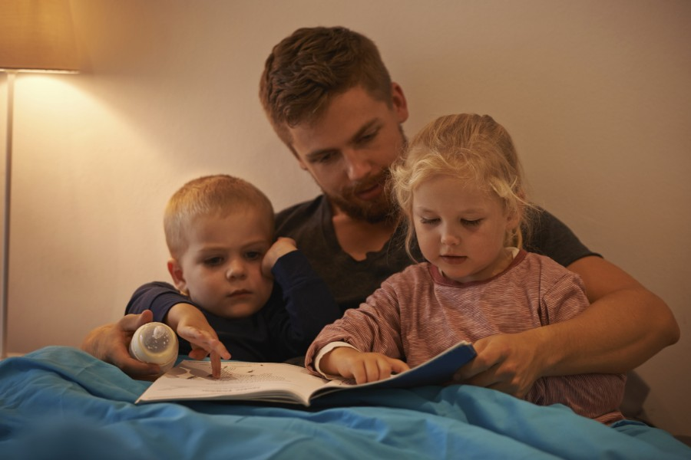

Slide 4
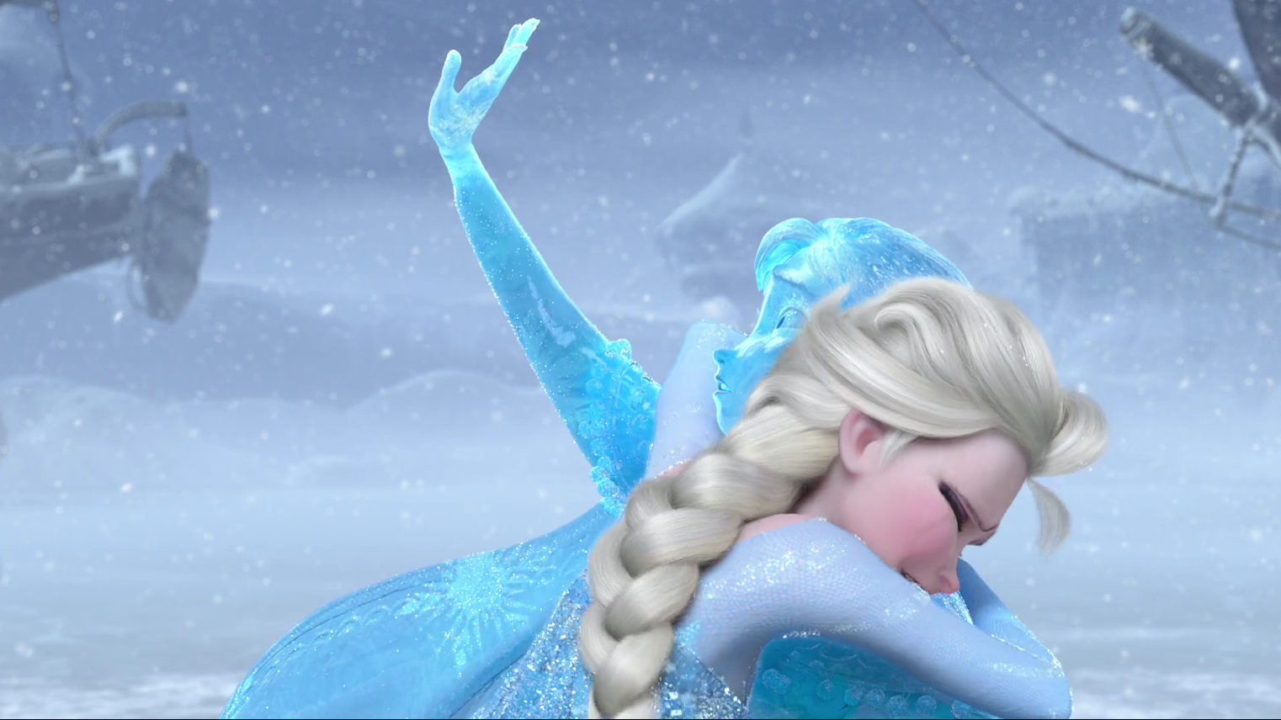

Slide 5
Words of
affirmation

Slide 6
The Father’s
Love Letter

Slide 7
quality
time

Slide 8
1 Thessalonians 5:17
New Living Translation
Never stop praying.

Slide 9
Psalm 121:3-4
New Living Translation
³ He will not let you stumble; the one who watches over you will not slumber. ⁴ Indeed, he who watches over Israel never slumbers or sleeps.

Slide 10
giving
gifts

Slide 11
James 1:17
New Living Translation
Whatever is good and perfect is a gift coming down to us from God our Father…

Slide 12
Luke 11:11-13
New Living Translation
¹¹ “You fathers—if your children ask for a fish, do you give them a snake instead? ¹² Or if they ask for an egg, do you give them a scorpion? Of course not! ¹³ So if you sinful people know how to give good gifts to your children, how much more will your heavenly Father give the Holy Spirit to those who ask him.”

Slide 13
Philippians 4:19
New Living Translation
And this same God who takes care of me will supply all your needs from his glorious riches, which have been given to us in Christ Jesus.

Slide 14
acts of
service

Slide 15
John 13:1
New Living Translation
Before the Passover celebration, Jesus knew that his hour had come to leave this world and return to his Father. He had loved his disciples during his ministry on earth, and now he loved them to the very end.

Slide 16
Philippians 2:6-8
New Living Translation
⁶ He existed in the form of God, yet he gave no thought to seizing equality with God as his supreme prize. ⁷ Instead he emptied himself of his outward glory by reducing himself to the form of a lowly servant. He became human! ⁸ He humbled himself and became vulnerable, choosing to be revealed as a man and was obedient. He was a perfect example, even in his death—a criminal’s death by crucifixion!

Slide 17
physical
touch

Slide 18
Matthew 8:1-3
New Living Translation
¹ Large crowds followed Jesus as he came down the mountainside. ² Suddenly, a man with leprosy approached him and knelt before him. “Lord,” the man said, “if you are willing, you can heal me and make me clean.” ³ Jesus reached out and touched him. “I am willing,” he said. “Be healed!” And instantly the leprosy disappeared.

