Slide 1
Who, Me?

Slide 2
1 Corinthians 14:26 The Passion Translation
Beloved friends, what does all this imply? When you conduct your meetings, you should always let everything be done to build up the church family. Whether you share a song of praise, a teaching, a divine revelation, or a tongue and interpretation, let each one contribute what strengthens others.

Slide 3
Philippians 2:3-4 New International Version
³ Instead of being motivated by selfish ambition or vanity, each of you should, in humility, be moved to treat one another as more important than yourself. ⁴ Each of you should be concerned not only about your own interests, but about the interests of others as well.

Slide 4
Hebrews 10:25 New Living Translation
And let us not neglect our meeting together, as some people do, but encourage one another, especially now that the day of his return is drawing near.

Slide 5
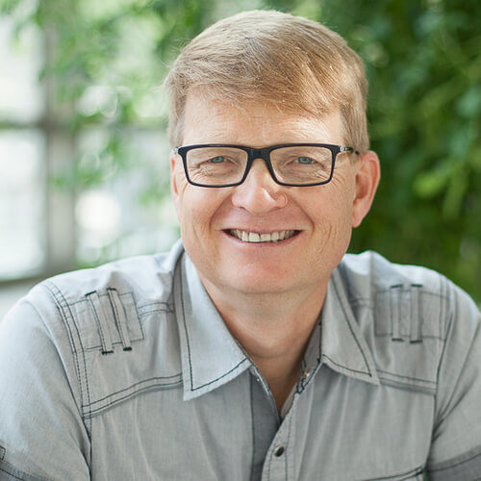
CONSUMER CONTRIBUTOR
Carey Nieuwhof

