Slide 1
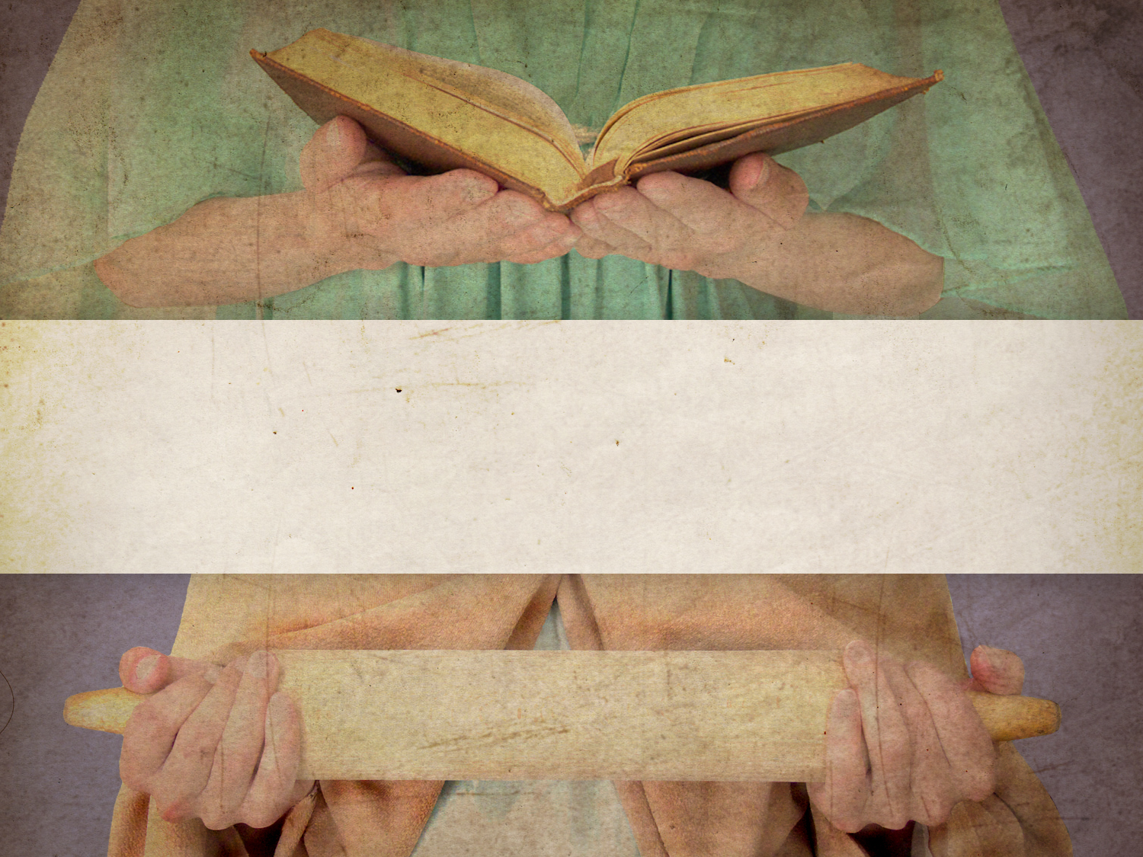
Mary & Martha

Slide 2
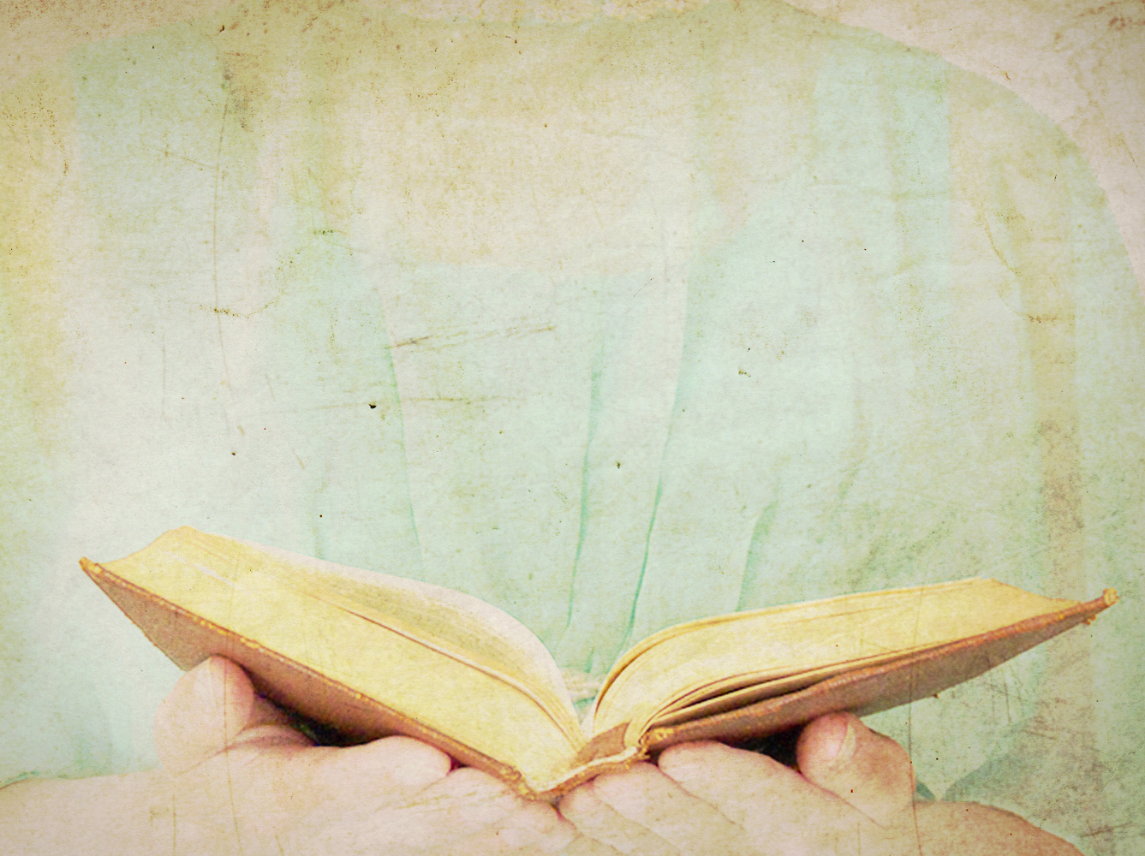
Luke 10:38-42
New Living Translation
³⁸ As Jesus and the disciples continued on their way to Jerusalem, they came to a certain village where a woman named Martha welcomed him into her home. ³⁹ Her sister, Mary, sat at the Lord’s feet, listening to what he taught.

Slide 3
Luke 10:38-42
New Living Translation
⁴⁰ But Martha was distracted by the big dinner she was preparing. She came to Jesus and said, “Lord, doesn’t it seem unfair to you that my sister just sits here while I do all the work? Tell her to come and help me.”

Slide 4
Luke 10:38-42
New Living Translation
⁴¹ But the Lord said to her, “My dear Martha, you are worried and upset over all these details! ⁴² There is only one thing worth being concerned about. Mary has discovered it, and it will not be taken away from her.”

Slide 5
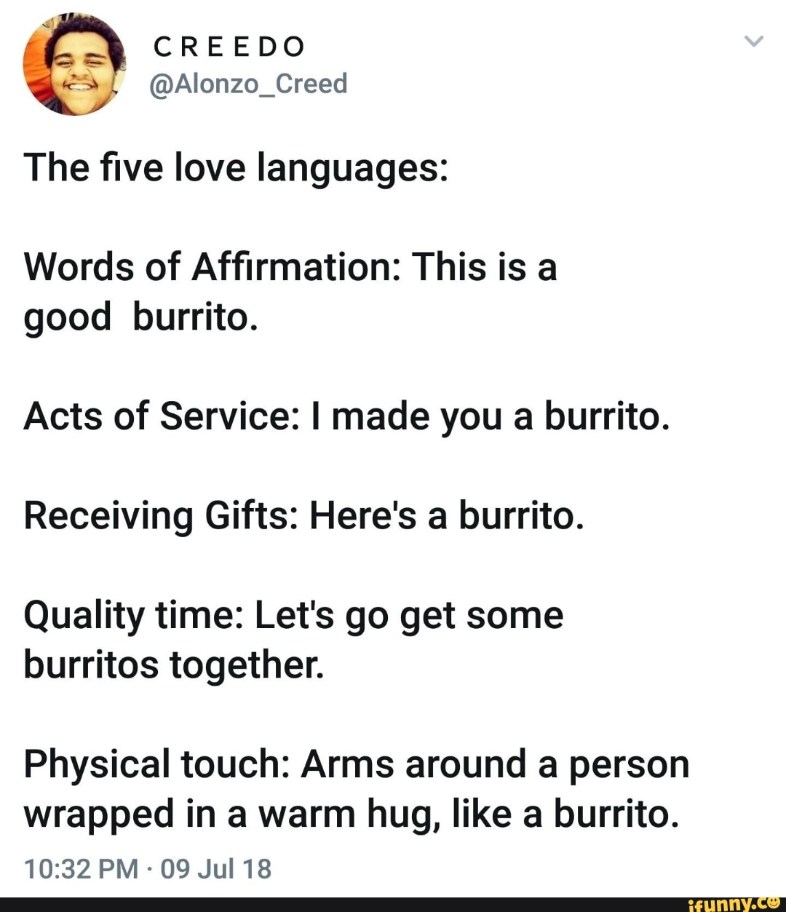

Slide 6
John 11:17-27
New Living Translation
¹⁷ When Jesus arrived at Bethany, he was told that Lazarus had already been in his grave for four days. ¹⁸ Bethany was only a few miles down the road from Jerusalem, ¹⁹ and many of the people had come to console Martha and Mary in their loss.

Slide 7
John 11:17-27
New Living Translation
²⁰ When Martha got word that Jesus was coming, she went to meet him. But Mary stayed in the house. ²¹ Martha said to Jesus, “Lord, if only you had been here, my brother would not have died. ²² But even now I know that God will give you whatever you ask.”

Slide 8
John 11:17-27
New Living Translation
²³ Jesus told her, “Your brother will rise again.”
²⁴ “Yes,” Martha said, “he will rise when everyone else rises, at the last day.”
²⁵ Jesus told her, “I am the resurrection and the life. Anyone who believes in me will live, even after dying.

Slide 9
John 11:17-27
New Living Translation
²⁶ Everyone who lives in me and believes in me will never ever die. Do you believe this, Martha?”
²⁷ “Yes, Lord,” she told him. “I have always believed you are the Messiah, the Son of God, the one who has come into the world from God.”

Slide 10
Prayer is…
Talking
Listening
Doing

