Slide 1
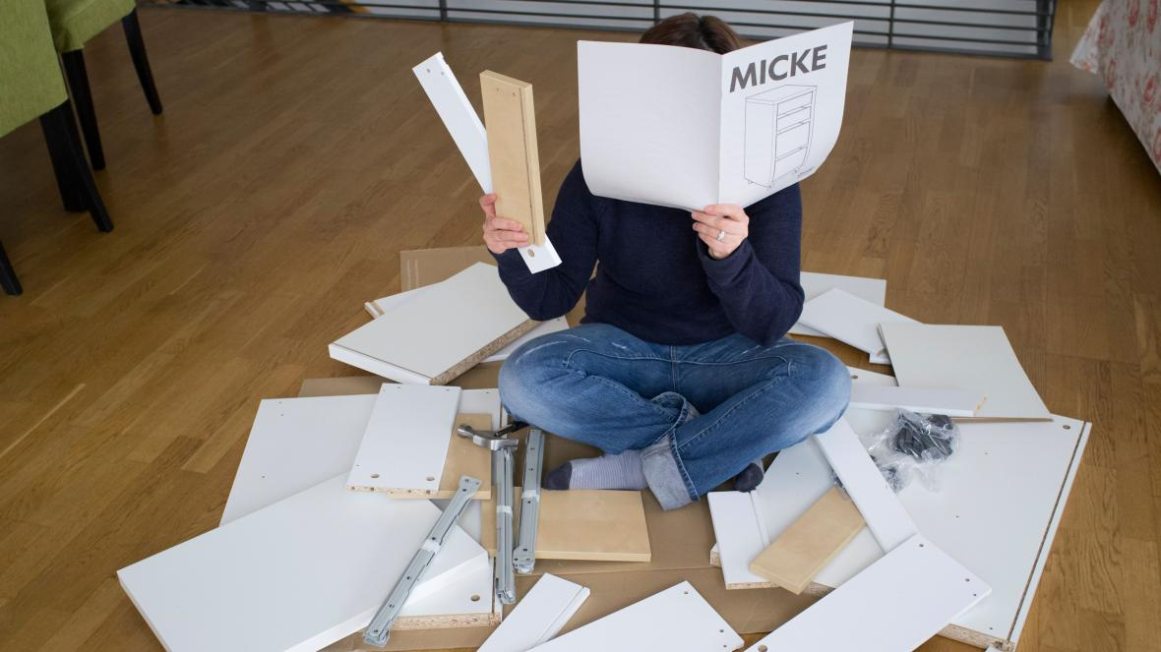
Living a
‘Flat-Pack’
Life

Slide 3
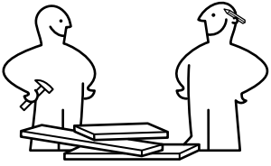
1. You aren’t finished… yet

Slide 4
Philippians 1:3-6 New Living Translation
³ Every time I think of you, I give thanks to my God. ⁴ Whenever I pray, I make my requests for all of you with joy, ⁵ for you have been my partners in spreading the Good News about Christ from the time you first heard it until now. ⁶ And I am certain that God, who began the good work within you, will continue his work until it is finally finished on the day when Christ Jesus returns.

Slide 6
2. Don’t give up on the Instructions

Slide 7
2 Timothy 3:16-17 New Living Translation
¹⁶ All Scripture is inspired by God and is useful to teach us what is true and to make us realize what is wrong in our lives. It corrects us when we are wrong and teaches us to do what is right. ¹⁷ God uses it to prepare and equip his people to do every good work.

Slide 8
3. Keep the end product in sight

Slide 9
Jeremiah 1:5 New Living Translation
⁵ “I knew you before I formed you in your mother’s womb. Before you were born I set you apart and appointed you as my prophet to the nations.”

Slide 10
Romans 8:28-29 New Living Translation
²⁸ And we know that God causes everything to work together for the good of those who love God and are called according to his purpose for them. ²⁹ For God knew his people in advance, and he chose them to become like his Son, so that his Son would be the firstborn among many brothers and sisters.

Slide 11
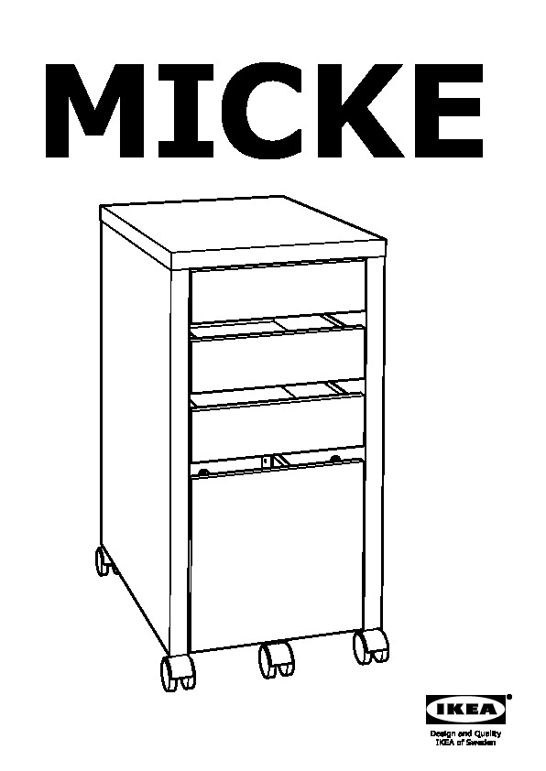

Slide 12
Hebrews 10:23-24 New Living Translation
²³ Let us hold tightly without wavering to the hope we affirm, for God can be trusted to keep his promise. ²⁴ Let us think of ways to motivate one another to acts of love and good works.

Slide 13
Hebrews 10:35-36 New Living Translation
³⁵ So do not throw away this confident trust in the Lord. Remember the great reward it brings you! ³⁶ Patient endurance is what you need now, so that you will continue to do God’s will. Then you will receive all that he has promised.

Slide 14
Hebrews 11:13 New Living Translation
All these people died still believing what God had promised them. They did not receive what was promised, but they saw it all from a distance and welcomed it.

Slide 15
Hebrews 12:1-3 New Living Translation
Therefore, since we are surrounded by such a huge crowd of witnesses to the life of faith, let us strip off every weight that slows us down, especially the sin that so easily trips us up. And let us run with endurance the race God has set before us. ² We do this by keeping our eyes on Jesus, the champion who initiates and perfects our faith.

Slide 16
Hebrews 12:1-3 New Living Translation
Because of the joy awaiting him, he endured the cross, disregarding its shame. Now he is seated in the place of honor beside God’s throne. ³ Think of all the hostility he endured from sinful people; then you won’t become weary and give up.

Slide 17
4. Let an expert help

Slide 18
