Slide 1
What We Owe To Each Other

Slide 2
1 Peter 5:8
New Living Translation
⁸ Stay alert! Watch out for your great enemy, the devil. He prowls around like a roaring lion, looking for someone to devour. ⁹ Stand firm against him, and be strong in your faith.

Slide 3
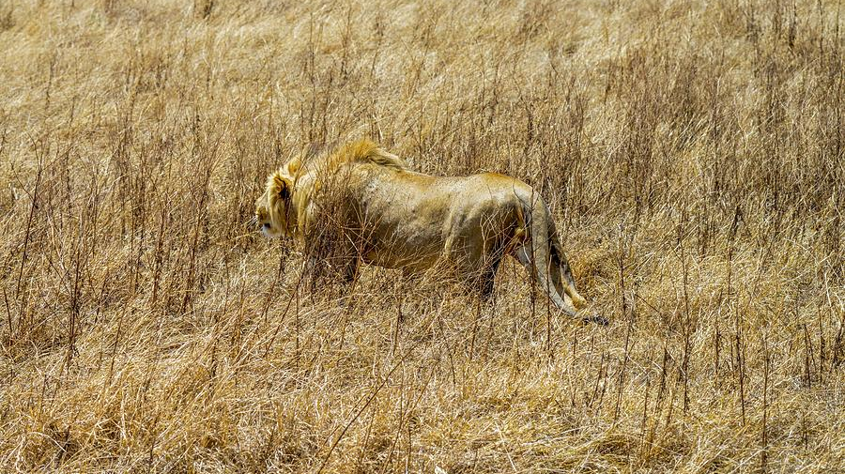

Slide 4
Ephesians 4:1-3
New Living Translation
Therefore I, a prisoner for serving the Lord, beg you to lead a life worthy of your calling, for you have been called by God. ² Always be humble and gentle. Be patient with each other, making allowance for each other’s faults because of your love. ³ Make every effort to keep yourselves united in the Spirit, binding yourselves together with peace.

Slide 5
Strategies for Good Relationships
Learn to Value our differences

Slide 6
1 Corinthians 12:17
New Living Translation
If the whole body were an eye, how would you hear? Or if your whole body were an ear, how would you smell anything?

Slide 7
Strategies for Good Relationships
Learn to value our differences
Forgive

Slide 8
Ephesians 4:31-32
New Living Translation
³¹ Get rid of all bitterness, rage, anger, harsh words, and slander, as well as all types of evil behavior. ³² Instead, be kind to each other, tenderhearted, forgiving one another, just as God through Christ has forgiven you.

Slide 9
Strategies for Good Relationships
Learn to value our differences
Forgive
Watch what you say

Slide 10
Ephesians 4:25
New Living Translation
So stop telling lies. Let us tell our neighbors the truth, for we are all parts of the same body.

Slide 11
Ephesians 4:29
New Living Translation
Don’t use foul or abusive language. Let everything you say be good and helpful, so that your words will be an encouragement to those who hear them.

Slide 12
Ephesians 4:31
New Living Translation
Get rid of all bitterness, rage, anger, harsh words, and slander, as well as all types of evil behavior.

Slide 13
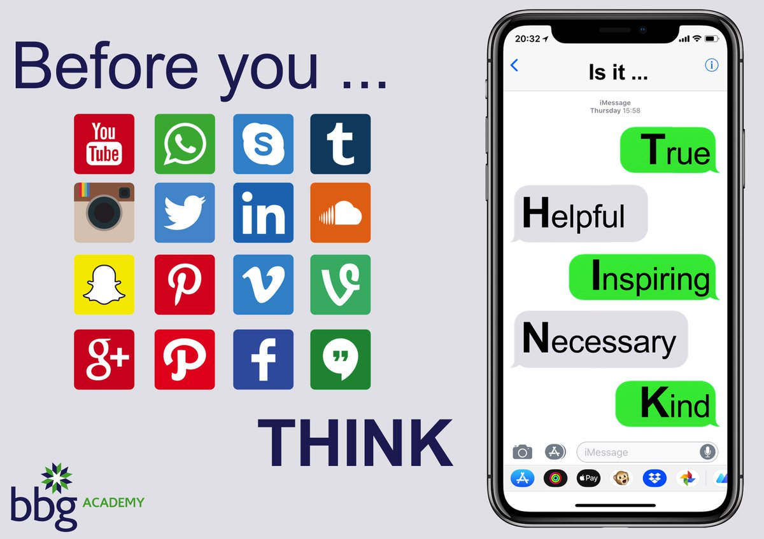

Slide 14
Strategies for Good Relationships
Learn to value our differences
Forgive
Watch what you say
What would Jesus do?

Slide 15
Ephesians 5:10
New Living Translation
Carefully determine what pleases the Lord.

Slide 16
Ephesians 5:17
New Living Translation
Don’t act thoughtlessly, but understand what the Lord wants you to do.

Slide 17
Strategies for Good Relationships
Learn to value our differences
Forgive
Watch what you say
What would Jesus do?
Submit to one another

Slide 18
Ephesians 5:21
New Living Translation
And further, submit to one another out of reverence for Christ.

Slide 19
Strategies for Good Relationships
Learn to value our differences
Forgive
Watch what you say
Ask: what would Jesus do?
Submit to one another
Pray

Slide 20
Ephesians 6:10-12
New Living Translation
¹⁰ A final word: Be strong in the Lord and in his mighty power. ¹¹ Put on all of God’s armor so that you will be able to stand firm against all strategies of the devil. ¹² For we are not fighting against flesh-and-blood enemies, but against evil rulers and authorities of the unseen world, against mighty powers in this dark world, and against evil spirits in the heavenly places.

Slide 21
Ephesians 6:18
New Living Translation
Pray in the Spirit at all times and on every occasion. Stay alert and be persistent in your prayers for all believers everywhere.

