Slide 1
NO FEAR?

Slide 2
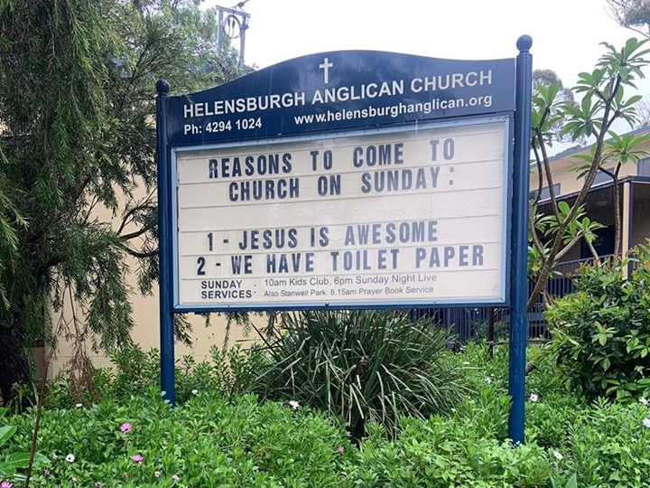

Slide 4
Psalm 56:3-4
New Living Translation
³ But when I am afraid, I will put my trust in you.
⁴ I praise God for what he has promised.
I trust in God, so why should I be afraid?
What can mere mortals do to me?

Slide 5
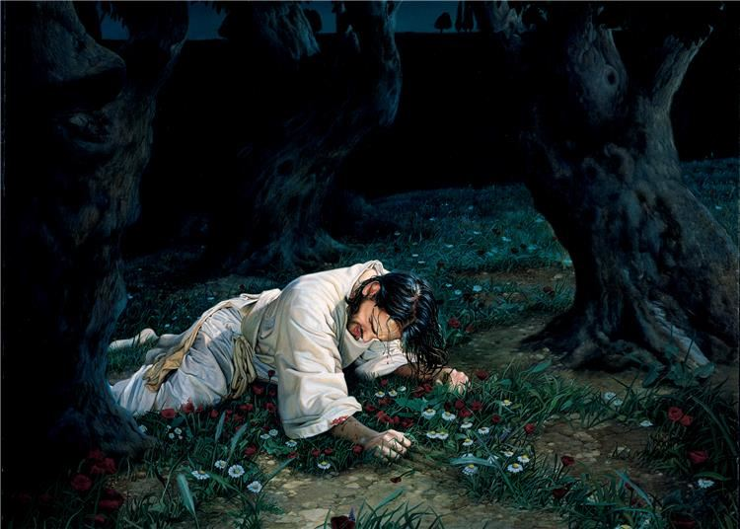

Slide 7
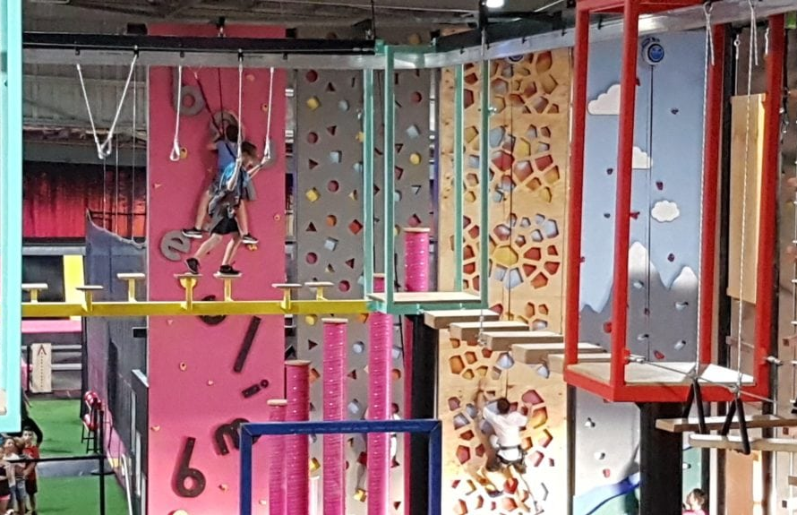

Slide 8
1 John 3:1a
New Living Translation
See how very much our Father loves us, for he calls us his children, and that is what we are!

Slide 9
Romans 8:38-39
New Living Translation
And I am convinced that nothing can ever separate us from God’s love. Neither death nor life, neither angels nor demons, neither our fears for today nor our worries about tomorrow—not even the powers of hell can separate us from God’s love.

Slide 10
Romans 8:38-39
New Living Translation
No power in the sky above or in the earth below—indeed, nothing in all creation will ever be able to separate us from the love of God that is revealed in Christ Jesus our Lord.

Slide 11
1 Samuel 17:45
New Living Translation
David replied to the Philistine, “You come to me with sword, spear, and javelin, but I come to you in the name of the Lord of Heaven’s Armies—the God of the armies of Israel, whom you have defied.

Slide 12
Daniel 3:17-18
New Living Translation
¹⁷ If we are thrown into the blazing furnace, the God we serve is able to deliver us from it, and he will deliver us from Your Majesty’s hand. ¹⁸ But even if he does not, we want you to know, Your Majesty, that we will not serve your gods or worship the image of gold you have set up.”

Slide 13
James 1:12
New Living Translation
God blesses those who patiently endure testing and temptation. Afterward they will receive the crown of life that God has promised to those who love him.

