Slide 1
It’s
Time
to
Shine
a

Slide 2
Matthew 5:14
New Living Translation
“You are the light of the world—like a city on a hilltop that cannot be hidden.

Slide 3
1. Here I am – I’m not going
Here I am – I’m not going!

Slide 4
Jonah 1:2-3
New Living Translation
“Get up and go to the great city of Nineveh. Announce my judgment against it because I have seen how wicked its people are.”
³ But Jonah got up and went in the opposite direction to get away from the Lord.

Slide 5
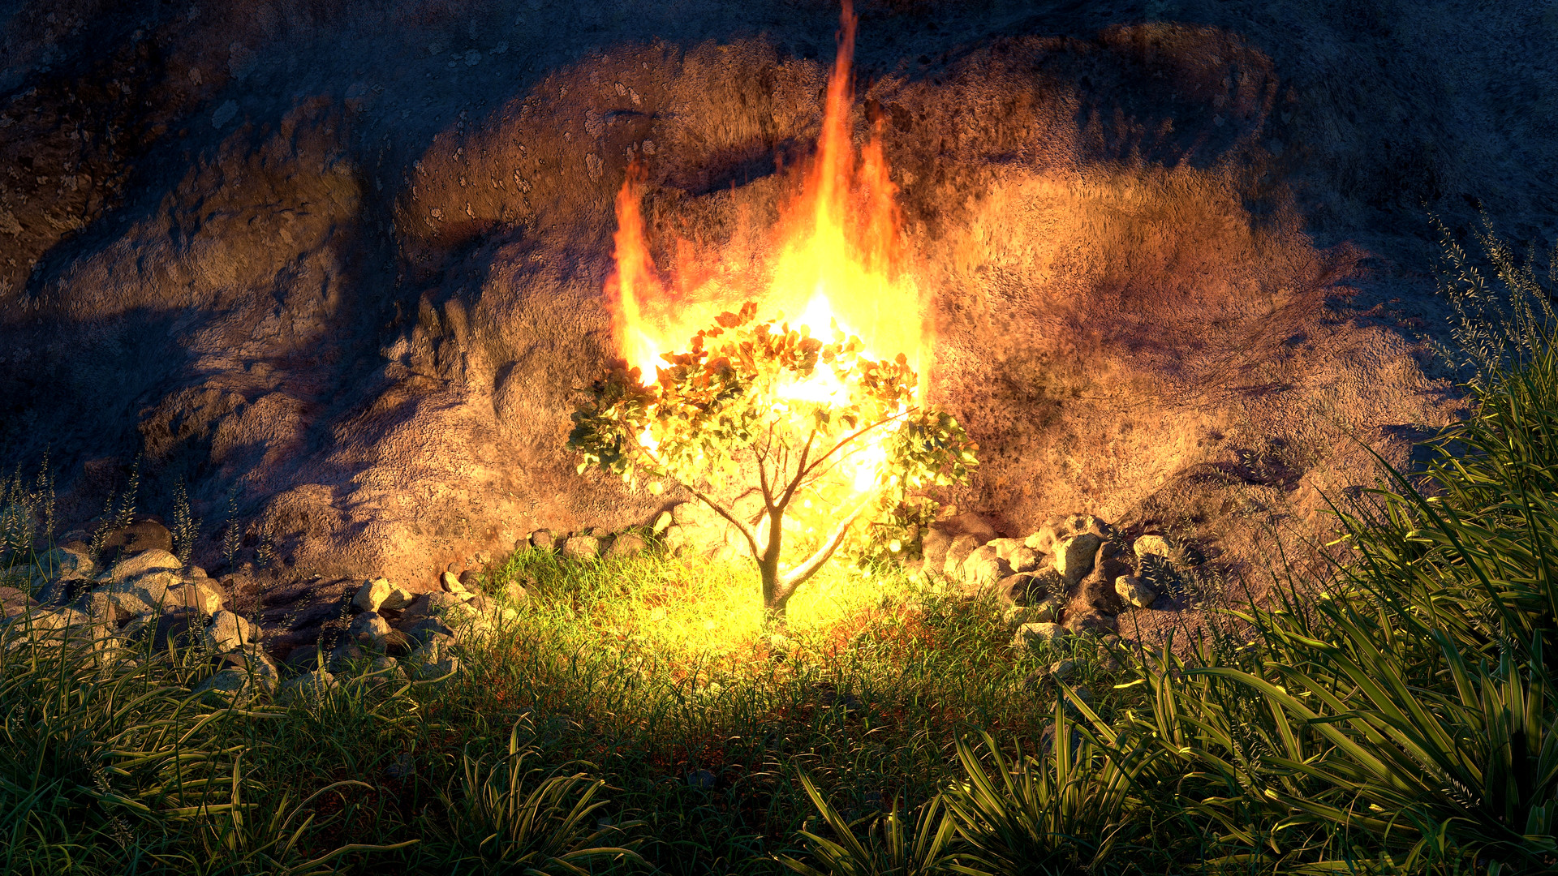
MOSES
Here I am – Send Someone else!

Slide 6
Exodus 3:10-11
New Living Translation
¹⁰ Now go, for I am sending you to Pharaoh. You must lead my people Israel out of Egypt.”
¹¹ But Moses protested to God, “Who am I to appear before Pharaoh? Who am I to lead the people of Israel out of Egypt?”

Slide 7
Exodus 4:13
New Living Translation
But Moses again pleaded, “Lord, please! Send anyone else.”

Slide 9
An experience with the Presence of God

Slide 10
Isaiah 6:1-8
New Living Translation
It was in the year King Uzziah died that I saw the Lord. He was sitting on a lofty throne, and the train of his robe filled the Temple. ² Attending him were mighty seraphim, each having six wings. With two wings they covered their faces, with two they covered their feet, and with two they flew. ³ They were calling out to each other,
“Holy, holy, holy is the Lord of Heaven’s Armies! The whole earth is filled with his glory!”

Slide 11
Isaiah 6:1-8
New Living Translation
⁴ Their voices shook the Temple to its foundations, and the entire building was filled with smoke.

Slide 12
An awareness of your sinfulness

Slide 13
Isaiah 6:1-8
New Living Translation
Then I said, “It’s all over! I am doomed, for I am a sinful man. I have filthy lips, and I live among a people with filthy lips. Yet I have seen the King, the Lord of Heaven’s Armies.”

Slide 14
An understanding of God’s grace

Slide 15
Isaiah 6:1-8
New Living Translation
Then one of the seraphim flew to me with a burning coal he had taken from the altar with a pair of tongs. He touched my lips with it and said,
“See, this coal has touched your lips. Now your guilt is removed, and your sins are forgiven.”

