Slide 1
DOING LIFE TOGETHER
The Importance of Small Groups in a
Growing Church

Slide 2
Acts 2:42-47
New Living Translation
⁴² All the believers devoted themselves to the apostles’ teaching, and to fellowship, and to sharing in meals (including the Lord’s Supper), and to prayer.
⁴³ A deep sense of awe came over them all, and the apostles performed many miraculous signs and wonders. ⁴⁴ And all the believers met together in one place and shared everything they had.

Slide 3
Acts 2:42-47
New Living Translation
⁴⁵ They sold their property and possessions and shared the money with those in need. ⁴⁶ They worshiped together at the Temple each day, met in homes for the Lord’s Supper, and shared their meals with great joy and generosity— ⁴⁷ all the while praising God and enjoying the goodwill of all the people. And each day the Lord added to their fellowship those who were being saved.

Slide 4
Four Defining Traits
The Apostle’s Teaching
Fellowship
Breaking Bread (The Lord’s Supper)
Prayer

Slide 5
What are
?

Slide 6
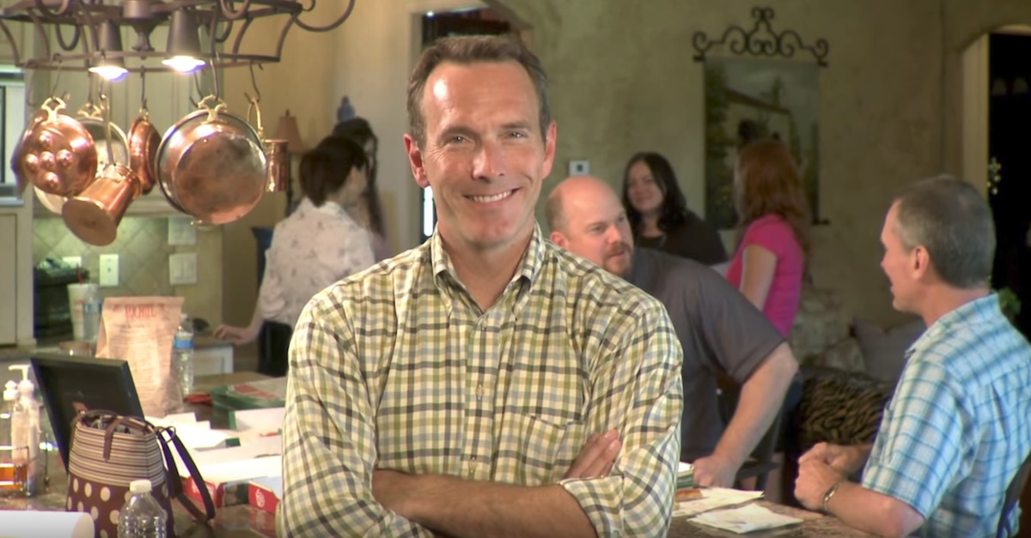

Slide 7
Natural Church Development
“If we were to identify any one principle as the ‘most important’, then without a doubt it would be the multiplication of small groups.”

Slide 8
Thom Rainer - Author
“Assimilation is five times more effective if a person is involved in a group versus attending worship only.”

