Slide 1
Great
EXPECTATIONS

Slide 3
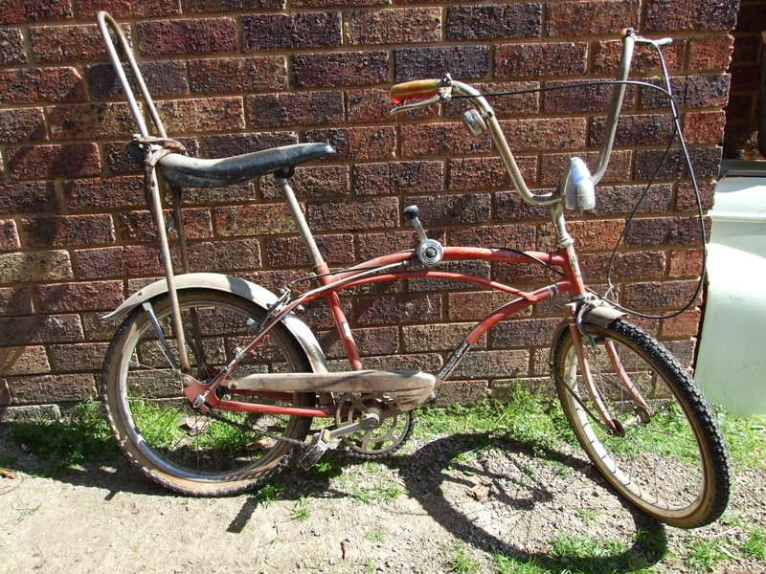

Slide 4
John 1:1-4
New Living Translation
In the beginning the Word already existed. The Word was with God, and the Word was God. ² He existed in the beginning with God. ³ God created everything through him, and nothing was created except through him. ⁴ The Word gave life to everything that was created, and his life brought light to everyone.

Slide 5
Luke 2:17-20
New Living Translation
¹⁷ After seeing him, the shepherds told everyone what had happened and what the angel had said to them about this child. ¹⁸ All who heard the shepherds’ story were astonished, ¹⁹ but Mary kept all these things in her heart and thought about them often.

Slide 6
Luke 2:17-20
New Living Translation
²⁰ The shepherds went back to their flocks, glorifying and praising God for all they had heard and seen. It was just as the angel had told them.

Slide 7
We expected the Christmas story to be comfortable and trouble-free, but God wanted to identify with us in our struggles.

Slide 8
Why People Give (Australia)
https://good2give.ngo/wp-content/uploads/2019/03/CAF-Australia-Giving-Report-2019.pdf

Slide 9
Hebrews 4:14-16
New Living Translation
¹⁴ So then, since we have a great High Priest who has entered heaven, Jesus the Son of God, let us hold firmly to what we believe. ¹⁵ This High Priest of ours understands our weaknesses, for he faced all of the same testings we do, yet he did not sin.

Slide 10
Hebrews 4:14-16
New Living Translation
¹⁶ So let us come boldly to the throne of our gracious God. There we will receive his mercy, and we will find grace to help us when we need it most.

Slide 11
We expected the Christmas story to be a Royal Extravaganza,
but God wanted to set an example of humility for us
to follow.

Slide 12
Philippians 2:6-8
New Living Translation
⁶ Though he was God, he did not think of equality with God as something to cling to. ⁷ Instead, he gave up his divine privileges he took the humble position of a slave and was born as a human being. When he appeared in human form, ⁸ he humbled himself in obedience to God and died a criminal’s death on a cross.

Slide 13
John 13:15
New Living Translation
I have given you an example to follow. Do as I have done to you.

Slide 14
We expected the Christmas story to be a Demonstration of His Supremacy, but God wanted to make a statement of His love for you.

Slide 15
John 3:16
New Living Translation
For God loved the world so much that he gave his one and only Son, so that everyone who believes in him will not perish but have eternal life. ¹⁷ God sent his Son into the world not to judge the world, but to save the world through him.

