Slide 1
GIFTS
Magi
OF
THE
Matthew 2:1-12

Slide 2
Matthew 2:1-12
New Living Translation
They entered the house and saw the child with his mother, Mary, and they bowed down and worshiped him. Then they opened their treasure chests and gave him gifts of gold, frankincense, and myrrh.

Slide 3
Gift #1
gold

Slide 4
Gift #2
Frankincense

Slide 5
Gift #3
myrrh

Slide 7
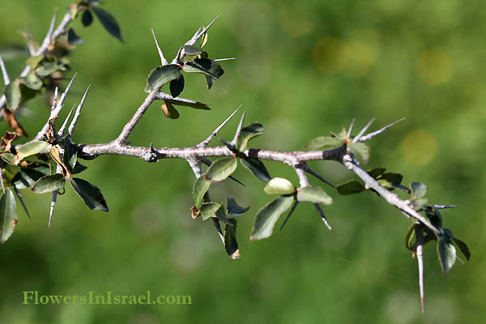

Slide 8
john 19:38-40
New Living Translation
When Pilate gave permission, Joseph came and took the body away. ³⁹ With him came Nicodemus, the man who had come to Jesus at night. He brought about seventy-five pounds of perfumed ointment made from myrrh and aloes. ⁴⁰ Following Jewish burial custom, they wrapped Jesus’ body with the spices in long sheets of linen cloth.

Slide 9
We Three Kings
(verse 4)
Myrrh is mine; its bitter perfume Breathes a life of gathering gloom; Sorrowing, sighing, bleeding, dying, Sealed in the stone-cold tomb.

Slide 10
Matthew 9:14-15
New Living Translation
¹⁴ One day the disciples of John the Baptist came to Jesus and asked him, “Why don’t your disciples fast like we do and the Pharisees do?”
¹⁵ Jesus replied, “Do wedding guests mourn while celebrating with the groom? Of course not. But someday the groom will be taken away from them, and then they will fast.

Slide 11
Matthew 10:38
New Living Translation
If you refuse to take up your cross and follow me, you are not worthy of being mine.

Slide 12
Matthew 12:39-40
New Living Translation
³⁹ But Jesus replied, “Only an evil, adulterous generation would demand a miraculous sign; but the only sign I will give them is the sign of the prophet Jonah. ⁴⁰ For as Jonah was in the belly of the great fish for three days and three nights, so will the Son of Man be in the heart of the earth for three days and three nights.

Slide 13
Matthew 16:21
New Living Translation
From then on Jesus began to tell his disciples plainly that it was necessary for him to go to Jerusalem, and that he would suffer many terrible things at the hands of the elders, the leading priests, and the teachers of religious law. He would be killed, but on the third day he would be raised from the dead.

Slide 14
Matthew 20:28
New Living Translation
“…For even the Son of Man came not to be served but to serve others and to give his life as a ransom for many.”

Slide 15
Matthew 26:53-54
New Living Translation
⁵³ Don’t you realize that I could ask my Father for thousands of angels to protect us, and he would send them instantly? ⁵⁴ But if I did, how would the Scriptures be fulfilled that describe what must happen now?”

Slide 16
What is a Passover lamb?

Slide 17
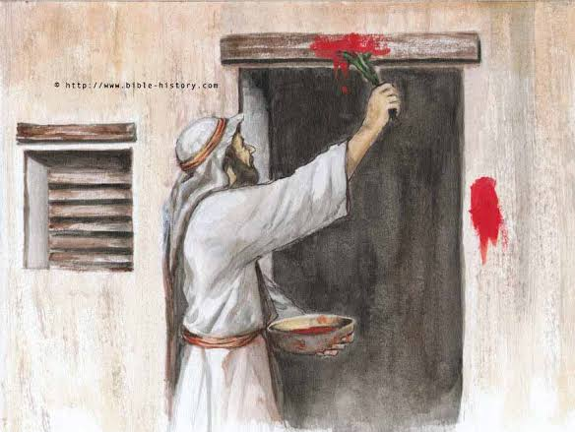

Slide 18
John 1:29
New Living Translation
The next day John saw Jesus coming toward him and said, “Look! The Lamb of God who takes away the sin of the world!

Slide 19
1 peter 1:19
New Living Translation
¹⁸ For you know that God paid a ransom to save you from the empty life you inherited from your ancestors. And it was not paid with mere gold or silver, which lose their value. ¹⁹ It was the precious blood of Christ, the sinless, spotless Lamb of God.

Slide 20
Romans 6:6
New Living Translation
We know that our old sinful selves were crucified with Christ so that sin might lose its power in our lives. We are no longer slaves to sin.

Slide 21
Romans 6:18
New Living Translation
Now you are free from your slavery to sin, and you have become slaves to righteous living.

Slide 22
Romans 6:23
New Living Translation
For the wages of sin is death, but the free gift of God is eternal life through Christ Jesus our Lord.

