Slide 1
GIFTS
Magi
OF
THE
Matthew 2:1-12

Slide 2
Matthew 2:1-12
New Living Translation
They entered the house and saw the child with his mother, Mary, and they bowed down and worshiped him. Then they opened their treasure chests and gave him gifts of gold, frankincense, and myrrh.

Slide 3
Gift #1
gold

Slide 4
Gift #2
Frankincense

Slide 5
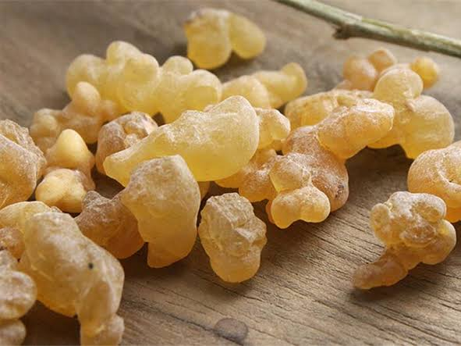
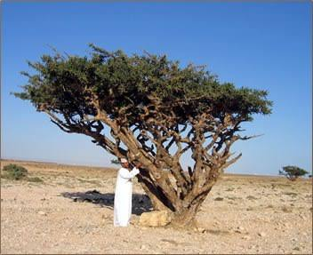

Slide 6
We Three Kings
(verse 3)
Frankincense to offer have I,
Incense owns a Deity nigh Pray'r and praising, all men raising, Worship him, God most high, oh

Slide 7
Exodus 30:34
New Living Translation
Then the Lord said to Moses, “Gather fragrant spices—resin droplets, mollusk shell, and galbanum—and mix these fragrant spices with pure frankincense, weighed out in equal amounts.

Slide 8
Exodus 30:37
New Living Translation
Never use this formula to make this incense for yourselves. It is reserved for the Lord, and you must treat it as holy.

Slide 9
Exodus 30:7-8
New Living Translation
⁷ “Every morning when Aaron maintains the lamps, he must burn fragrant incense on the altar. ⁸ And each evening when he lights the lamps, he must again burn incense in the Lord’s presence. This must be done from generation to generation.

Slide 10
Why do we need a high priest?

Slide 11
Why do we need a high priest?
To make atonement for sin

Slide 12
hebrews 5:1
New Living Translation
Every high priest is a man chosen to represent other people in their dealings with God. He presents their gifts to God and offers sacrifices for their sins.

Slide 13
romans 3:23
New Living Translation
For everyone has sinned; we all fall short of God’s glorious standard.

Slide 14
hebrews 10:1-4
New Living Translation
The old system under the law of Moses was only a shadow, a dim preview of the good things to come, not the good things themselves. The sacrifices under that system were repeated again and again, year after year, but they were never able to provide perfect cleansing for those who came to worship.

Slide 15
hebrews 10:1-4
New Living Translation
² If they could have provided perfect cleansing, the sacrifices would have stopped, for the worshipers would have been purified once for all time, and their feelings of guilt would have disappeared.
³ But instead, those sacrifices actually reminded them of their sins year after year. ⁴ For it is not possible for the blood of bulls and goats to take away sins.

Slide 16
hebrews 10:12
New Living Translation
¹² But our High Priest offered himself to God as a single sacrifice for sins, good for all time. Then he sat down in the place of honor at God’s right hand.
¹³ There he waits until his enemies are humbled and made a footstool under his feet. ¹⁴ For by that one offering he forever made perfect those who are being made holy.

Slide 17
hebrews 10:12
New Living Translation
¹⁵ And the Holy Spirit also testifies that this is so. For he says,
¹⁶ “This is the new covenant I will make with my people on that day, says the Lord: I will put my laws in their hearts, and I will write them on their minds.”

Slide 18
hebrews 10:12
New Living Translation
¹⁷ Then he says,
“I will never again remember their sins and lawless deeds.”
¹⁸ And when sins have been forgiven, there is no need to offer any more sacrifices.

Slide 19
Why do we need a high priest?
To make atonement for sin
To help us know God

Slide 20
matthew 1:23
New Living Translation
“Look! The virgin will conceive a child! She will give birth to a son, and they will call him Immanuel, which means ‘God is with us.’”

Slide 21
John 14:7-9
New Living Translation
⁷ If you had really known me, you would know who my Father is. From now on, you do know him and have seen him!” ⁸ Philip said, “Lord, show us the Father, and we will be satisfied.” ⁹ Jesus replied, “Have I been with you all this time, Philip, and yet you still don’t know who I am? Anyone who has seen me has seen the Father!

Slide 22
What kind of high priest is he?

Slide 23
What kind of high priest is he?
One who can understand

Slide 24
Hebrews 4:14-16
New Living Translation
¹⁴ So then, since we have a great High Priest who has entered heaven, Jesus the Son of God, let us hold firmly to what we believe. ¹⁵ This High Priest of ours understands our weaknesses, for he faced all of the same testings we do, yet he did not sin. ¹⁶ So let us come boldly to the throne of our gracious God. There we will receive his mercy, and we will find grace to help us when we need it most.

Slide 25
What kind of high priest is he?
One who can understand
One who can stand in our place

Slide 26
1 Peter 2:24
New Living Translation
He personally carried our sins in his body on the cross so that we can be dead to sin and live for what is right.

Slide 27
What kind of high priest is he?
One who can understand
One who can stand in our place
One who is eternal

Slide 28
Hebrews 5:8-10
New Living Translation
⁸ Even though Jesus was God’s Son, he learned obedience from the things he suffered. ⁹ In this way, God qualified him as a perfect High Priest, and he became the source of eternal salvation for all those who obey him. ¹⁰ And God designated him to be a High Priest in the order of Melchizedek.

Slide 29
1 Timothy 2:5-6
New Living Translation
⁵ For, There is one God and one Mediator who can reconcile God and humanity—the man Christ Jesus. ⁶ He gave his life to purchase freedom for everyone.
This is the message God gave to the world at just the right time.

