Slide 1
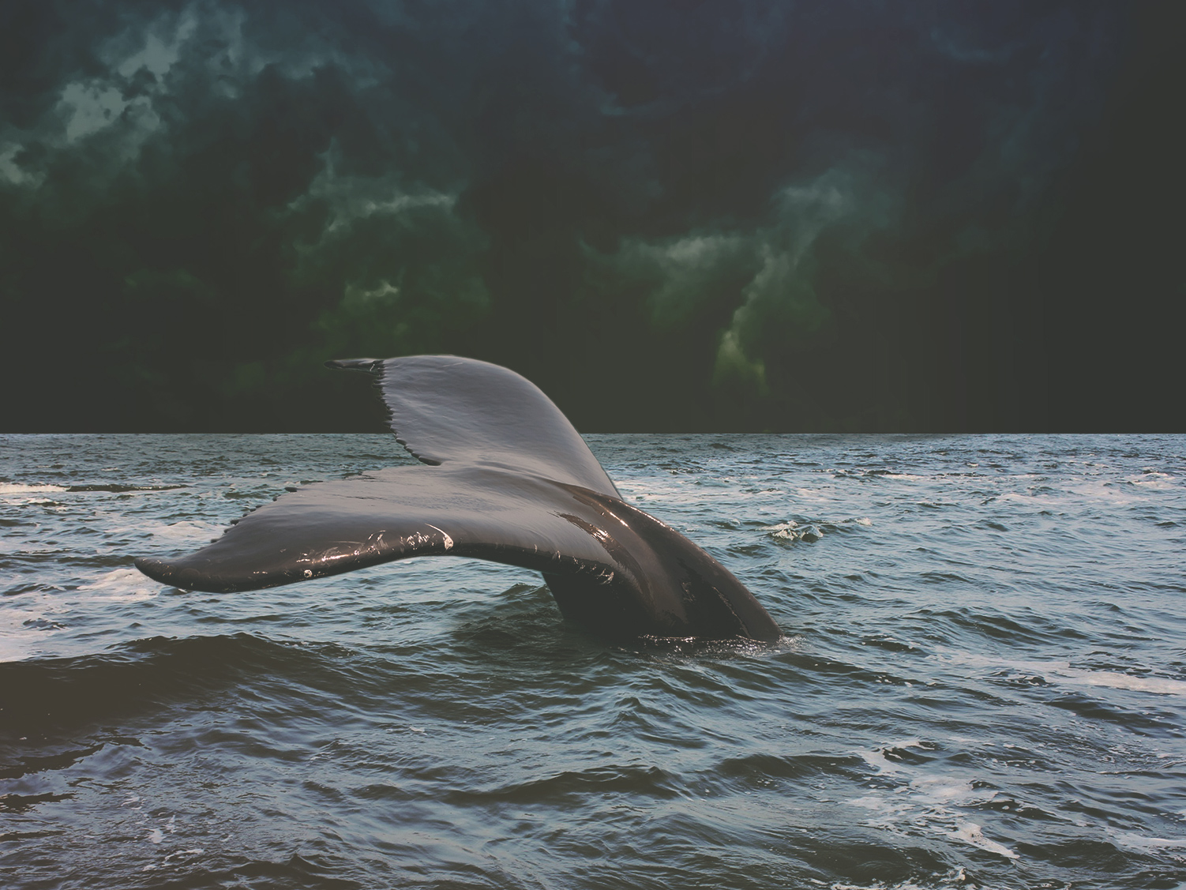
The GOD who PURSUES

Slide 2

God Pursues:
The Ninevites

Slide 3
God Pursues:
The Ninevites
The Sailors

Slide 4
God Pursues:
The Ninevites
The Sailors
Jonah

