Slide 1

OF THE CHURCH

Slide 2

Acts 4:23-31
New Living Translation
²³ As soon as they were freed, Peter and John returned to the other believers and told them what the leading priests and elders had said.²⁴ When they heard the report, all the believers lifted their voices together in prayer to God: “O Sovereign Lord, Creator of heaven and earth, the sea, and everything in them— ²⁵ you spoke long ago by the Holy Spirit through our ancestor David, your servant, saying, …

Slide 3
Acts 4:23-31
New Living Translation
‘Why were the nations so angry?
Why did they waste their time with futile plans?
²⁶ The kings of the earth prepared for battle;
the rulers gathered together
against the Lord
and against his Messiah.’

Slide 4
Acts 4:23-31
New Living Translation
²⁷ “In fact, this has happened here in this very city! For Herod Antipas, Pontius Pilate the governor, the Gentiles, and the people of Israel were all united against Jesus, your holy servant, whom you anointed. ²⁸ But everything they did was determined beforehand according to your will. ²⁹And now, O Lord, hear their threats, and give us, your servants, great boldness in preaching your word.

Slide 5
Acts 4:23-31
New Living Translation
³⁰ Stretch out your hand with healing power; may miraculous signs and wonders be done through the name of your holy servant Jesus.”
³¹ After this prayer, the meeting place shook, and they were all filled with the Holy Spirit. Then they preached the word of God with boldness.

Slide 6

What are we Praying for?

Slide 7
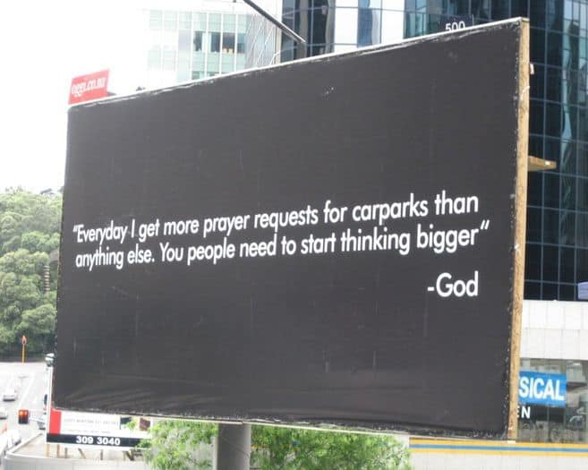

Slide 8
A Worshipping Church

Slide 9
Acts 4:24
New Living Translation
When they heard the report, all the believers lifted their voices together in prayer to God: “O Sovereign Lord, Creator of heaven and earth, the sea, and everything in them…”

Slide 10
Acts 4:25-26
New Living Translation
‘Why were the nations so angry?
Why did they waste their time with futile plans?
²⁶ The kings of the earth prepared for battle;
the rulers gathered together
against the Lord
and against his Messiah.’

Slide 11
Psalm 2:4
New Living Translation
But the one who rules in heaven laughs.
The Lord scoffs at them.

Slide 12
A Kingdom-Building Church

Slide 13
Acts 4:29
New Living Translation
And now, O Lord, hear their threats, and give us, your servants, great boldness in preaching your word.

Slide 14
Psalm 2:5
New Living Translation
Then in anger he rebukes them,
terrifying them with his fierce fury.

Slide 15
A Ministering Church

Slide 16
Acts 4:30
New Living Translation
Stretch out your hand with healing power; may miraculous signs and wonders be done through the name of your holy servant Jesus.”

Slide 17
Acts 4:31
New Living Translation
³¹ After this prayer, the meeting place shook, and they were all filled with the Holy Spirit. Then they preached the word of God with boldness.

