Slide 1
Renewing Your Commitment

Slide 2
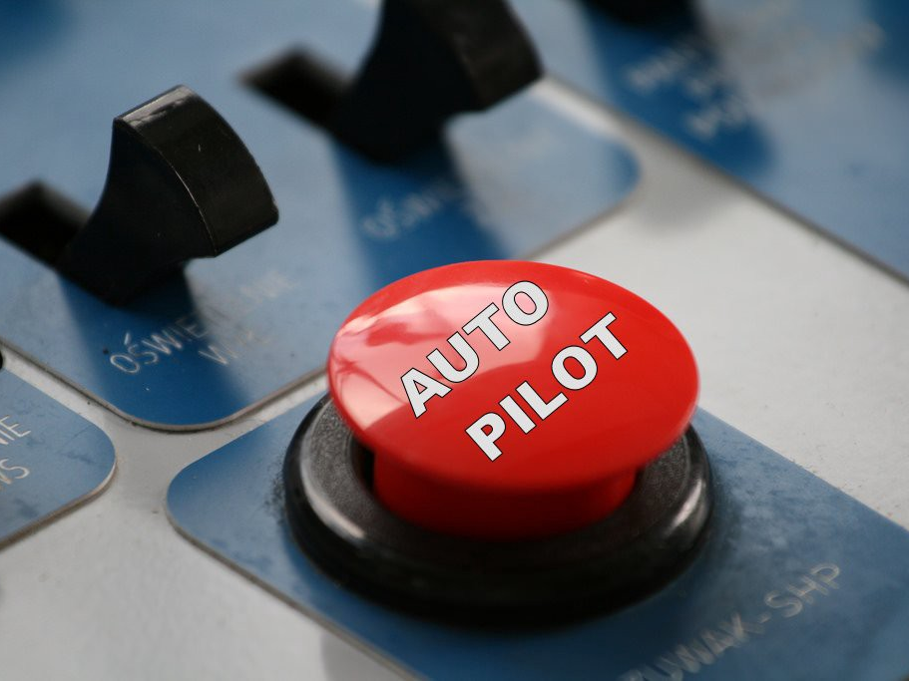

Slide 3
Things That Erode Commitment
Unmet Needs/Desires

Slide 4
Things That Erode Commitment
Unmet Needs/Desires
Not feeling valued/appreciated

Slide 5
Things That Erode Commitment
Unmet Needs/Desires
Not feeling valued/appreciated
Suffering

Slide 6
Joshua 23:1-3 New Living Translation
The years passed, and the Lord had given the people of Israel rest from all their enemies. Joshua, who was now very old, ² called together all the elders, leaders, judges, and officers of Israel. He said to them, “I am now a very old man. ³ You have seen everything the Lord your God has done for you during my lifetime. The Lord your God has fought for you against your enemies.

Slide 7
Joshua 24:14-28 New Living Translation
¹⁴ “So fear the Lord and serve him wholeheartedly. Put away forever the idols your ancestors worshiped when they lived beyond the Euphrates River and in Egypt. Serve the Lord alone. ¹⁵ But if you refuse to serve the Lord, then choose today whom you will serve. Would you prefer the gods your ancestors served beyond the Euphrates? Or will it be the gods of the Amorites in whose land you now live? But as for me and my family, we will serve the Lord.”

Slide 8
Joshua 24:14-28 New Living Translation
¹⁶ The people replied, “We would never abandon the Lord and serve other gods. ¹⁷ For the Lord our God is the one who rescued us and our ancestors from slavery in the land of Egypt. He performed mighty miracles before our very eyes. As we traveled through the wilderness among our enemies, he preserved us. ¹⁸ It was the Lord who drove out the Amorites and the other nations living here in the land. So we, too, will serve the Lord, for he alone is our God.”

Slide 9
Joshua 24:14-28 New Living Translation
¹⁹ Then Joshua warned the people, “You are not able to serve the Lord, for he is a holy and jealous God. He will not forgive your rebellion and your sins. ²⁰ If you abandon the Lord and serve other gods, he will turn against you and destroy you, even though he has been so good to you.”
²¹ But the people answered Joshua, “No, we will serve the Lord!”

Slide 10
Joshua 24:14-28 New Living Translation
²² “You are a witness to your own decision,” Joshua said. “You have chosen to serve the Lord.”
“Yes,” they replied, “we are witnesses to what we have said.”
²³ “All right then,” Joshua said, “destroy the idols among you, and turn your hearts to the Lord, the God of Israel.”
²⁴ The people said to Joshua, “We will serve the Lord our God. We will obey him alone.”

Slide 11
Joshua 24:14-28 New Living Translation
²⁵ So Joshua made a covenant with the people that day at Shechem, committing them to follow the decrees and regulations of the Lord.²⁶ Joshua recorded these things in the Book of God’s Instructions. As a reminder of their agreement, he took a huge stone and rolled it beneath the terebinth tree beside the Tabernacle of the Lord.

Slide 12
Joshua 24:14-28 New Living Translation
²⁷ Joshua said to all the people, “This stone has heard everything the Lord said to us. It will be a witness to testify against you if you go back on your word to God.”
²⁸ Then Joshua sent all the people away to their own homelands.

Slide 13
Renewing Your Commitment
Stay Connected to God

Slide 14
Renewing Your Commitment
Stay Connected to God
Know Your Heritage

Slide 15
Romans 8:16-17 New Living Translation
¹⁶ For his Spirit joins with our spirit to affirm that we are God’s children. ¹⁷ And since we are his children, we are his heirs. In fact, together with Christ we are heirs of God’s glory. But if we are to share his glory, we must also share his suffering.

Slide 16
1 Peter 1:3-4 New Living Translation
³ All praise to God, the Father of our Lord Jesus Christ. It is by his great mercy that we have been born again, because God raised Jesus Christ from the dead. Now we live with great expectation, ⁴ and we have a priceless inheritance—an inheritance that is kept in heaven for you, pure and undefiled, beyond the reach of change and decay.

Slide 17
Renewing Your Commitment
Stay Connected to God
Know Your Heritage
Set a Reminder

Slide 18
Renewing Your Commitment
Stay Connected to God
Know Your Heritage
Set a Reminder
Public Declaration

Slide 19
Romans 10:9 New Living Translation
⁹ If you openly declare that Jesus is Lord and believe in your heart that God raised him from the dead, you will be saved.

Slide 20
We will serve the Lord our God. We will obey him alone.

