Slide 1
Work in
Progress

Slide 3
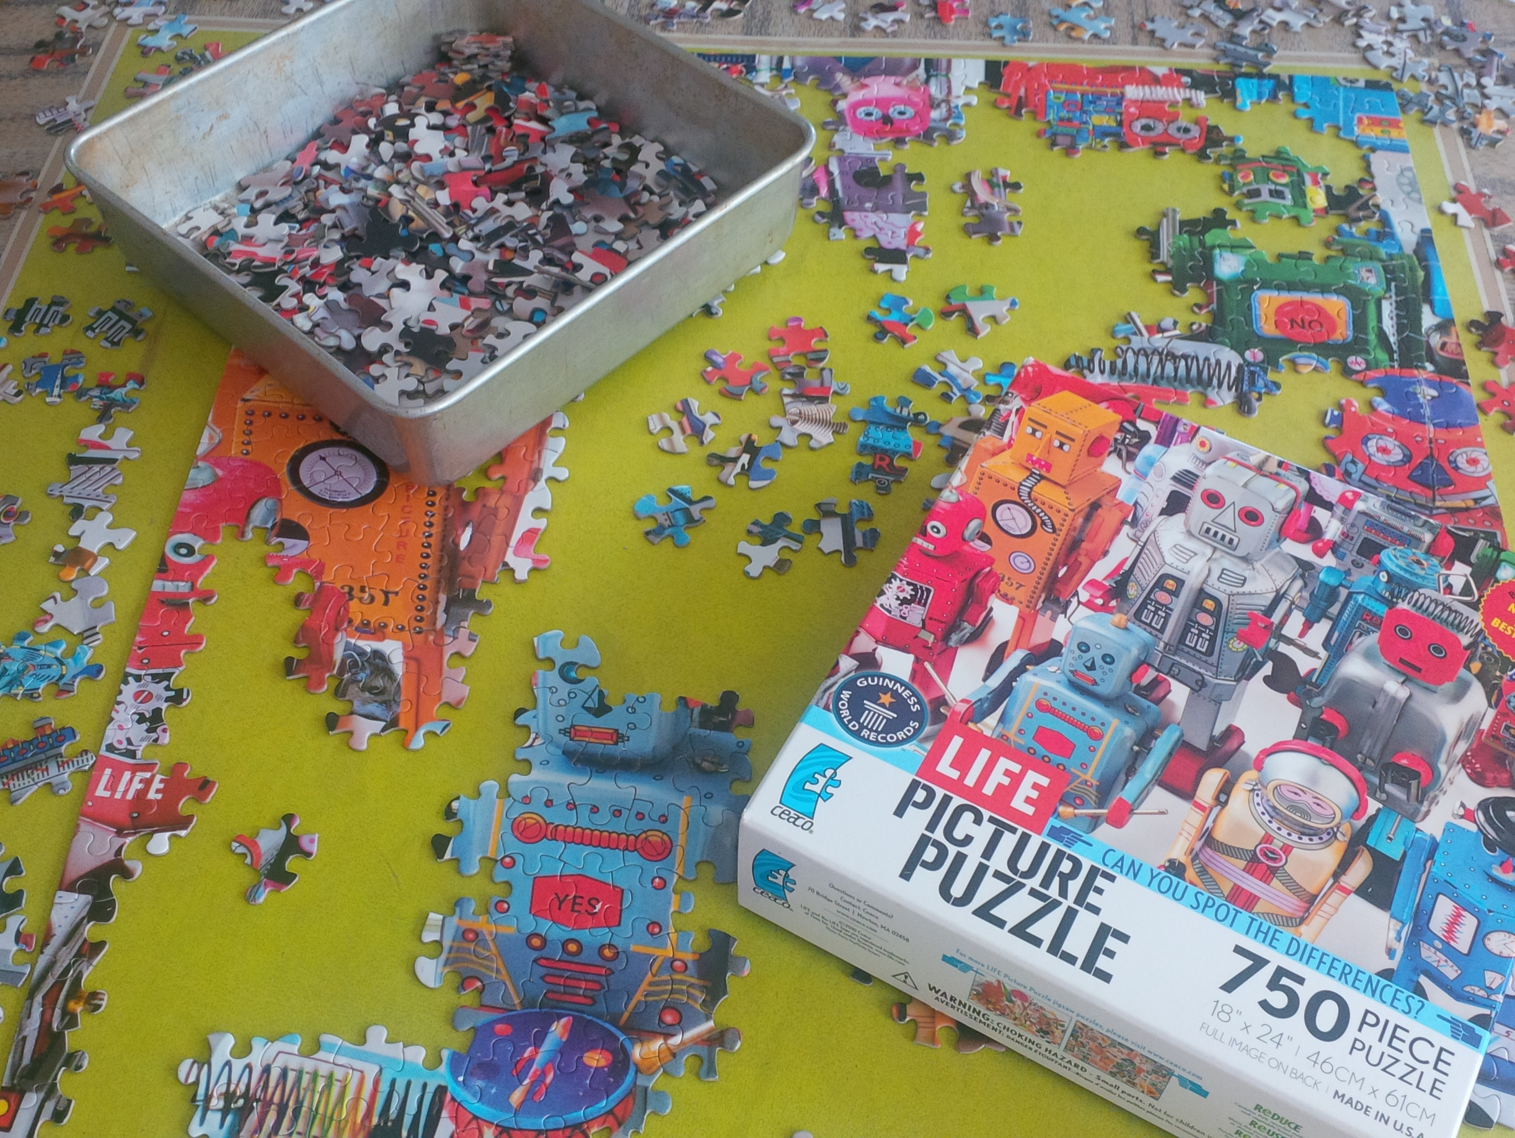

Slide 4
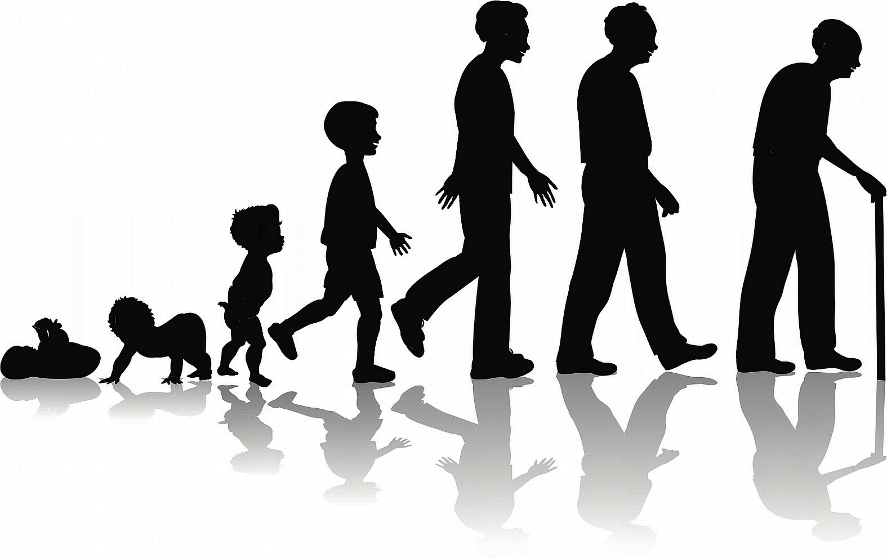

Slide 5
F.U.E.L.

Slide 6
Faith

Slide 7
Hebrews 11:6
New Living Translation
And it is impossible to please God without faith. Anyone who wants to come to him must believe that God exists and that he rewards those who sincerely seek him.

Slide 8
Ask God

Slide 9
Mark 9:24
New Living Translation
The father instantly cried out, “I do believe, but help me overcome my unbelief!”

Slide 10
Ask God
Focus on obeying

Slide 11
James 2:21-22
New Living Translation
²¹ Don’t you remember that our ancestor Abraham was shown to be right with God by his actions when he offered his son Isaac on the altar? ²² You see, his faith and his actions worked together. His actions made his faith complete.

Slide 12
Ask God
Focus on obeying
Put God’s Word in your mind

Slide 13
Luke 17:5-10
New Living Translation
⁵ The apostles said to the Lord, “Show us how to increase our faith.”
⁶ The Lord answered, “If you had faith even as small as a mustard seed, you could say to this mulberry tree, ‘May you be uprooted and be planted in the sea,’ and it would obey you!

Slide 14
Luke 17:5-10
New Living Translation
⁷ “When a servant comes in from plowing or taking care of sheep, does his master say, ‘Come in and eat with me’? ⁸ No, he says, ‘Prepare my meal, put on your apron, and serve me while I eat. Then you can eat later.’ ⁹ And does the master thank the servant for doing what he was told to do? Of course not.

Slide 15
Luke 17:5-10
New Living Translation
¹⁰ In the same way, when you obey me you should say, ‘We are unworthy servants who have simply done our duty.’”

Slide 16
Understanding
(Knowledge)

Slide 17
Ephesians 1:17-20
New Living Translation
I pray for you constantly,¹⁷ asking God, the glorious Father of our Lord Jesus Christ, to give you spiritual wisdom and insight so that you might grow in your knowledge of God. ¹⁸ I pray that your hearts will be flooded with light so that you can understand the confident hope he has given to those he called—his holy people who are his rich and glorious inheritance.

Slide 18
Ephesians 1:17-20
New Living Translation
¹⁹ I also pray that you will understand the incredible greatness of God’s power for us who believe him. This is the same mighty power ²⁰ that raised Christ from the dead and seated him in the place of honor at God’s right hand in the heavenly realms.

Slide 19
Effectiveness

Slide 20
Colossians 1:9-10
New Living Translation
⁹ So we have not stopped praying for you since we first heard about you. We ask God to give you complete knowledge of his will and to give you spiritual wisdom and understanding. ¹⁰ Then the way you live will always honor and please the Lord, and your lives will produce every kind of good fruit. All the while, you will grow as you learn to know God better and better.

Slide 21
Knowing God’s will
Get healthy
Use your gifts

Slide 22
Love

Slide 23
2 Thessalonians 1:3
New Living Translation
Dear brothers and sisters, we can’t help but thank God for you, because your faith is flourishing and your love for one another is growing.

Slide 24
Ask God
Choose
Remember how God loves you

Slide 25
1 John 4:11
New Living Translation
¹⁰ This is real love—not that we loved God, but that he loved us and sent his Son as a sacrifice to take away our sins.
¹¹ Dear friends, since God loved us that much, we surely ought to love each other.

Slide 26
Philippians 1:6
New Living Translation
⁶ And I am certain that God, who began the good work within you, will continue his work until it is finally finished on the day when Christ Jesus returns.

