Slide 1
WATCH WHERE YOU SIT

Slide 2
Matthew 28:1-5
New Living Translation
After the Sabbath, at dawn on the first day of the week, Mary Magdalene and the other Mary went to look at the tomb. ² There was a violent earthquake, for an angel of the Lord came down from heaven and, going to the tomb, rolled back the stone and sat on it. ³ His appearance was like lightning, and his clothes were white as snow.

Slide 3
Matthew 28:1-5
New Living Translation
⁴ The guards were so afraid of him that they shook and became like dead men. ⁵ The angel said to the women, “Do not be afraid, for I know that you are looking for Jesus, who was crucified. ⁶ He is not here; he has risen, just as he said. Come and see the place where he lay.

Slide 4
Matthew 28:1-5
New Living Translation
There was a violent earthquake, for an angel of the Lord came down from heaven and, going to the tomb, rolled back the stone and SAT ON IT.

Slide 5
1 Kings 19:3-4a
New Living Translation
³ Elijah was afraid and fled for his life. He went to Beersheba, a town in Judah, and he left his servant there. ⁴ Then he went on alone into the wilderness, traveling all day. He sat down under a solitary broom tree and prayed that he might die.

Slide 6
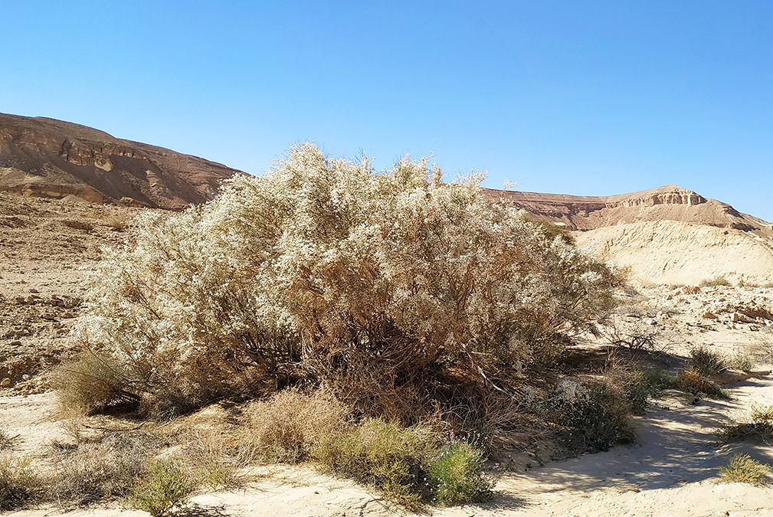
White Weeping Broom (Retama Raetam)

Slide 7
The Broom Tree:
1. Grows in the desert

Slide 8
The Broom Tree:
1. Grows in the desert
2. Bitter root that the poor would eat in desperation

Slide 9
The Broom Tree:
1. Grows in the desert
2. Bitter root that the poor would eat in desperation
3. Their twigs were used for binding

Slide 10
2 Kings 10:30
New Living Translation
...the Lord said to Jehu, “You have done well in following my instructions to destroy the family of Ahab. Therefore, your descendants will be kings of Israel down to the fourth generation.”

Slide 11
2 Kings 10:31 - Jehu
New Living Translation
But Jehu did not obey the Law of the Lord, the God of Israel, with all his heart. He refused to turn from the sins that Jeroboam had led Israel to commit.

Slide 12
2 Kings 13:2 - Jehoahaz
New Living Translation
But he did what was evil in the Lord’s sight. He followed the example of Jeroboam son of Nebat, continuing the sins that Jeroboam had led Israel to commit.

Slide 13
2 Kings 13:11 - Jehoash
New Living Translation
But he did what was evil in the Lord’s sight. He refused to turn from the sins that Jeroboam son of Nebat had led Israel to commit.

Slide 14
2 Kings 14:24 - Jereboam II
New Living Translation
He did what was evil in the Lord’s sight. He refused to turn from the sins that Jeroboam son of Nebat had led Israel to commit.

Slide 15
2 Kings 15:9 - Zechariah
New Living Translation
Zechariah did what was evil in the Lord’s sight, as his ancestors had done. He refused to turn from the sins that Jeroboam son of Nebat had led Israel to commit.

Slide 16
2 Kings 15:9 - Zechariah
New Living Translation
Zechariah did what was evil in the Lord’s sight, as his ancestors had done. He refused to turn from the sins that Jeroboam son of Nebat had led Israel to commit.

Slide 17
Hebrews 12:1-3
New Living Translation
Therefore, since we are surrounded by such a huge crowd of witnesses to the life of faith, let us strip off every weight that slows us down, especially the sin that so easily trips us up. And let us run with endurance the race God has set before us.

Slide 18
Hebrews 12:1-3
New Living Translation
² We do this by keeping our eyes on Jesus, the champion who initiates and perfects our faith. Because of the joy awaiting him, he endured the cross, disregarding its shame. Now he is seated in the place of honor beside God’s throne. Think of all the hostility he endured from sinful people; then you won’t become weary and give up.

Slide 19
WHERE WILL YOU SIT?

Slide 20
Next Week:
Part 2 –
‘SAVING SEATS’

