Slide 1
WATCH WHERE YOU SIT
(Part 2)

Slide 2
Last Week:
The angel sat ON the tomb stone
vs
Elijah sat UNDER the broom tree

Slide 3
SAVING SEATS

Slide 4
Three Brains:
1. The SURVIVAL Brain

Slide 5
Three Brains:
1. The Survival Brain
2. The LOGICAL Brain

Slide 6
Three Brains:
1. The Survival Brain
2. The Logical Brain
3. The EMOTIONAL Brain

Slide 7
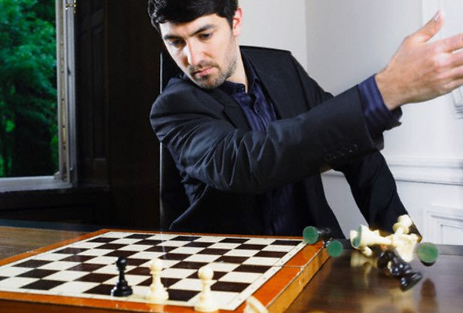

Slide 8
Philippians 4:6-7
New Living Translation
⁶ Don’t worry about anything; instead, pray about everything. Tell God what you need, and thank him for all he has done. ⁷ Then you will experience God’s peace, which exceeds anything we can understand. His peace will guard your hearts and minds as you live in Christ Jesus.

Slide 9
Philippians 4:8
New Living Translation
⁸ And now, dear brothers and sisters, one final thing. Fix your thoughts on what is true, and honorable, and right, and pure, and lovely, and admirable. Think about things that are excellent and worthy of praise.

Slide 10
2 Corinthians 10:5
New Living Translation
...we take captive every thought to make it obedient to Christ.

Slide 11
Romans 12:2
New International Version
...be transformed by the renewing of your mind.

Slide 12
A SEAT HAS BEEN SAVED
FOR YOU

Slide 13
Ephesians 2:6-9
New Living Translation
⁶ For he raised us from the dead along with Christ and seated us with him in the heavenly realms because we are united with Christ Jesus. ⁷ So God can point to us in all future ages as examples of the incredible wealth of his grace and kindness toward us, as shown in all he has done for us who are united with Christ Jesus.

Slide 14
Ephesians 2:6-9
New Living Translation
⁸ God saved you by his grace when you believed. And you can’t take credit for this; it is a gift from God. ⁹ Salvation is not a reward for the good things we have done, so none of us can boast about it.

Slide 15
Revelation 3:21
New International Version
²¹ To the one who is victorious, I will give the right to sit with me on my throne, just as I was victorious and sat down with my Father on his throne.

Slide 16
Galatians 3:13
The Passion Translation
Yet, Christ paid the full price to set us free from the curse of the law. He absorbed it completely as he became a curse in our place.

