Slide 1
REALITYCHECK
(noun): an occasion or opportunity to consider a matter realistically or honestly

Slide 2
The Purpose Driven Church
Worship (Love the Lord with all your heart)
Ministry (Love your neighbour as yourself)
Evangelism (Go and make disciples)
Fellowship (Baptising them)
Discipleship (Teaching them to obey)

Slide 3
Matthew 28:18-20 New Living Translation
¹⁸ Jesus came and told his disciples, “I have been given all authority in heaven and on earth. ¹⁹ Therefore, go and make disciples of all the nations, baptizing them in the name of the Father and the Son and the Holy Spirit. ²⁰ Teach these new disciples to obey all the commands I have given you. And be sure of this: I am with you always, even to the end of the age.”

Slide 4
PURPOSEDISCIPLESHIP
(noun): the process of helping people to become more like Christ in their thoughts, feelings and actions.

Slide 5
FOLLOWER

Slide 6
Ephesians 4:12-16 New Living Translation
¹² Their responsibility is to equip God’s people to do his work and build up the church, the body of Christ. ¹³ This will continue until we all come to such unity in our faith and knowledge of God’s Son that we will be mature in the Lord, measuring up to the full and complete standard of Christ.

Slide 7
Ephesians 4:12-16 New Living Translation
¹⁴ Then we will no longer be immature like children. We won’t be tossed and blown about by every wind of new teaching. We will not be influenced when people try to trick us with lies so clever they sound like the truth. ¹⁵ Instead, we will speak the truth in love, growing in every way more and more like Christ, who is the head of his body, the church.

Slide 8
Ephesians 4:12-16 New Living Translation
¹⁶ He makes the whole body fit together perfectly. As each part does its own special work, it helps the other parts grow, so that the whole body is healthy and growing and full of love.

Slide 9
BEING Disciples

Slide 10
Philippians 1:6 New Living Translation
And I am certain that God, who began the good work within you, will continue his work until it is finally finished on the day when Christ Jesus returns.

Slide 11
QUESTION: WHO ARE MY ROLE MODELS?

Slide 12
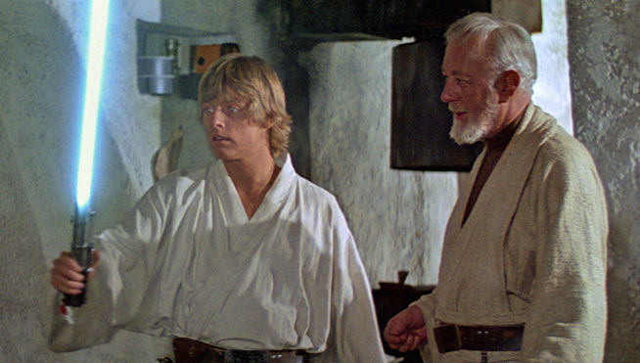

Slide 13
QUESTION: WHAT KIND OF STUDENT AM I?

Slide 14
MAKING Disciples

Slide 15
1 Corinthians 11:1 New Living Translation
And you should imitate me, just as I imitate Christ.

Slide 16
Philippians 3:17 New Living Translation
Dear brothers and sisters, pattern your lives after mine, and learn from those who follow our example.

Slide 17
Philippians 4:9a New Living Translation
Keep putting into practice all you learned and received from me—everything you heard from me and saw me doing.

Slide 18
QUESTION: WHO IS WATCHING ME?

Slide 20
Making
DISCIPLE-MAKERS

Slide 21
2 Timothy 2:2 New Living Translation
You have heard me teach things that have been confirmed by many reliable witnesses. Now teach these truths to other trustworthy people who will be able to pass them on to others.

Slide 22
QUESTION: AM I WILLING TO BE A DISCIPLE-MAKER?

Slide 23
QUESTION: WHAT COULD I DO TO HELP SOMEONE ELSE BE MORE CONNECTED?

