Slide 1
INSEPARABLE
Romans 8:31-39

Slide 2
Romans 8:31-39
New Living Translation
What then shall we say about such wonderful things as these? ...

Slide 3
Romans 8:26-28
New Living Translation
And the Holy Spirit helps us in our weakness. For example, we don’t know what God wants us to pray for. But the Holy Spirit prays for us with groanings that cannot be expressed in words. ²⁷ And the Father who knows all hearts knows what the Spirit is saying, for the Spirit pleads for us believers in harmony with God’s own will.

Slide 4
Romans 8:26-28
New Living Translation
²⁸ And we know that God causes everything to work together for the good of those who love God and are called according to his purpose for them.

Slide 5
Romans 8:31-39
New Living Translation
What then shall we say about such wonderful things as these? ... If God is for us, who can ever be against us? ³² Since he did not spare even his own Son but gave him up for us all, won’t he also give us everything else?
³³ Who dares accuse us whom God has chosen for his own?

Slide 6
Romans 8:31-39
New Living Translation
No one—for God himself has given us right standing with himself. ³⁴ Who then will condemn us? No one—for Christ Jesus died for us and was raised to life for us, and he is sitting in the place of honour at God’s right hand, pleading for us.

Slide 7
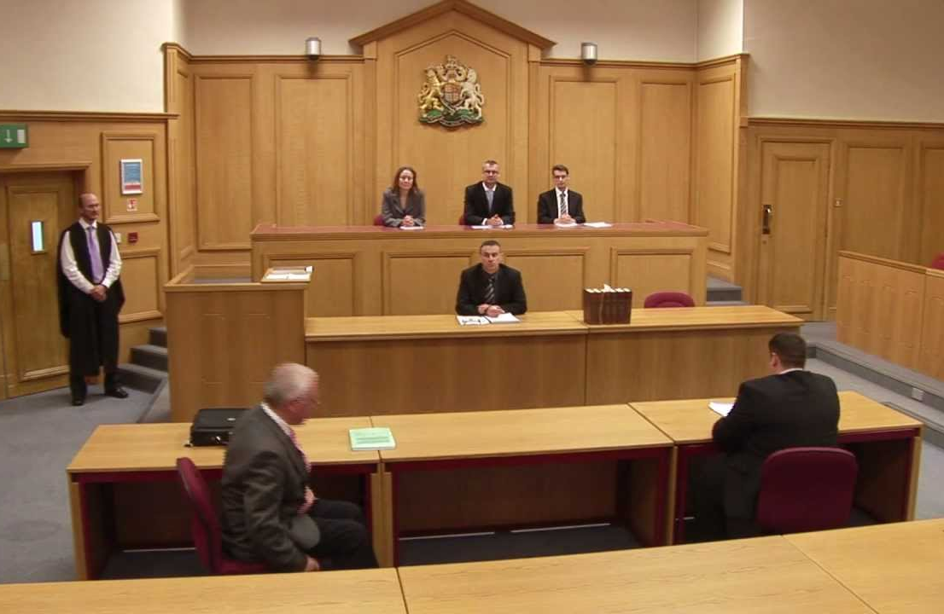

Slide 8
Romans 8:1
New Living Translation
So now there is no condemnation for those who belong to Christ Jesus.

Slide 9
You are not condemned

Slide 10
Romans 8:31-39
New Living Translation
³⁵ Can anything ever separate us from Christ’s love? Does it mean he no longer loves us if we have trouble or calamity, or are persecuted, or hungry, or destitute, or in danger, or threatened with death? ³⁶ (As the Scriptures say, “For your sake we are killed every day; we are being slaughtered like sheep.”)

Slide 11
Romans 8:31-39
New Living Translation
³⁷ No, despite all these things, overwhelming victory is ours through Christ, who loved us.

Slide 12
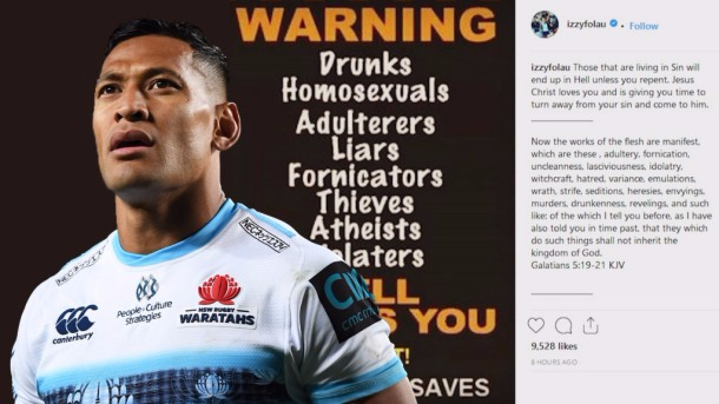

Slide 13
Romans 8:31-39
New Living Translation
³⁷ No, despite all these things, overwhelming victory is ours through Christ, who loved us.

Slide 14
Romans 8:31-39
New Living Translation
³⁸ And I am convinced that nothing can ever separate us from God’s love. Neither death nor life, neither angels nor demons, neither our fears for today nor our worries about tomorrow—not even the powers of hell can separate us from God’s love.

Slide 15
Romans 8:31-39
New Living Translation
³⁹ No power in the sky above or in the earth below—indeed, nothing in all creation will ever be able to separate us from the love of God that is revealed in Christ Jesus our Lord.

Slide 16
