Slide 2
Exodus 20:16
New Living Translation
You must not covet your neighbour’s house. You must not covet your neighbour’s wife, male or female servant, ox or donkey, or anything else that belongs to your neighbour.

Slide 3
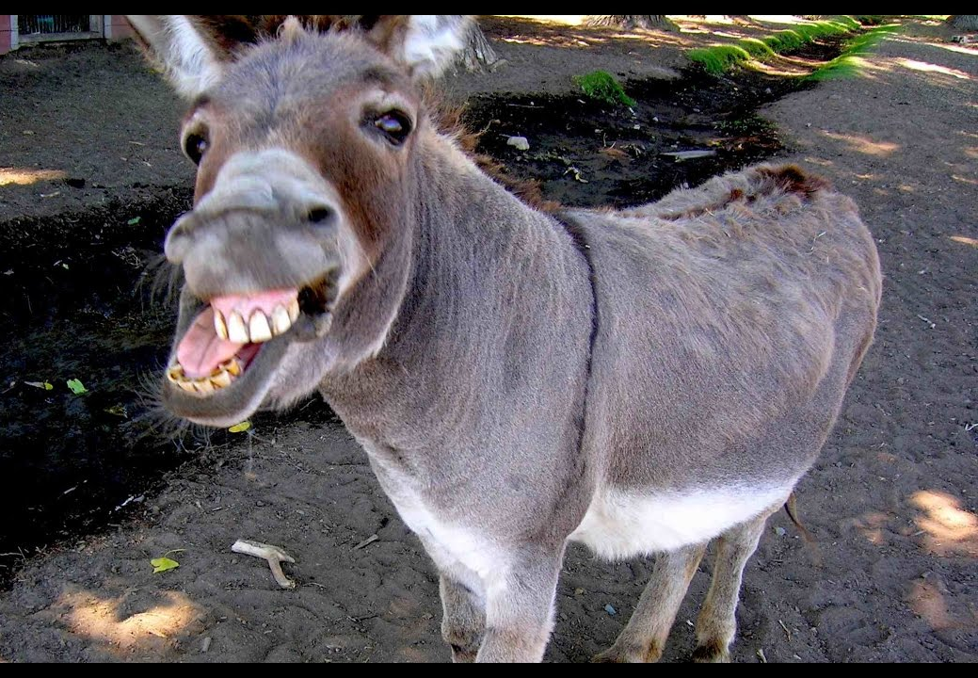

Slide 4
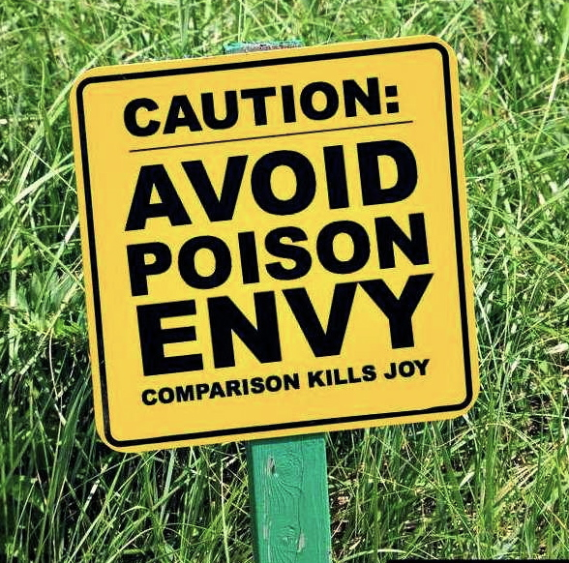
Covet = Strong Desire, especially for what someone else has
Closely related to: Envy, Jealousy

Slide 5
Vocabulary.com
“Basically this means you should be happy with your electronic gadgets and not be jealous when a friend gets something better.”

Slide 6
1 Corinthians 12:31
New Living Translation
So you should earnestly desire the most helpful [spiritual] gifts.

Slide 7
Matthew 5:6
New International Version
Blessed are those who hunger and thirst for righteousness for they will be filled.

Slide 8
Psalm 37:4
New Living Translation
Take delight in the Lord, and he will give you your heart’s desires.

Slide 9
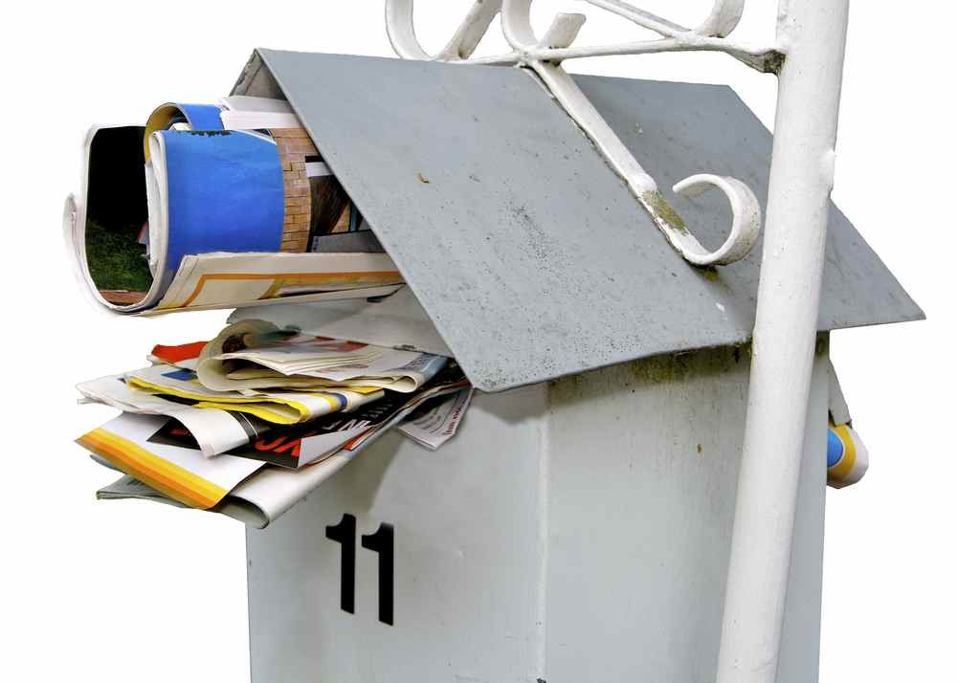
It must be nearly Christmas!

Slide 10
What does God know about Coveting?
1. It leads to other sins

Slide 11
What does God know about Coveting?
1. It leads to other sins
Saul & David
David & Bathsheba
Ahab & Naboth
Ananias & Sapphira

Slide 12
What does God know about Coveting?
1. It leads to other sins
2. It blinds us to what is really important

Slide 13
What does God know about Coveting?
1. It leads to other sins
2. It blinds us to what is really important
3. It blinds us to the needs of others

Slide 14
1 John 3:17
New Living Translation
If someone has enough money to live well and sees a brother or sister in need but shows no compassion—how can God’s love be in that person?

Slide 15
What does God know about Coveting?
1. It leads to other sins
2. It blinds us to what is really important
3. It blinds us to the needs of others
4. It is deceptive

Slide 16
The Things of the Lord (Colin Buchanan)
You save your money and you pay your cash Buying things that are really flash But one day when they collect the trash That's where they're gonna be
'Cause they're all gonna fade They're all gonna rust They're all gonna start to fall apart They're all gonna turn to dust All that stuff is gonna be trash Only the things of the Lord will last

Slide 17
1 Timothy 6:6-8
New Living Translation
⁶ Yet true godliness with contentment is itself great wealth. ⁷ After all, we brought nothing with us when we came into the world, and we can’t take anything with us when we leave it. ⁸ So if we have enough food and clothing, let us be content.

Slide 18
Hebrews 13:5
New Living Translation
Don’t love money; be satisfied with what you have. For God has said, “I will never fail you. I will never abandon you.”

Slide 19
Philippians 4:11
New Living Translation
I have learned how to be content with whatever I have.

Slide 20
Philippians 3:7-9a
New Living Translation
⁷ I once thought these things were valuable, but now I consider them worthless because of what Christ has done. ⁸ Yes, everything else is worthless when compared with the infinite value of knowing Christ Jesus my Lord. For his sake I have discarded everything else, counting it all as garbage, so that I could gain Christ ⁹and become one with him.

