Slide 2
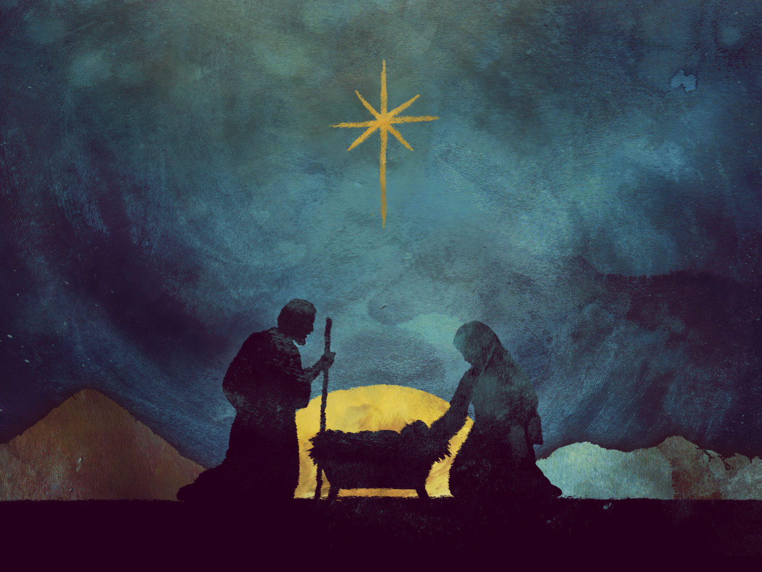
CHRISTMAS IS...
Sharing

Slide 3
Sharing My Story:
Mary & Joseph

Slide 4
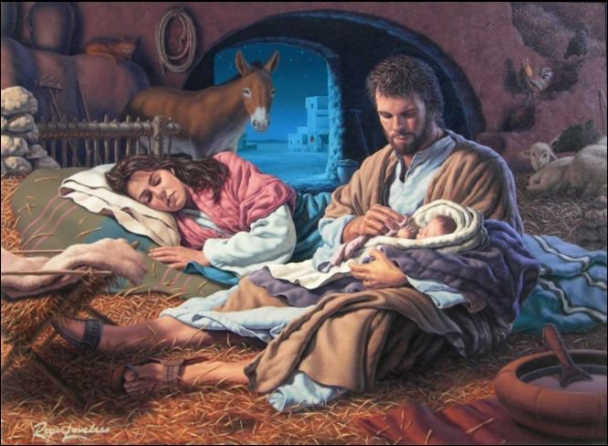

Slide 5
1 Peter 3:15
New Living Translation
¹³ Now, who will want to harm you if you are eager to do good? ¹⁴ But even if you suffer for doing what is right, God will reward you for it. So don’t worry or be afraid of their threats. ¹⁵ Instead, you must worship Christ as Lord of your life. And if someone asks about your hope as a believer, always be ready to explain it.

Slide 6
Sharing God’s Story:
The Shepherds

Slide 7
Luke 2:16-17
New Living Translation
¹⁶ They hurried to the village and found Mary and Joseph. And there was the baby, lying in the manger. ¹⁷ After seeing him, the shepherds told everyone what had happened and what the angel had said to them about this child.

Slide 8
Matthew 10:7-8
New Living Translation
Go and announce to them that the Kingdom of Heaven is near. ⁸ Heal the sick, raise the dead, cure those with leprosy, and cast out demons. Give as freely as you have received!

Slide 9
Sharing What I Have:
The Magi

Slide 10
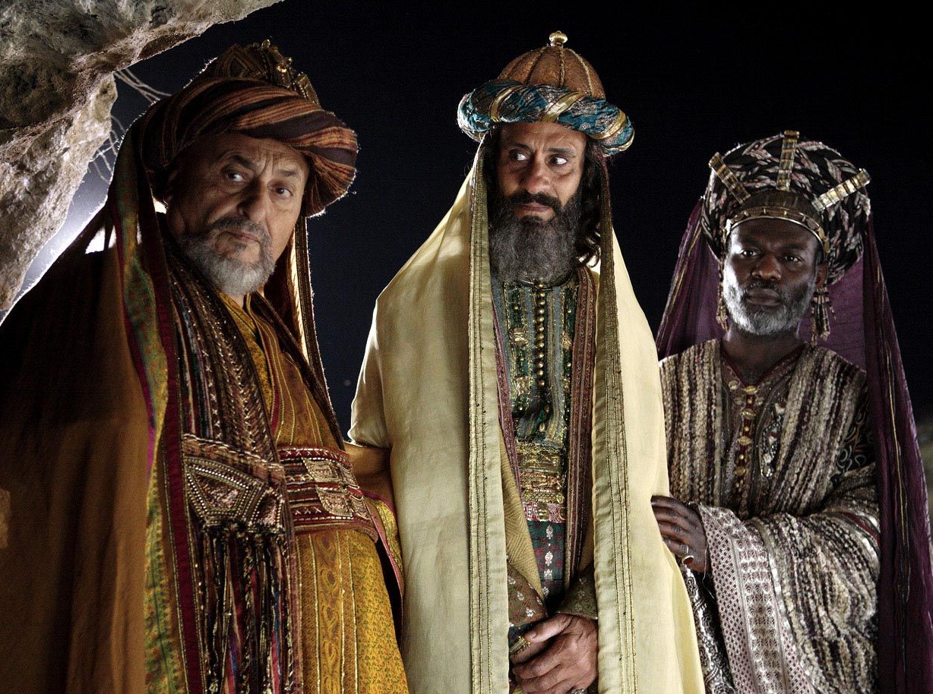

Slide 11
Matthew 2:9-11
New Living Translation
⁹ After this interview the wise men went their way. And the star they had seen in the east guided them to Bethlehem. It went ahead of them and stopped over the place where the child was. ¹⁰ When they saw the star, they were filled with joy! ¹¹ They entered the house and saw the child with his mother, Mary, and they bowed down and worshiped him. Then they opened their treasure chests and gave him gifts of gold, frankincense, and myrrh.

Slide 12
Luke 3:10-11
New Living Translation
¹⁰ The crowds asked, “What should we do?”
¹¹ John replied, “If you have two shirts, give one to the poor. If you have food, share it with those who are hungry.”

Slide 13
Romans 12:13
New International Version
Share with the Lord’s people who are in need. Practice hospitality.

Slide 14
Philippians 2:4
New Living Translation
Don’t look out only for your own interests, but take an interest in others, too.

Slide 15
2 Corinthians 8:12-14
New Living Translation
¹² Whatever you give is acceptable if you give it eagerly. And give according to what you have, not what you don’t have. ¹³ Of course, I don’t mean your giving should make life easy for others and hard for yourselves. I only mean that there should be some equality. ¹⁴ Right now you have plenty and can help those who are in need. Later, they will have plenty and can share with you when you need it. In this way, things will be equal.

Slide 16
1 John 3:17-18
New Living Translation
¹⁷ If someone has enough money to live well and sees a brother or sister in need but shows no compassion—how can God’s love be in that person?
¹⁸ Dear children, let’s not merely say that we love each other; let us show the truth by our actions.

