Slide 2
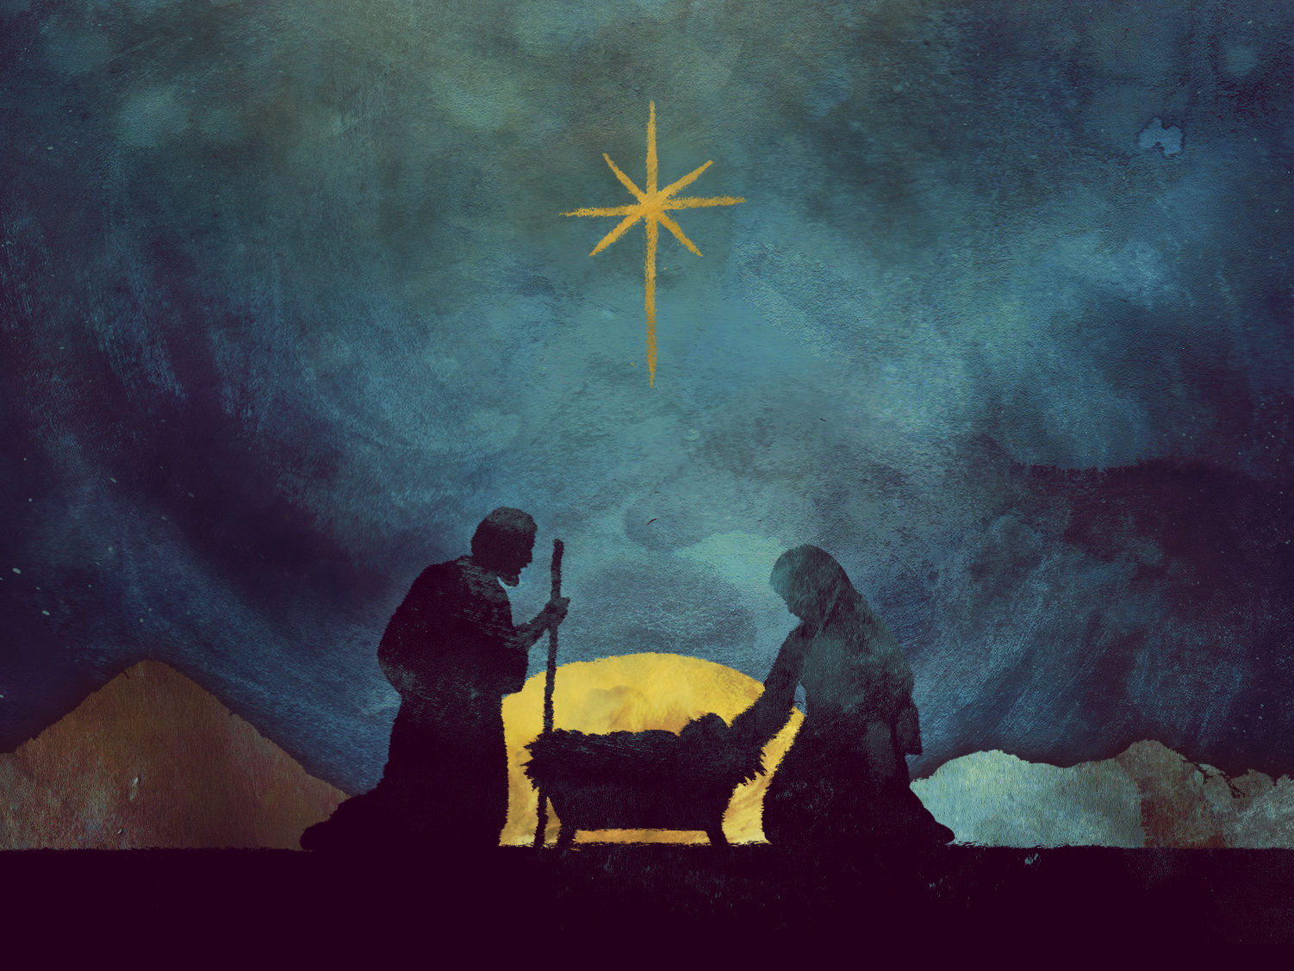
CHRISTMAS IS...
Saying Yes

Slide 4
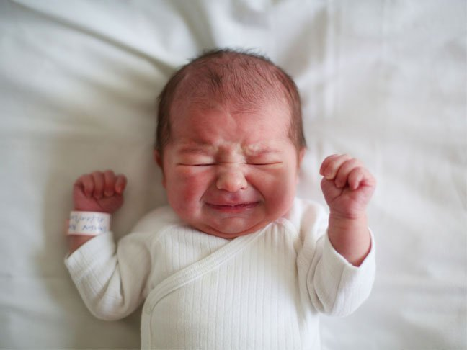
Jesus
(not an actual photo)

Slide 5
John 17:5
New Living Translation
⁴ I brought glory to you here on earth by completing the work you gave me to do. ⁵ Now, Father, bring me into the glory we shared before the world began.

Slide 6
Colossians 1:15
New Living Translation
Christ is the visible image of the invisible God. He existed before anything was created and is supreme over all creation...

Slide 7
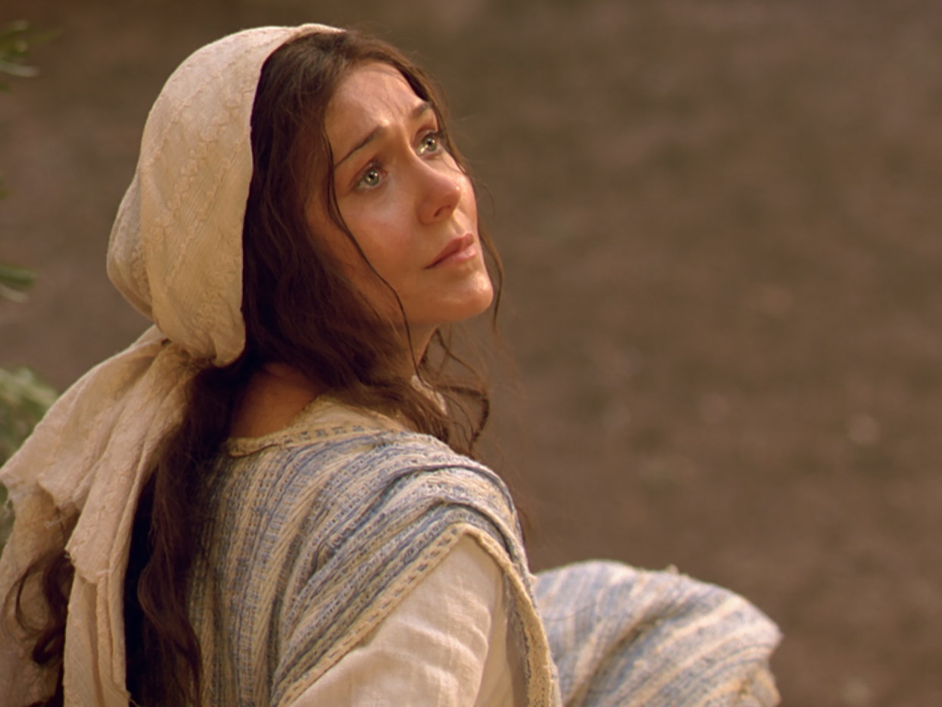
Mary
(also not actual photo)

Slide 8
Luke 1:26-38
New Living Translation
²⁶ In the sixth month of Elizabeth’s pregnancy, God sent the angel Gabriel to Nazareth, a town in Galilee, ²⁷ to a virgin pledged to be married to a man named Joseph, a descendant of David. The virgin’s name was Mary. ²⁸ The angel went to her and said, “Greetings, you who are highly favored! The Lord is with you.”

Slide 9
Luke 1:26-38
New Living Translation
²⁹ Mary was greatly troubled at his words and wondered what kind of greeting this might be. ³⁰ But the angel said to her, “Do not be afraid, Mary; you have found favor with God. ³¹ You will conceive and give birth to a son, and you are to call him Jesus. ³² He will be great and will be called the Son of the Most High. The Lord God will give him the throne of his father David, ³³ and he will reign over Jacob’s descendants forever; his kingdom will never end.”

Slide 10
Luke 1:26-38
New Living Translation
³⁴ “How will this be,” Mary asked the angel, “since I am a virgin?”
³⁵ The angel answered, “The Holy Spirit will come on you, and the power of the Most High will overshadow you. So the holy one to be born will be called the Son of God. ³⁶ Even Elizabeth your relative is going to have a child in her old age, and she who was said to be unable to conceive is in her sixth month. ³⁷ For no word from God will ever fail.”

Slide 11
Luke 1:26-38
New Living Translation
“I am the Lord’s servant,” Mary answered. “May your word to me be fulfilled.” Then the angel left her.

Slide 13
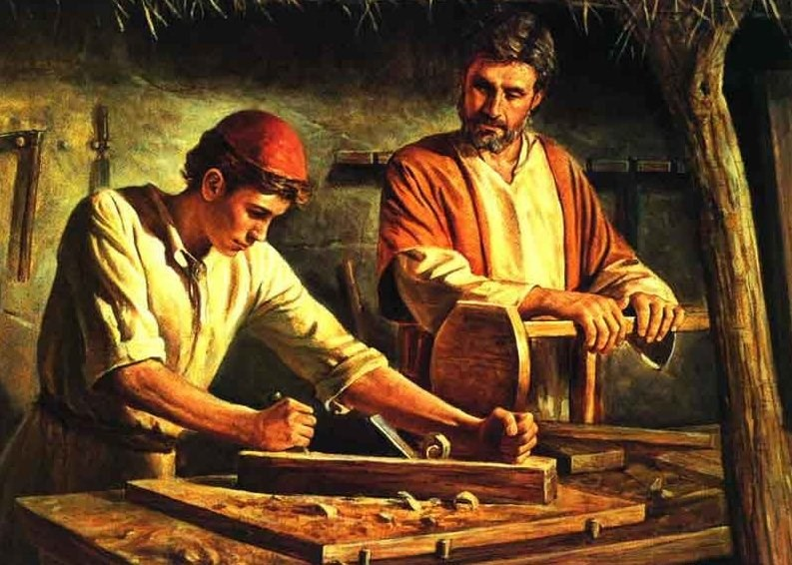
Joseph

Slide 14
Matthew 1:19-21
New Living Translation
¹⁹ Joseph, to whom she was engaged, was a righteous man and did not want to disgrace her publicly, so he decided to break the engagement quietly.
²⁰ As he considered this, an angel of the Lord appeared to him in a dream. “Joseph, son of David,” the angel said, “do not be afraid to take Mary as your wife. For the child within her was conceived by the Holy Spirit.

Slide 15
Matthew 1:19-21
New Living Translation
²¹ And she will have a son, and you are to name him Jesus, for he will save his people from their sins.”

Slide 17
Luke 5:4-5
New Living Translation
⁴ When [Jesus] had finished speaking, he said to Simon, “Put out into deep water, and let down the nets for a catch.”
⁵ Simon answered, “Master, we’ve worked hard all night and haven’t caught anything. But because you say so, I will let down the nets.”

Slide 18
Will you say “Yes”?

