Slide 2
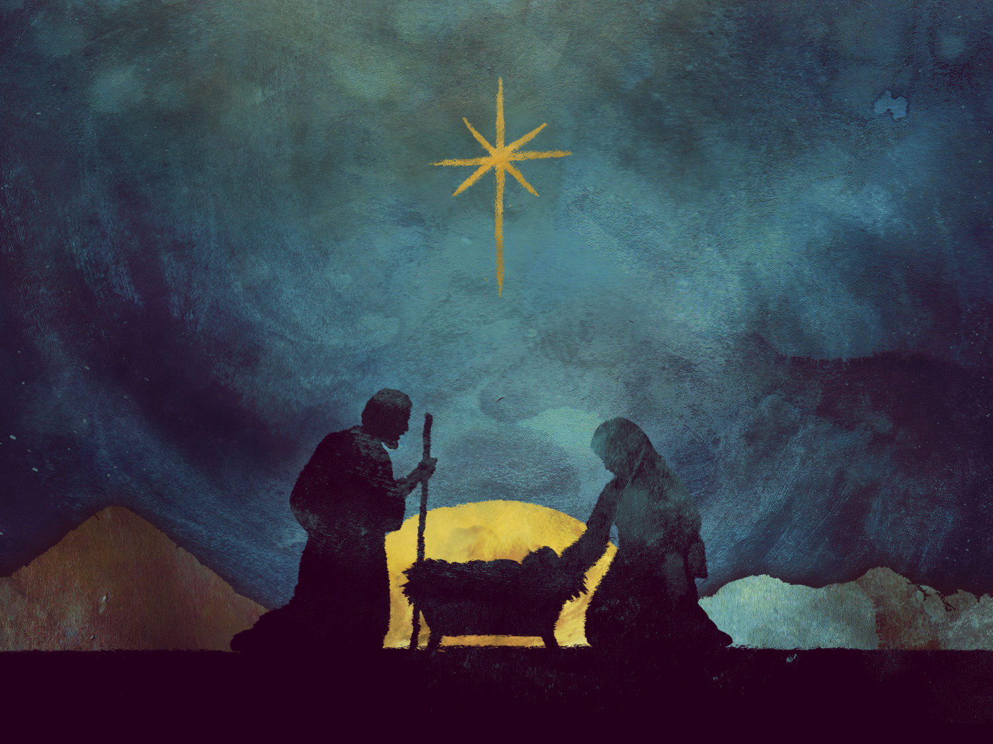
CHRISTMAS IS...
Being Grateful

Slide 4
Ephesians 5:20
New Living Translation
And give thanks for everything to God the Father in the name of our Lord Jesus Christ.

Slide 5
Romans 1:8
New Living Translation
Let me say first that I thank my God through Jesus Christ for all of you, because your faith in him is being talked about all over the world.

Slide 6
1 Corinthians 1:4
New Living Translation
I always thank my God for you and for the gracious gifts he has given you, now that you belong to Christ Jesus.

Slide 7
Ephesians 1:15-16a
New Living Translation
Ever since I first heard of your strong faith in the Lord Jesus and your love for God’s people everywhere, ¹⁶ I have not stopped thanking God for you.

Slide 8
Philippians 1:3
New Living Translation
Every time I think of you, I give thanks to my God.

Slide 9
Why is it so important?
1. It helps us to be content
2. It helps us to acknowledge the source

Slide 10
James 1:17
New International Version
Every good and perfect gift is from above, coming down from the Father of the heavenly lights, who does not change like shifting shadows.

Slide 11
Why is it so important?
1. It helps us to be content
2. It helps us to acknowledge the source
3. It helps us trust God to provide
4. It helps us to be generous

Slide 12
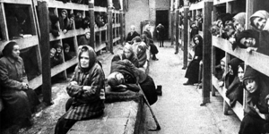
“The Hiding Place” Corrie Ten Boom

Slide 13
THE FIRST CHRISTMAS

Slide 14
Luke 1:46-49
New Living Translation
⁴⁶ Mary responded,
“Oh, how my soul praises the Lord. ⁴⁷ How my spirit rejoices in God my Savior! ⁴⁸ For he took notice of his lowly servant girl, and from now on all generations will call me blessed. ⁴⁹ For the Mighty One is holy, and he has done great things for me.

Slide 15
Ephesians 1:3
New Living Translation
All praise to God, the Father of our Lord Jesus Christ, who has blessed us with every spiritual blessing in the heavenly realms because we are united with Christ.

Slide 16
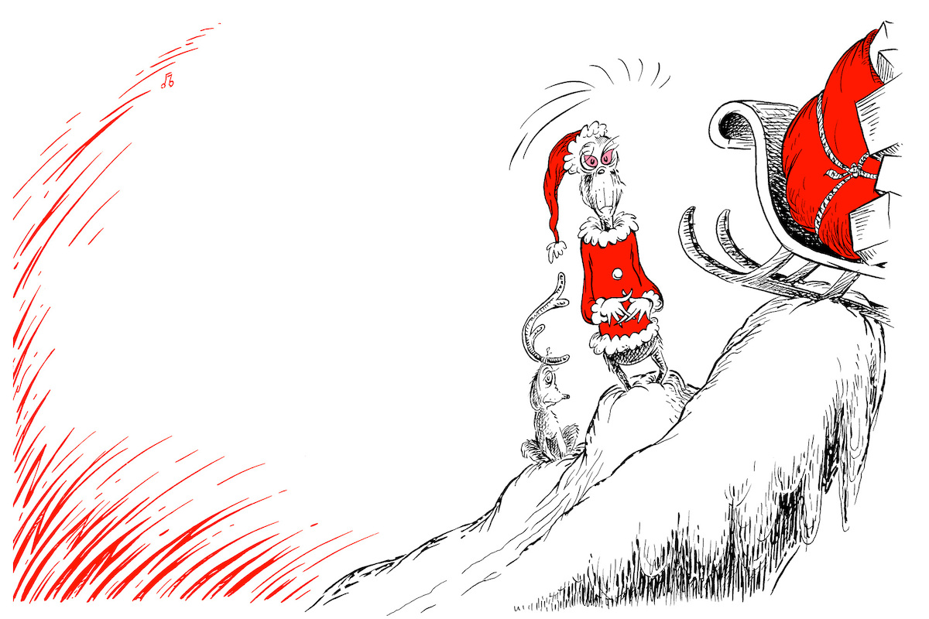
'Maybe Christmas, he thought, doesn't come from a store.
Maybe Christmas... perhaps... means a little bit more!'
The Grinch

