Slide 2
Exodus 20:15
New Living Translation
You must not steal.

Slide 3
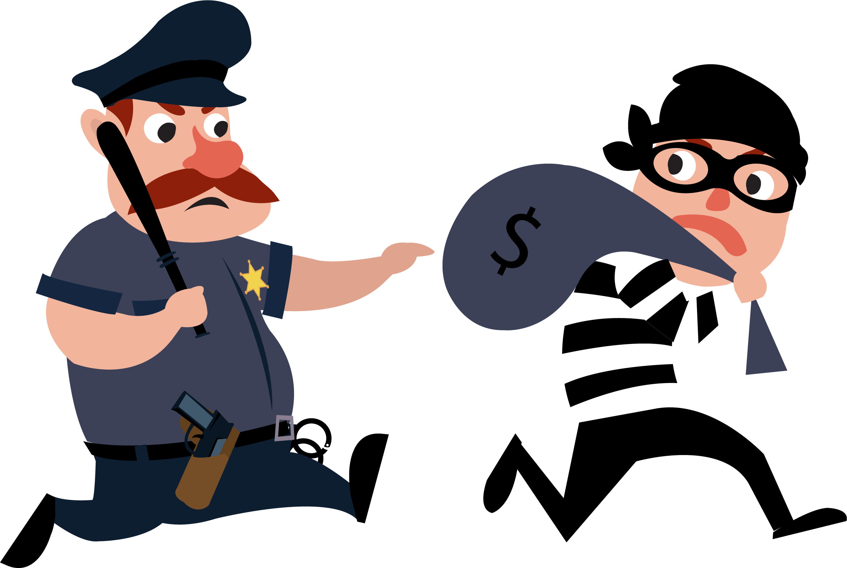
Stealing

Slide 5
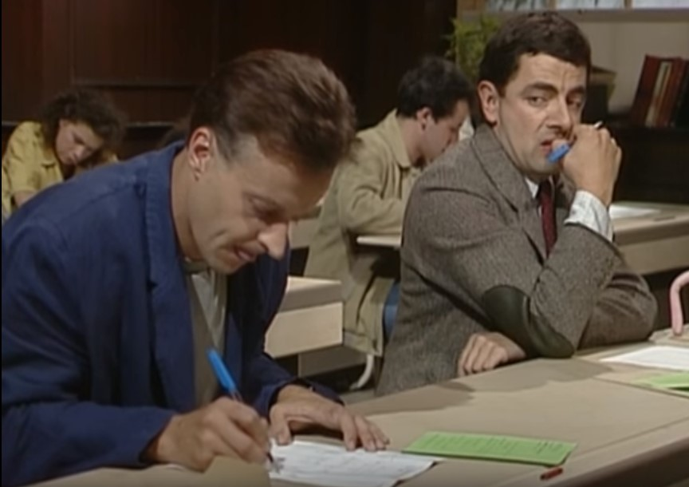

Slide 6
Stealing from God
1. Financially

Slide 7
1 Corinthians 6:19-20
New Living Translation
You do not belong to yourself, ²⁰ for God bought you with a high price.

Slide 8
Stealing from God
1. Financially
2. Our Gifts

Slide 9
Ephesians 4:11-12
New Living Translation
¹¹ Now these are the gifts Christ gave to the church: the apostles, the prophets, the evangelists, and the pastors and teachers. ¹² Their responsibility is to equip God’s people to do his work and build up the church, the body of Christ.

Slide 10
God’s Best For Us
Peace
Integrity

Slide 11
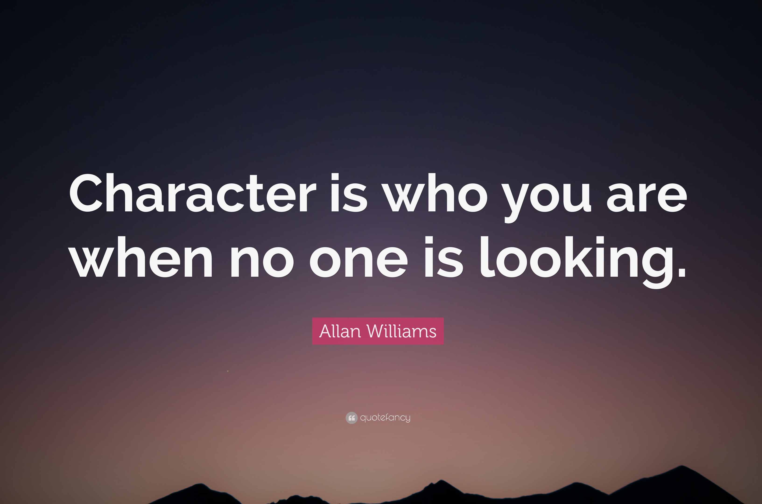

Slide 12
God’s Best For Us
Peace
Integrity
Love

Slide 13
Philippians 2:4
New Living Translation
Don’t look out only for your own interests, but take an interest in others, too.

Slide 14
Proverbs 21:13
New Living Translation
Those who shut their ears to the cries of the poor will be ignored in their own time of need.

Slide 15
John 13:34-35
New Living Translation
³⁴ So now I am giving you a new commandment: Love each other. Just as I have loved you, you should love each other. ³⁵ Your love for one another will prove to the world that you are my disciples.”

Slide 16
Romans 13:8-10
New Living Translation
⁸ Owe nothing to anyone—except for your obligation to love one another. If you love your neighbor, you will fulfill the requirements of God’s law. ⁹ For the commandments say, “You must not commit adultery. You must not murder. You must not steal. You must not covet.”

Slide 17
Romans 13:8-10
New Living Translation
These—and other such commandments—are summed up in this one commandment: “Love your neighbor as yourself.” ¹⁰ Love does no wrong to others, so love fulfills the requirements of God’s law.

Slide 18
The HEART
of the Problem

Slide 19
Philippians 4:11-13
New Living Translation
¹¹ Not that I was ever in need, for I have learned how to be content with whatever I have. ¹² I know how to live on almost nothing or with everything. I have learned the secret of living in every situation, whether it is with a full stomach or empty, with plenty or little. ¹³ For I can do everything through Christ, who gives me strength.

Slide 20
Hebrews 13:5
New Living Translation
⁵ Don’t love money; be satisfied with what you have. For God has said,
“I will never fail you.
I will never abandon you.”

Slide 21
Matthew 6:19-21
New Living Translation
¹⁹ “Don’t store up treasures here on earth, where moths eat them and rust destroys them, and where thieves break in and steal. ²⁰ Store your treasures in heaven, where moths and rust cannot destroy, and thieves do not break in and steal. ²¹ Wherever your treasure is, there the desires of your heart will also be.

