Slide 1


Slide 2

Exodus 20:14
New Living Translation
You must not commit adultery.

Slide 3
Matthew 5:27-28
New Living Translation
²⁷ “You have heard the commandment that says, ‘You must not commit adultery.' ²⁸ But I say, anyone who even looks at a woman with lust has already committed adultery with her in his heart.

Slide 4
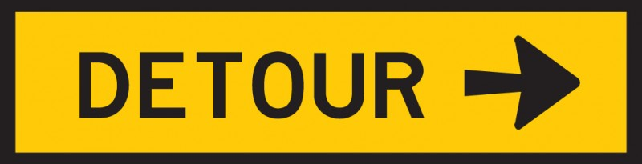

Slide 5
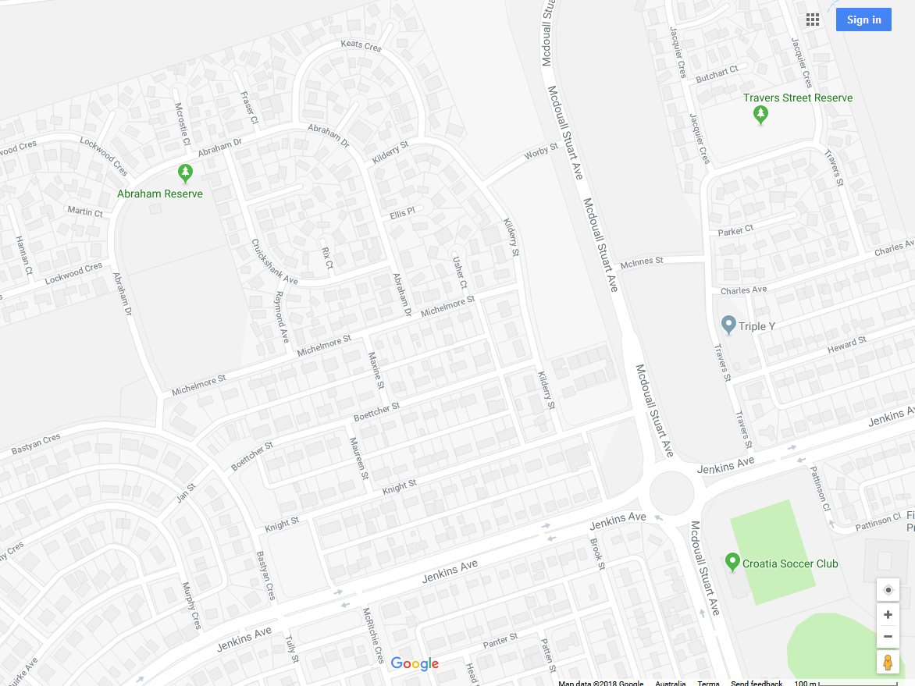

Slide 6
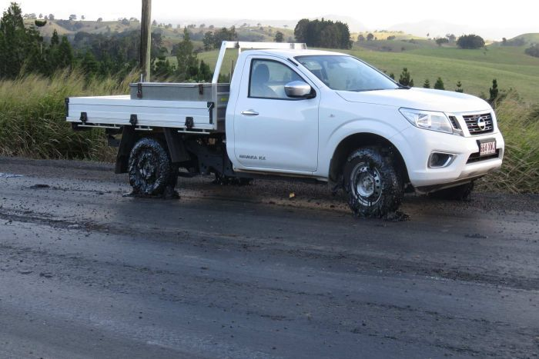

Slide 7
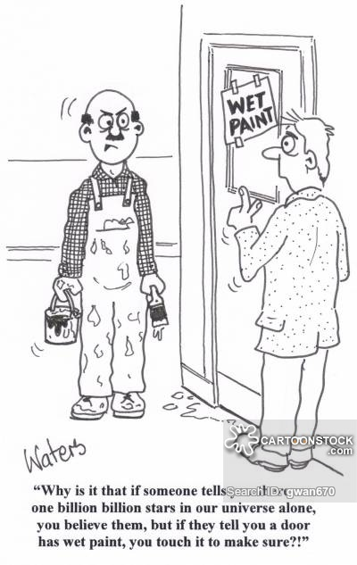

Slide 8
“Everybody looks for different things in the Ten Commandments. Some look for Divine guidance, some look for a code to live by… but most of us are looking for loopholes.”
Unknown

Slide 9
Adultery
Adulterium (Latin)
=
Contamination, mixing of different ingredients

Slide 10
Adulterate/Adulteration
=
to render something poorer in quality by adding another substance.

Slide 11
Adultery: (Published in the LA Times)
“Adultery is when you participate in the type of close behavior with someone who is not your spouse, and you would not want your spouse to behave likewise with someone else.”

Slide 12


Slide 13


Slide 14
Adultery Hurts Us

Slide 15
"...of those who break up their marriage to marry someone else, 80% are sorry later. Of those who do marry their lover, which is only about 10%, about 70% get another divorce. Of the 25-30% who stay married, only half of them are happy.”
Dr Lana Staheli

Slide 16
Proverbs 6:32
New Living Translation
But the man who commits adultery is an utter fool, for he destroys himself.

Slide 17
Proverbs 6:32
New Living Translation
²⁵Don’t lust for [the beauty of an immoral woman]. Don’t let her coy glances seduce you. ²⁶ For a prostitute will bring you to poverty, but sleeping with another man’s wife will cost you your life. ²⁷ Can a man scoop a flame into his lap and not have his clothes catch on fire?

Slide 18
Proverbs 6:32
New Living Translation
²⁸ Can he walk on hot coals and not blister his feet? ²⁹ So it is with the man who sleeps with another man’s wife.

Slide 19
Adultery Hurts Us
Adultery Hurts Those We Love

Slide 20
Adultery Hurts Us
Adultery Hurts Those We Love
Adultery Hurts God

Slide 21
Ephesians 6:12
New Living Translation
For we are not fighting against flesh-and-blood enemies, but against evil rulers and authorities of the unseen world, against mighty powers in this dark world, and against evil spirits in the heavenly places.

Slide 22
Understand True Love
Get Rid of Unrealistic Expectations

Slide 23
Ecclesiastes 2:11
New Living Translation
... it was all so meaningless—like chasing the wind. There was nothing really worthwhile anywhere.

Slide 24
Ecclesiastes 12:13
New Living Translation
Here now is my final conclusion: Fear God and obey his commands...

Slide 25
Understand True Love
Get Rid of Unrealistic Expectations
Cherish each other

Slide 26


